Slide 1
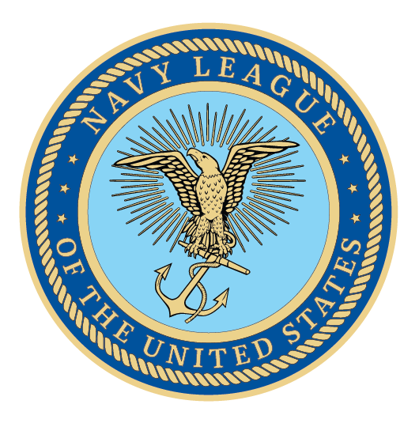
U.S. Coast Guard
Presenter Name
Date

Slide 2
U.S. Coast Guard
Semper Paratus: Always Ready

Slide 3
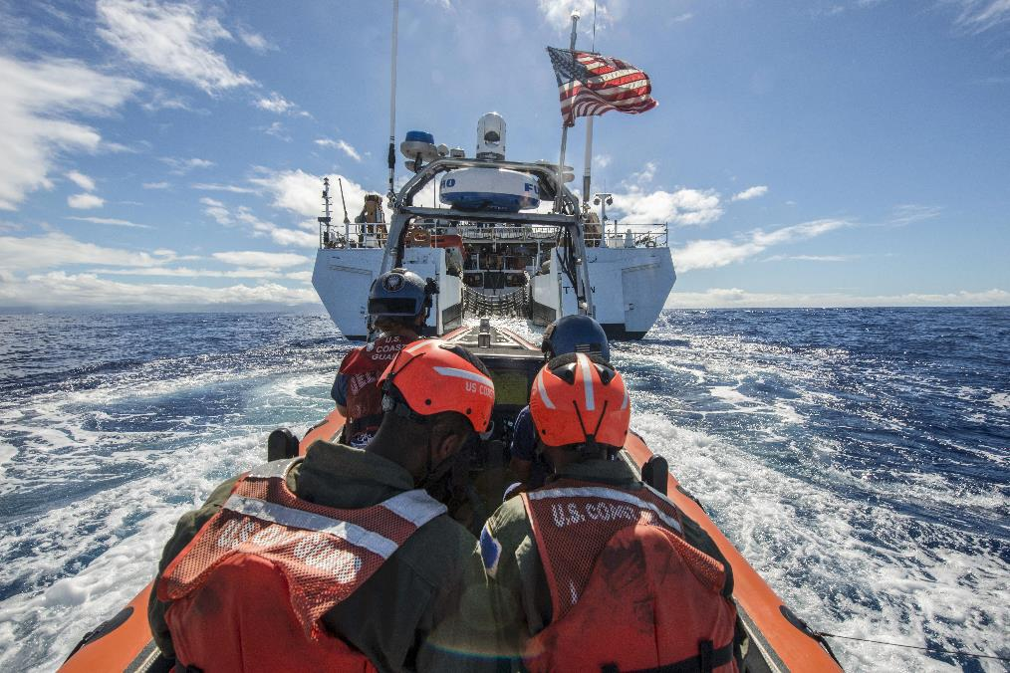
Agenda
About the Navy League
Overview of Coast Guard roles and missions
Current Priorities: FY2020 Funding, Recapitalization and Building Capacity
Closing Comments

Slide 4
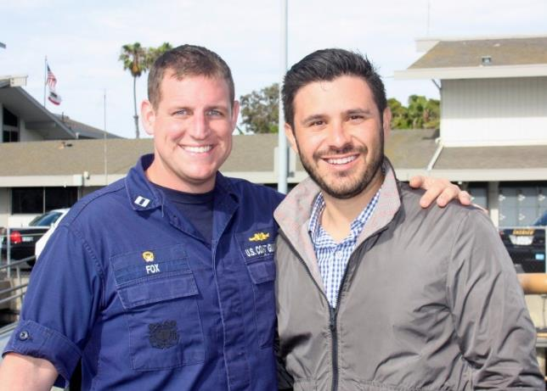
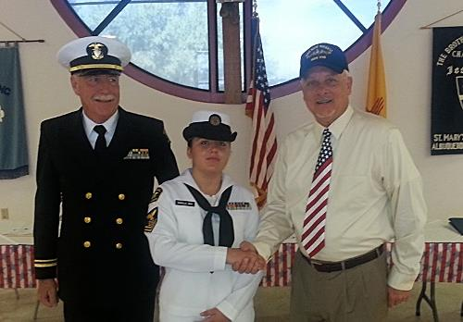
About the Navy League
Founded in 1902 with the support of President Teddy Roosevelt
Promotes the need for strong sea services
Civilian organization
  200 local councils
  37,000 members worldwide
Our goal: to educate the public and elected officials on the importance of a strong maritime component for our national security
Supports and advocates for members of the Navy, Marine Corps, Coast Guard, and U.S. Flag-Merchant Marine

Slide 5
Overview of the Coast Guard
11 Statutory Missions

Slide 6
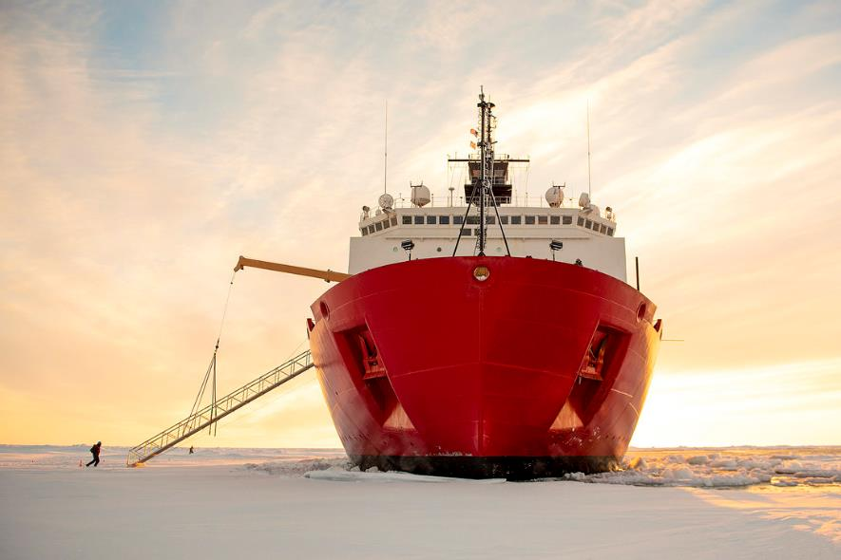
11 Statutory Missions
  Ports, waterways, and coastal security
  Drug interdiction
  Immigrant Interdiction
  Aids to navigation
  Search and rescue
  Marine environmental protection
  Marine safety
  Ice operations
  Living marine resources
  Defense readiness
  Law enforcement
The only organization that is a military service, federal law
enforcement agency, and our nation’s lead maritime first responder with the mandate to act. The Coast Guard is military, multi-mission,
and maritime.

Slide 7
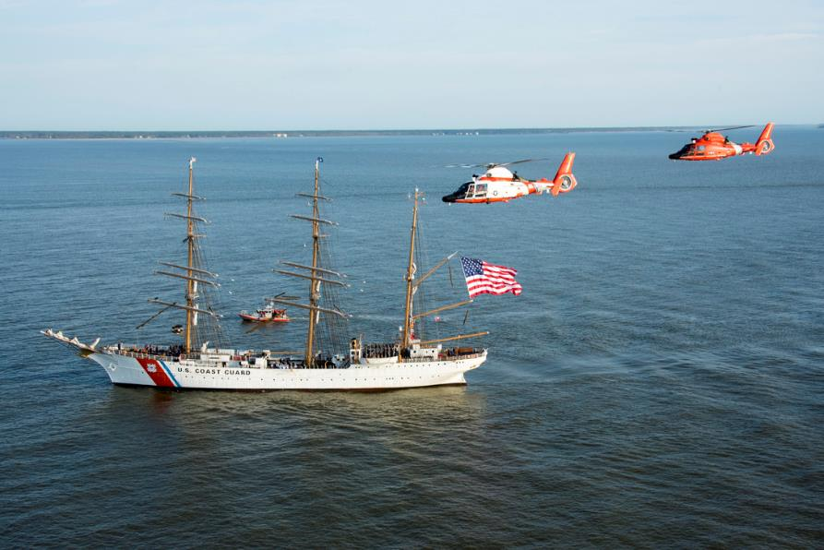
The U.S. Maritime Environment
95,000 miles of shoreline.
Waterborne trade carries over 1.3 billion metric tons of cargo each year. Another billion tons of cargo is carried in domestic waterborne movements.
$4.6 trillion of economic activity is generated by the Maritime Transportation System.
One of every six jobs is marine-related.
Maritime transportation is the lifeblood of our national economy and fuels the global economy.
The Coast Guard is imperative
to our economic security!

Slide 8
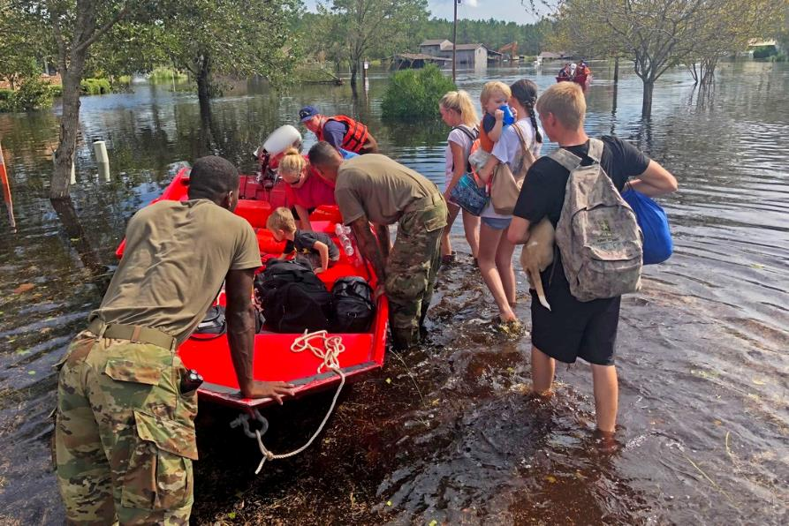
A Day for the
Coast Guard
Conducts 44 search and rescue cases;
Saves 12 lives;
Seizes 1,221 pounds of cocaine and 85 pounds of marijuana
Interdicts 7 undocumented migrants;
Screens 329 merchant vessels for potential security threats
prior to arrival in U.S. ports;
Conducts 15 fisheries conservation boardings;
Services 80 buoys and fixed aids to navigation;
Facilitates movement of $12.6B worth of goods and commodities through the Nation’s Maritime Transportation System;
Investigates 34 pollution incidents.

Slide 9
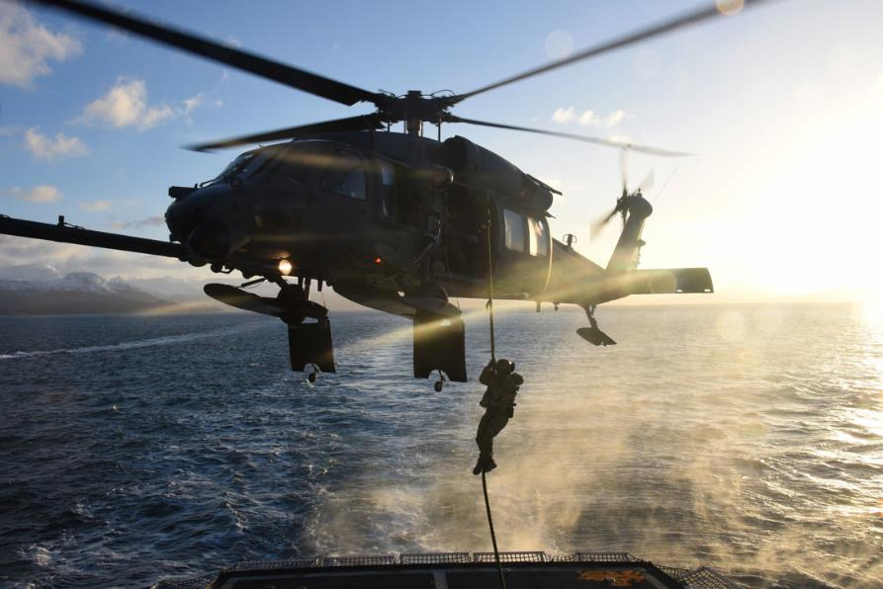
Evolving Threats to Homeland Security
The Coast Guard has several areas of strategic focus that drive USCG operations and capital investments:
Transnational organized crime networks
The imperative for border security
Increasing maritime commerce
Emerging cyber risk
Future challenges in the polar region.

Slide 10
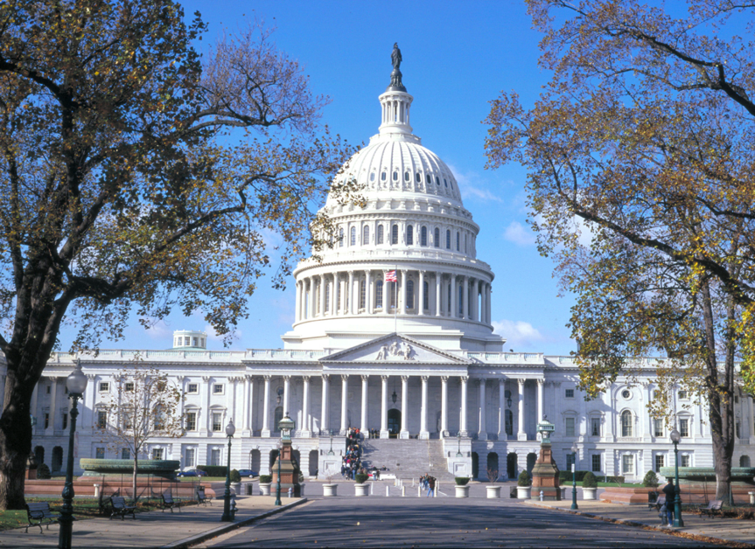
A National Imperative
History has demonstrated that a strong maritime capability is a key characteristic of great nations, and challenges to our maritime dominance are beginning to emerge.
We must continue to invest in the Coast Guard to ensure they have the cutters, aircraft, and new technology they need to succeed across many different mission sets.
The Navy League recommends:
Funding the Procurement, Construction, and Improvement (PC&I) budget at least $2B/year.

Slide 11
The Coast Guard Needs Your Help
Coast Guard recapitalization is on track, but operations budgets have remained flat even as new assets come online. This means cutbacks elsewhere:
Not enough funds for fuel
Not enough funds for training
Not enough funds for quality of life benefits
The Navy League recommends:
5% per year growth in Operations & Support funding.

Slide 12
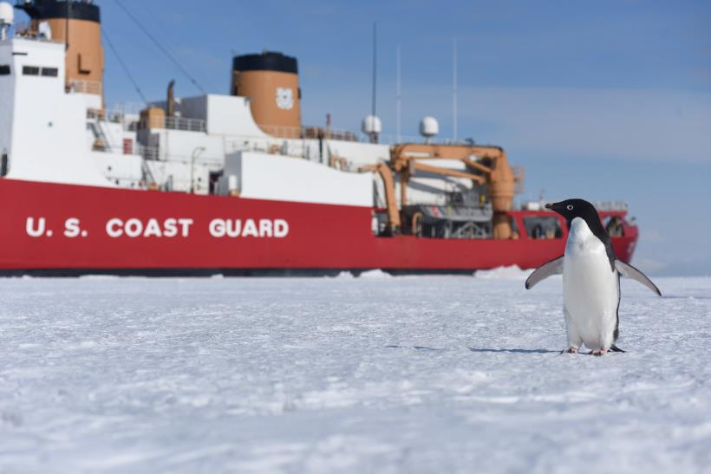
The Arctic Imperative
The Coast Guard is the lead federal agency for the Arctic: It must have enhanced capability to strengthen partnerships in a rules-based international order, and innovate to promote prosperity
Human activity in the Arctic is increasing, and the Coast Guard must be able to respond in a crisis.
Other Arctic nations have a strong presence in the region: The U.S. should too: Six different government agencies depend on Coast Guard having icebreaking capabilities.
The Coast Guard needs 3 heavy and 3 medium icebreakers, yet has just one medium and one operational heavy icebreaker.
The Coast Guard issued a contract for the first PSC hull in April after Congress funded the program.

Slide 13
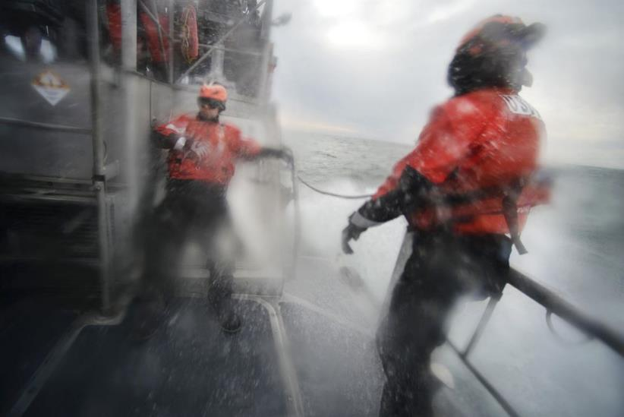
FY2020 Coast Guard Priorities
To meet the future demands of our maritime system, we must invest in our Coast Guard. The Navy League’s priorities for the Coast Guard are:
Fund the Procurement Budget at least $2B/year to fully fund the Offshore Patrol Cutter and other recapitalization efforts like the inland waterways fleet.
Increase Operations funds by 5% per year to improve readiness and retention.
Deliver at least six new Fast Response Cutters (FRCs) per year.
Construction contract for the Polar Security Cutter.
Aviation and C4ISR improvements, including polar aviation.
Recapitalize Shore Infrastructure: $1.7B of improvement backlog should be funded at least $300M/year.
Grow the workforce by adding 5,000 active duty and 1,100 reservists.

Slide 14

Closing Comments
The Coast Guard plays a critical role in protecting our nation’s waterways, ports, and citizens from emerging threats.
The Navy League recommends:
Funding PC&I at $2B/year
5% yearly growth in Operations & Support funding, including increasing end strength

Slide 15
Thank You!
Presenter Name
Contact Info | Contact Info
Contact Info | Contact Info

