Slide 1
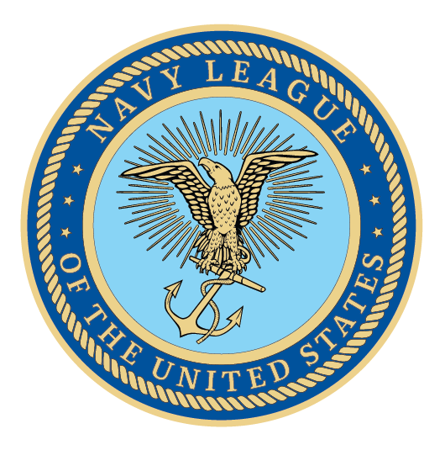
Merchant Marine
Presenter Name
Date

Slide 2
U.S.-Flag Merchant Marine
A Critical Economic and National Security Asset

Slide 3
Agenda
About the Navy League
Introduce the Marine Transportation System
Outline U.S.-flag Merchant Marine Programs
Legislative Priorities
Conclusion

Slide 4
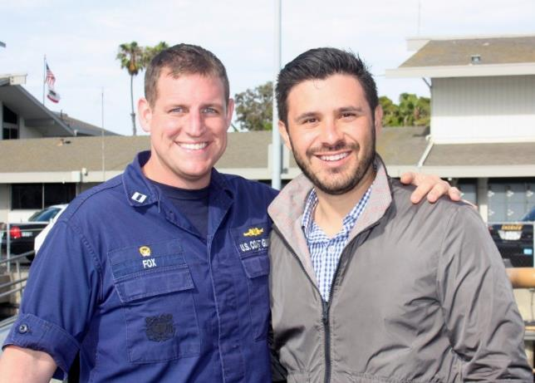
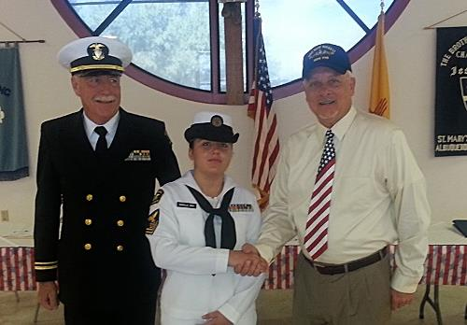
About the
Navy League
Founded in 1902 with the support of President Teddy Roosevelt
Promotes the need for strong sea services
Civilian organization
200 Local Councils
37,000 members worldwide
Our goal: to educate the public and elected officials on the importance of a strong maritime component for our National Security
Supports and advocates for members of the Navy, Marine Corps, Coast Guard, and U.S.-flag Merchant Marine

Slide 5
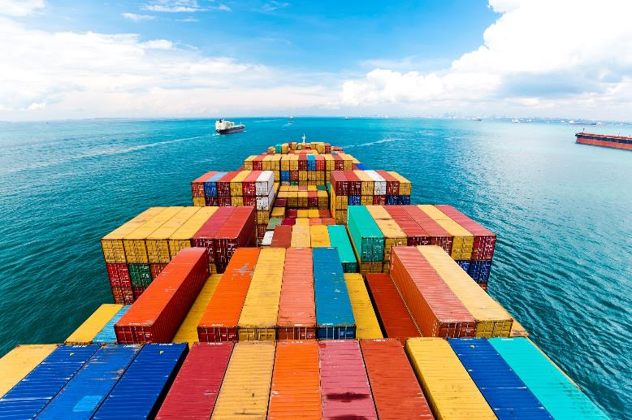
The U.S. Marine Transportation System
The U.S. Marine Transportation System (MTS) consists of waterways, ports and their intermodal connections.
As a world trade leader, the United States requires a technologically advanced, secure, efficient and environmentally sound Marine Transportation System by investing in mariners, ports, waterways infrastructure, and shipbuilding.

Slide 6
The U.S. Marine Transportation System
The U.S. Marine Transportation System (MTS):
sustains approximately 13.3 million jobs
contributes more than $649 Billion per year to the U.S. GDP
employs over 66,000 water transportation workers and 36,000 mariners providing more than $4B in wages
supports deployment of 95% of military equipment/supplies
International Trade:
accounts for 30% of U.S. economy
over 99% of overseas cargo tonnage moves by sea

Slide 7
The U.S. Marine Transportation System
Freight flowing through MTS is expected to double by the 2040s.
MTS port improvements to support new Panama Canal and larger sized ships will be critical to our nation’s prosperity and security.
Aging Inland Waterways requires maintenance & refurbishment.
FY2019 appropriations allocated 91% of HMT revenue but the FY2020 budget request only gives 55%.

Slide 8
U.S. Merchant Marine Programs

Slide 9
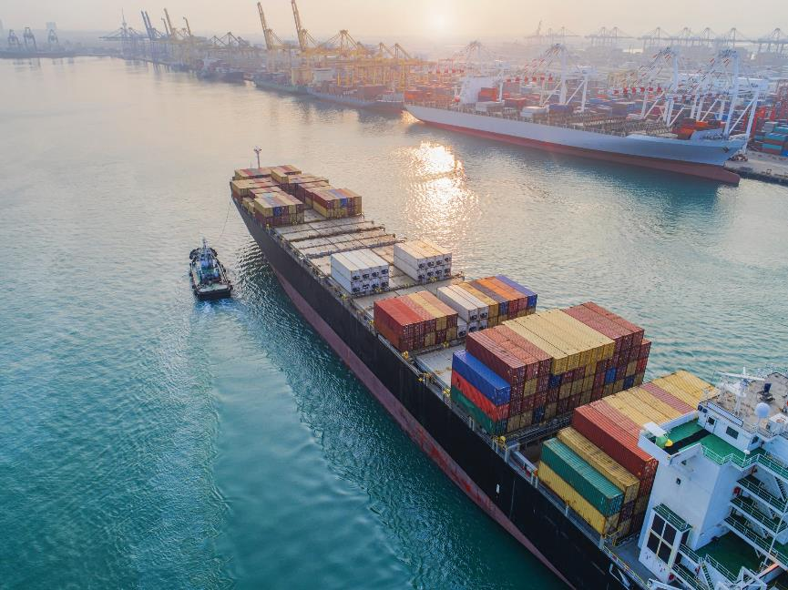
U.S. Merchant Marine Programs
        The U.S. has five pillars to support our maritime requirements:
        Maritime Security Program
        Jones Act — under attack!
        Cargo Preference Laws — being cut back!
        Title XI Shipbuilding Program — unfunded!
        State School Training Vessels — underfunded!

Slide 10
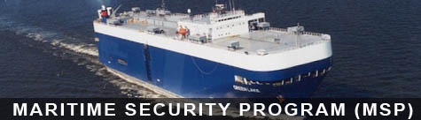
Maritime Security Program
        The MSP guarantees that the Department of Defense (DoD) will have needed sealift capacity using commercial vessels manned by U.S.-trained citizen merchant mariners.
        DoD reports that MSP is the most economical solution to provide sealift resources in time of National Emergency.
        $300 million currently authorized for 60 vessels operated by 13 companies, the budget request finally requested the full amount for FY2020.
        Need future years authorization of $300M after FY2025.

Slide 11
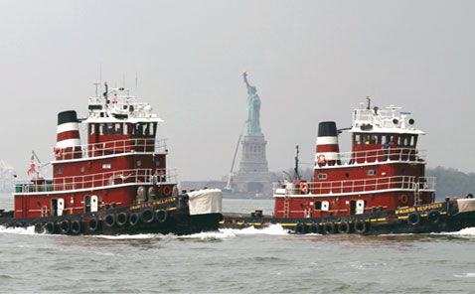
The Jones Act
        The Jones Act mandates that cargo moving between U.S. ports must be carried on vessels that are U.S.- flagged, built, crewed and owned by U.S. citizens.
        The Jones Act:
        generates approximately $154 billion in total annual economic output.
        supports approximately 650,000 American jobs and $41 billion in wages.
        provides 55% of U.S.-flag and 100% of U.S. built oceangoing commercial cargo vessels.

Slide 12
The Jones Act:
Under Attack
        Many have recently called for the Jones Act to be repealed, unfairly blaming it for delayed help for Puerto Rico and other issues.
        Legislative attacks, both national and state, could negatively impact the Jones Act.
        The Commandant of the Coast Guard testified before Congress that the Jones Act is critical to homeland security.
Stop this attack on the domestic U.S.-flagged Merchant Marine: It provides the majority
of our active oceangoing cargo ships for
national security.

Slide 13
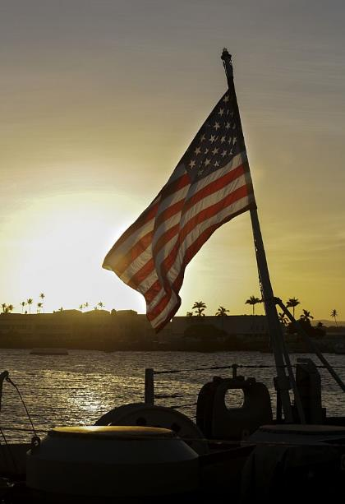
Cargo Preference Laws
        To ensure sealift capacity and guarantee a skilled cadre of U.S. seafarers operating ships in foreign trade, Congress enacted laws to require certain percentages of government cargo to be carried on U.S.-flagged, owned and crewed vessels.
        Cargo preference covers government-impelled cargo movement on international waters, composed of agricultural, civilian agencies and military cargoes.
        Cargo preference is commonplace among the world’s seafaring nations.

Slide 14
Cargo Preference Laws: Need Your Support
        Government-impelled cargoes have declined 35% since 2014:
        Reduced military operations in Iraq & Afghanistan
        Legislation reduced cargo preference requirements for food aid (75% to 50%)
        U.S. sourced Food Aid via U.S.-flag ships reduced by 25% and the FY2020 budget request recommends total elimination.
        Existing preference regulations are unenforced.
        U.S. Ex-Im Bank Limited to $10M Loan Guarantees
        The Navy League supports compensating these reductions with new commercial cargo preference programs like the Energizing American Maritime Act.
The number of U.S. vessels in international trade has
declined by almost 25%: from 106 to 81, over the last
five years (60 supported by MSP). We must Restore
Food for Peace or lose more!

Slide 15
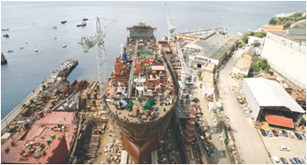
Title XI Federal Ship Financing Program
        Title XI promotes U.S. shipyard growth and modernization through long term debt repayment guarantees.
        Encourages U.S. ship owners to obtain new vessels from U.S. shipyards cost effectively and shipbuilders to modernize.
        This program depends on Congress to survive.

Slide 16
Title XI Federal Ship Financing Program: Unfunded
        Provides a strong return for the government, as each appropriated Title XI dollar can leverage up to $12 of private investment.
        Helps retain jobs for thousands of shipyard welders, electricians, and fitters necessary to maintain a healthy Naval shipbuilding industrial base.
        Several Title XI applications need funding.
        Requires annual appropriations $25-$35M/year to be effective — but Congress appropriated just $3M in 2019. The FY2020 budget requests $0.
We must Restore Title XI.

Slide 17
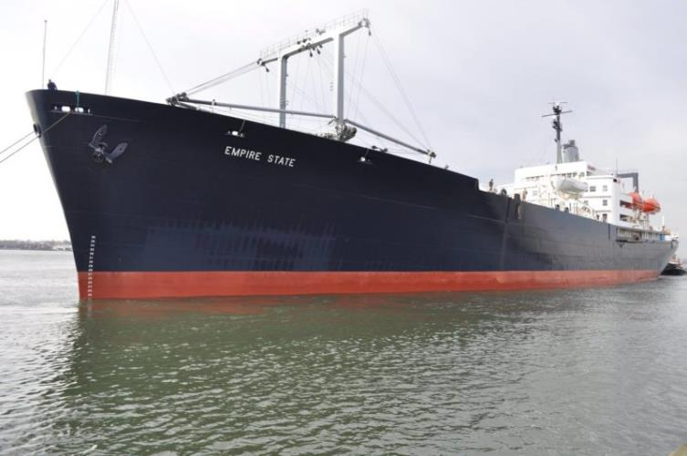
Training Ships for Maritime Academies
        Six State Maritime Academy Training Vessels reaching end of service-life
        TS Empire State (NY Maritime College) is 57 years old, 10 years beyond service life.
        First two NSMVs funded in FY18 and FY19, need one a year funded through FY23 for economic construction costs.
        The FY2020 budget requests funding for smaller vessel although full sized NSMV required.
We must fully fund a 3rd NSMV.

Slide 18
FY2020 Priorities
Fund the Maritime Security Program at the $300M level authorized by Congress.
Protect the Jones Act from Legislative Changes.
Fund maritime academy training & ops., including $300M for one NSMV training ship.
Ensure the Administration enforces Cargo Preference Laws via strong rulemaking and reject changes for Food Aid Cargo.
Enact Commercial Cargo Preference for a percentage of U.S. gas and oil exports.
Provide funding for the Title XI Ship Financing Program of at least $25-35M/year.
Support the Department of Transportation’s Marine Highway initiatives that would transport more freight cargo in national waterways and exempts waterborne cargo, shipped between U.S. ports from the Harbor Maintenance Tax.

Slide 19
Other Issues Affecting the U.S.-Flag Fleet
Supply full funding of the WRRDA specified authorizations from the Harbor Maintenance Trust Fund to maintain America’s harbors, inland locks, dams, and waterways. Oppose Lock/Dam User Fee.
Fully fund the maintenance of Maritime Administration’s Ready Reserve Force of 46 vessels high readiness status.
Review the Navy’s 30 Year Shipbuilding Plan “Auxiliary Vessel Plan” for its cost and shipping/shipbuilding industrial base impacts.
The Navy League urges Congress to support these maritime programs to ensure the U.S. maritime sector can remain competitive in the global economy.

Slide 20
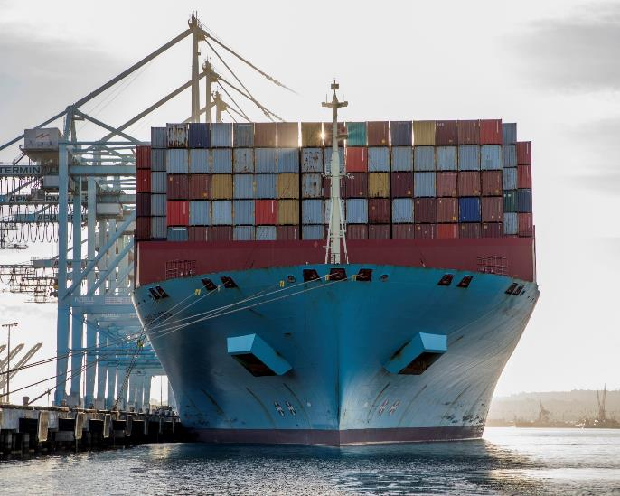
The Merchant Marine Fleet Needs Congress
        The Merchant Marine fleet is facing a perfect storm of factors that are shrinking the fleet.
        Future ship and Mariner shortages will have significant impacts on our strategic sealift capability.
        “Without a healthy U.S. merchant fleet, we lack the capability to deliver our military forces to war.”
        − Lt. Gen. Stephen Lyons,
        Deputy Commander,
        U.S. Transportation Command

Slide 21
Thank You!
Presenter Name
Contact Info | Contact Info
Contact Info | Contact Info

