Slide 1
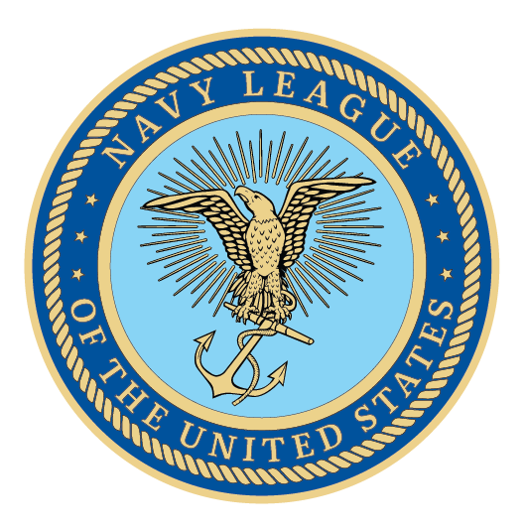
U.S. Navy
Presenter Name
Date

Slide 2
U.S. Navy
America’s Strength

Slide 3
Agenda
        Background on the Navy League of the United States
        The Navy the Nation Needs
        Navy League Recommendations
        Closing

Slide 4
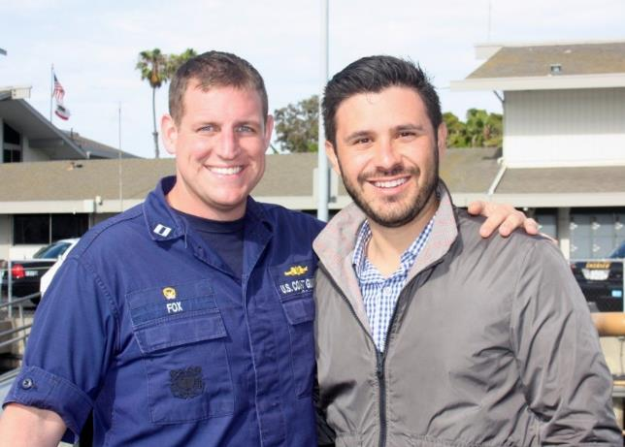
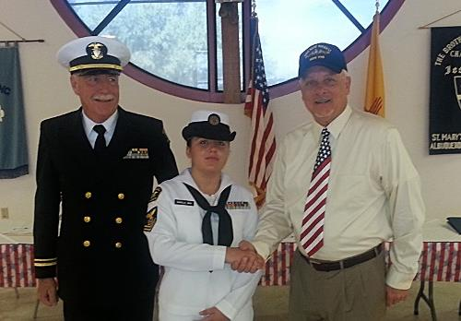
About the Navy League
Founded in 1902 with the support of President Teddy Roosevelt
Promotes the need for strength in sea power
Civilian organization
200 Local Councils
37,000 members worldwide
Our goal: to educate the public and elected officials on the importance of our sea services for peace and prosperity.
Supports and advocates for members of the Navy, Marine Corps, Coast Guard, and U.S.-flag Merchant Marine

Slide 5
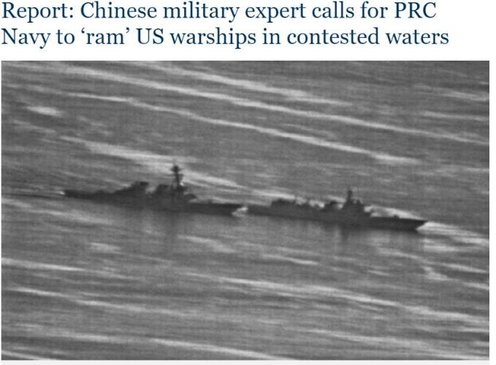
Threats We Face
The U.S. views our major threats as:
China
Russia
North Korea
Iran
Terrorism
Both China and Russia are rising global powers making significant investments in their own military to counteract our conventional advantage. North Korea and Iran are rogue states that mistreat their citizens and that could act out in unpredictable ways. Iran could block maritime chokepoints, bringing global trade to a halt.

Slide 6
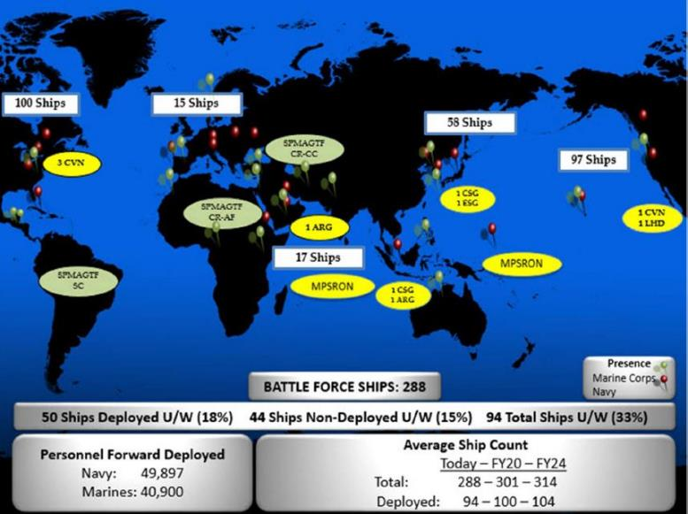
The Navy the Nation Needs
Navy is busy protecting our freedom throughout the world and is doing so with the smallest number of ships since before WWI.
The most recent Force Structure Assessment, released December 2016, recommends a fleet of 355 ships, as does our Maritime Policy report.
The Navy plans to increase the number of its deployed ships by more than 20 percent over the next five years, providing the U.S more firepower and assets in the Middle East and Asia to meet security demands.

Slide 7
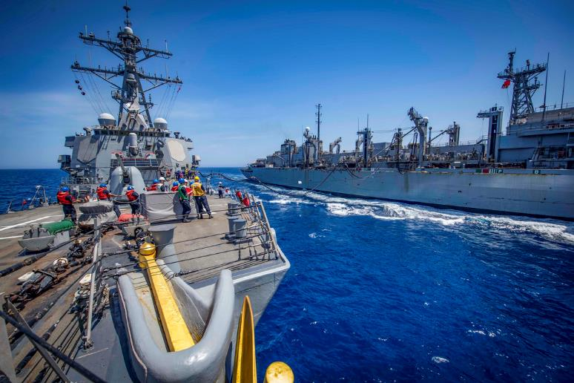
The Value of a 355-Ship Navy
Even though the fleet is smaller than it has been, we have the same number of ships deployed, leading to readiness issues, fatigue and backlogs for repair work at shipyards.
High deterrent value; our Navy is present worldwide.
Our fleet is imperative to ensure capabilities for:
Conflict Deterrence
Forward Presence
Maritime Security
Protection of international sea lanes
Humanitarian assistance/ disaster response
While our fleet size declines, our global trade increases:
90% of worldwide trade is transported by sea.
Thank you to Congress for codifying this requirement in law.

Slide 8
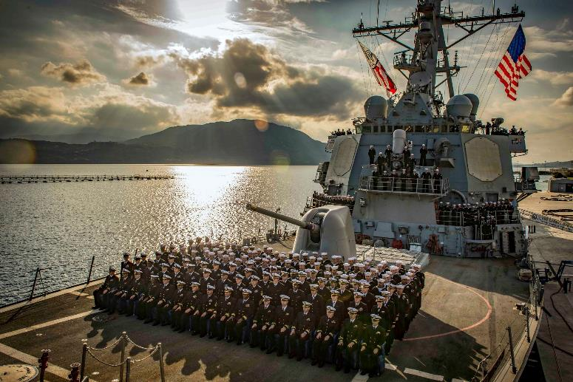
30-Year
Shipbuilding Plan
Unless Congress increases shipbuilding funds, the Navy will not be able to reach the right mix of ships in 2034.
For FY20, the right level is $26.7B and at least 13 new ships, but the current budget request falls short, which means FY21 will need to be funded at an even higher level.

Slide 9
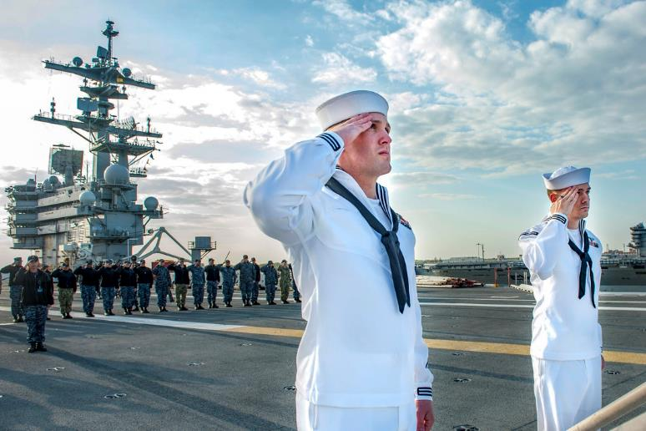
Invest in the Future of the Navy
With technology changing at exponential rates, the Navy must look towards the future and consider the right investments for an increasingly digital and connected world. We urge the Navy to consider:
How to confront adversaries in this new environment.
How to recruit, train, and retain the next generation.
How can investments in new weapons technology provide cost savings over the long term.

Slide 10
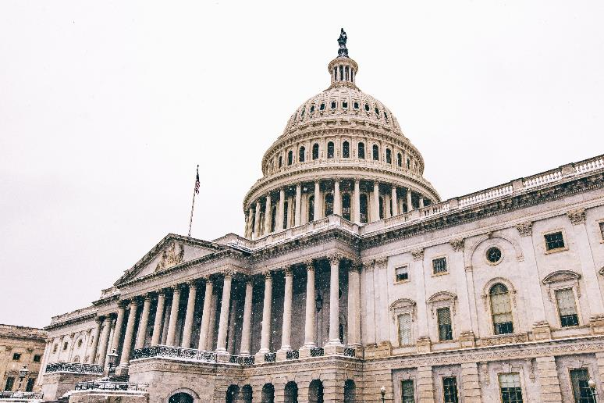
The Top Priority: Steady and Stable Budget Funding
We thank Congress for eliminating threat of sequestration.
No more continuing resolutions.
Return to a regular appropriations process.

Slide 11
Overall Priorities

Slide 12
Overall Priorities
        Columbia-Class Submarine Program
        The Ohio-class replacement will provide the most survivable leg of our nuclear triad, carrying over 70% of our deployed warheads.
        We must fund the Columbia-class submarine, crucial to deterrence while growing the fleet and cannot afford any delays to this program.

Slide 13
Overall Priorities
        Protect Readiness
        Lack of spare parts, delayed maintenance on aircraft and surface ships.
        Despite improving budgets continued stable funding is required to fly adequate training flight hours, eroding carefully-honed skills.
        Shipyards have a significant backlog of ship and submarine maintenance due to sequestration cuts and continuing resolutions (CRs).
        Surface ship training required to develop and maintain ship handling skills.

Slide 14
Overall Priorities
        Research and Development
        The Navy must continue to invest increasing funds in technology and force structure innovation to prepare for the future fight.

Slide 15

The Navy League Recommends
        Steady and stable budgets.
        Funding SCN budget at $26.7B to reach a fleet of 355 with the right mix of ships in the 2030s.
        Ensuring the Columbia-class submarine is well-funded and on schedule.
        Investing in readiness.

Slide 16

In Conclusion
        Our national fleet size is smaller today than needed during a time of global instability.
        Building and maintaining a fleet of 355 ships requires the support of Congress.
        Congress must pass regular budgets in a timely fashion.
        In the words of Navy League’s founder, President Teddy Roosevelt, “ A good navy is not a provocation to war. It is the surest guarantee of peace.”

Slide 17
Thank You!
Presenter Name
Contact Info | Contact Info
Contact Info | Contact Info

