Slide 1
Training & Mentoring Committee
STEM Webinar
17 Oct 2019
Tom Pruter
NVP STEM and Youth Programs
1

Slide 2
Agenda:
STEM Global Explanation
Sea Perch, Robotics, Quadcopters, CyberPatriot programs
NL STEM Institute and Grant Program
Resources

Slide 3
STEM stands for science, technology, engineering, and mathematics. STEM is important because it is part of our lives. Science is everywhere in the world around us. Technology is continuously expanding into every aspect of our lives. Engineering is the basic designs of roads, bridges and buildings, and also tackles the challenges of changing global weather and environmentally-friendly changes to our home. Mathematics is in every occupation, every activity we do in our lives. By exposing students to STEM and giving them opportunities to explore STEM-related concepts, they will develop a passion for it and hopefully pursue a job in a STEM field. A curriculum that is STEM-based has real-life situations to help the student learn.

Slide 4
Why STEM?
“In the 21st century, scientific and technological innovations have become increasingly important as we face the benefits and challenges of both globalization and a knowledge-based economy. To succeed in this new information-based and highly technological society, students need to develop their capabilities in STEM to levels much beyond what was considered acceptable in the past.” (National Science Foundation)

Slide 5
NL STEM Program Mission
Putting science, technology, engineering and mathematics into the minds of America’s youth focusing on middle and high school youth (grades 6 – 12) and instilling interest in developing basic skill sets for career opportunities.
There are many opportunities for Councils to participate and support ….STEM programs in your community, in schools, scouts, Sea Cadets

Slide 6
Sea Perch
SeaPerch is an innovative underwater robotics program that equips teachers and students with the resources they need to build an underwater Remotely Operated Vehicle (ROV) in an in-school or out-of-school setting.
The SeaPerch Program provides students with the opportunity to learn about robotics, engineering, science, and mathematics (STEM)
Throughout the project, students will learn engineering concepts, problem solving, teamwork, and technical applications.
Sea Perch Challenge Competition is held annually at college/university locations throughout the US
Notes:
SeaPerch is an innovative underwater robotics program that equips teachers and students with the resources they need to build an underwater Remotely Operated Vehicle (ROV) in an in-school or out-of-school setting. Students build the ROV from a kit comprised of low-cost, easily accessible parts, following a curriculum that teaches basic engineering and science concepts with a marine engineering theme. The SeaPerch Program provides students with the opportunity to learn about robotics, engineering, science, and mathematics (STEM) while building an underwater ROV as part of a science and engineering technology curriculum. Throughout the project, students will learn engineering concepts, problem solving, teamwork, and technical applications.

Slide 7
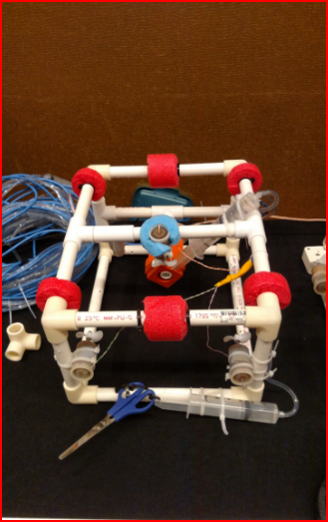
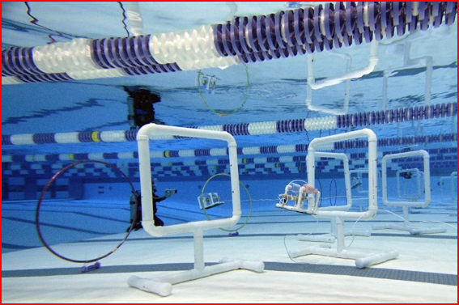

Slide 8
Sea Perch 2019 Challenge
Middle & High School Stock and Open Classes
In Mission Rescue & Recovery, SeaPerch teams were tasked to assist with navigating a narrow underwater cavern to transport important supplies and rescue an ROV that fell apart during an earlier attempt at the course.
SeaPerch Engineering Process: Documenting and clearly communicating the engineering process utilized in an engineering project is very important. This information provides insight into the iterative design process and data collected for analysis purposes that supports the final design.
For the 2020 International SeaPerch Challenge, teams will be required to submit a short Technical Design Report. This report should provide an overview of each team's unique design, approach, and reflection on the design process.

Slide 9
Sea Perch 2019 Challenge Results
In excess of 200 teams registered:
Overall rankings:
Stock Class:
Middle school: 5 Sea Cadet Units
High school: 9 Sea Cadet & 3 NJROTC
Engineering Design:
Sea Cadets: 7 Units & 5 NJROTC
Rescue & Recovery Course:
Middle school: 5 Sea Cadet Units
High school: 9 Sea Cadet & 4 NJROTC

Slide 10
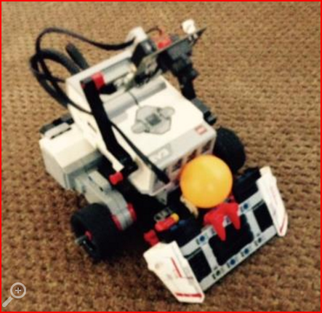
Robotics
LEGO MINDSTORMS EV3: build, program and command your own LEGO robots
mixing LEGO elements, motors, sensors and the intelligent P-Brick with apps and programming software to bring LEGO creations to life, the MINDSTORMS robot kit inspires LEGO inventors of all ages to command their own buildable LEGO creatures, humanoid, snake and other intelligent LEGO inventions.
In FIRST ® LEGO® League, children are immersed in
real-world science and technology challenges.
Teams design their own solution to a current
STEM question or problem and build autonomous
robots that perform a
series of missions based on an annual Challenge
theme.

Slide 11
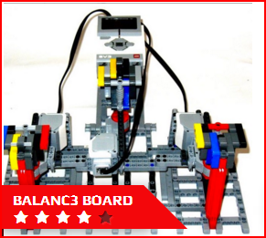
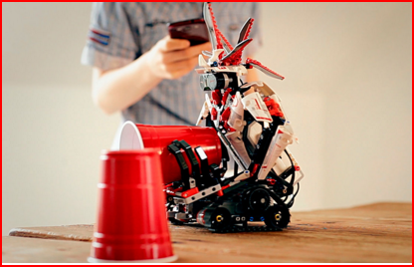
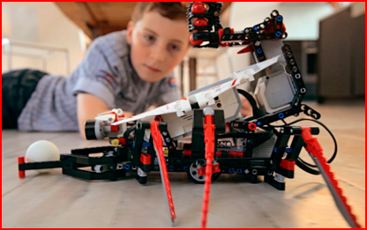
LEGO Mindstorms EV3.
Notes:
Discover the ultimate LEGO® challenge: Powerful LEGO MINDSTORMS® EV3! LEGO® MINDSTORMS® EV3 gives you the power to create and command your own robotic LEGO creatures, vehicles, machines and inventions! By combining LEGO® elements with a programmable brick, motors and sensors, you can make your creations walk, talk, grab, think, shoot and do almost anything you can imagine! Each robot comes complete with its own unique features and a program that controls the robot’s behavior.

Slide 12
Quadcopter kits
Students should learn fundamental electrical, mechanical and aerospace engineering and then apply this knowledge to construct a quadcopter from basic kit components.
Examples in the $100-$160 range:
LHI 250mm Pro Pure Carbon Fiber Quadcopter Frame Kit + CC3D Flight Controller MT2204 2300KV Motor
Hobbypower Unassembled DIY 250 Mini 250mm Quadcopter Frame Kit T2204 2300KV Motor
450mm GPS Quadcopter Kit with Naza-M Lite FC M7N GPS 2212 Motors 30a ESC Props

Slide 13
CyberPatriot
CyberPatriot is the National Youth Cyber Education Program created to inspire
K-12 students toward careers in cybersecurity or other science, technology, engineering, and mathematics (STEM) disciplines critical to our nation's future. The CyberPatriot Programs are:
At the center of CyberPatriot is the National Youth Cyber Defense Competition. The competition puts teams of high school and middle school students in the position of newly hired IT professionals tasked with managing the network of a small company. In the rounds of competition, teams are given a set of virtual images that represent operating systems and are tasked with finding cybersecurity vulnerabilities within the images and hardening the system while maintaining critical services in a six hour period.
CyberCamps
Elementary School Cyber Education Initiative
Notes:
CyberPatriot is the National Youth Cyber Education Program. At the center of CyberPatriot is the National Youth Cyber Defense Competition. The competition puts teams of high school and middle school students in the position of newly hired IT professionals tasked with managing the network of a small company. In the rounds of competition, teams are given a set of virtual images that represent operating systems and are tasked with finding cybersecurity vulnerabilities within the images and hardening the system while maintaining critical services in a six hour period. Teams compete for the top placement within their state and region, and the top teams in the nation earn all-expenses paid trips to Baltimore, MD for the National Finals Competition where they can earn national recognition and scholarship money.​

Slide 14
Navy League Grant Program
The Navy League STEM Institute has proud to have provided grant funding of Navy League Council STEM initiatives.
To date, the Navy League STEM Institute has awarded in excess of $20,000 to NL Councils to support various STEM projects.
Visit https://www.navyleague.org/file/programs/stem- initiative/NLSTEMI-grant.pdf for NL STEM Grant information.

Slide 15
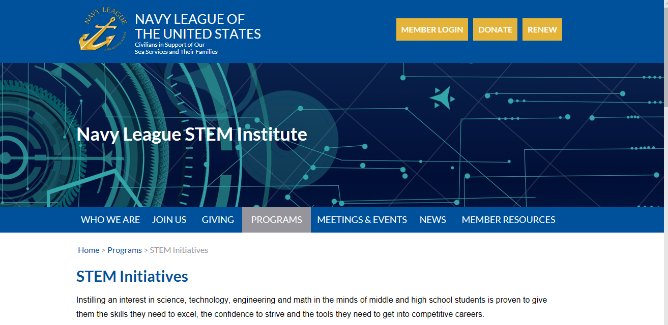

Slide 16
Resources:
NL STEM Institute: http://www.navyleague.org/stem/index.html
includes STEM Grant application information
STEM Platforms:
Cyber Education: https://www.uscyberpatriot.org/
Sea Perch: http://www.seaperch.org/index
Robotics: https://www.lego.com/en-us/mindstorms/about-ev3

