Slide 1
Sea Service Adoption
Presented by
Bobby Ferguson
19 September 2019

Slide 2
Thank you for joining us! Please mute your phones and the audio on your laptops/computers. We will start the webinar in a few minutes. Feel free to use the chat function of the webinar to ask questions along the way, and they’ll be addressed at the end of the presentation.

Slide 3
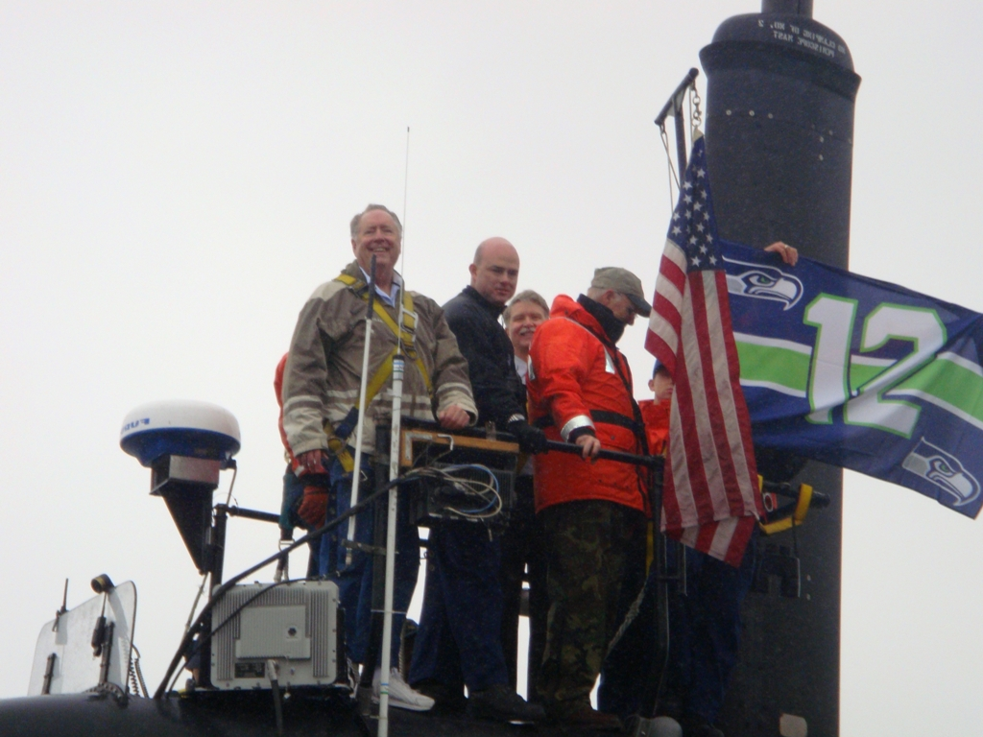
Background
Sea Service Adoption
Adoption of Sea Service units is a long-standing tradition of NLUS Councils
Adoptions are primary element of our mission to support the Sea Service
“Win-Win” arrangement for the Sea Service Unit and the adopting Council
Association between Council and Sea Service Unit is typically geographical or some namesake relationship
Multiple or co-adoptions are allowed
Sea Service Unit Adoption Guide (NLUS Website, Member Resources, Council Support Materials)
Layout EXAMPLE ONLY

Slide 4
Background (continued)
Targeted Units:
- U.S. Navy Ships, Shore Commands, and Aviation Units
- Coast Guard Ships, Shore Commands, and Aviation Units
- Marine Corps Units
- Naval Reserve Officer Training Corps (NROTC) Units
- NJROTC and National Defense Cadet Corps (NDCC) Units
- MCJROTC Units
- Maritime Academies that offer USN reserve commissions
- Naval Sea Cadet Corps Units
- Navy League Cadet Corps Units
- Young Marine Units

Slide 5
Background (continued)
Priority for selecting units to adopt:
- Deployable/afloat units
- Sea Cadet Units
- Shore Commands
- National Defense Cadet Corps (NDCC) Units
- ROTC and JROTC Units
- Young Marines
- Foreign Sea Service Units
- Other Units (USNS, NOAA, and historical ships)

Slide 6
Where are we today (Sep 2019)?
Note::
81 Units adopted by more than one Council (7 by 3; 1 by 4; 73 by 2)

Slide 7
What Units are Available?
NLUS website (navyleague.org): LOG-IN FIRST, then click on dropdown menu “Programs”; click on “Adopted Ships and Units”; scroll down past the big yellow box.
Below “All Adopted Units” are lists of unadopted units by category (Navy Ships, Coast Guard Vessels, NROTC Units, Sea Cadet Units, etc) and by State

Slide 8
Process Overview
Council identifies appropriate adoption candidate
Council considers size of unit and Council resources
Council seeks concurrence from Area and Region President
Council appoints an Adoption Unit Liasion (AUL)

Slide 9
Procedure
AUL approaches CO or OIC of adoption candidate
AUL Presents an adoption proposal in writing as permanent record
For youth groups, refer to NLUS Guide to Youth Programs (Website, Member Resources, Training) and NLUS Operations Manual
If CO agrees to adoption, plan for an adoption ceremony, public or private, preferably at or on the unit; issue invitations
Prepare a plaque and a certificate of adoption (can be created from sample in Appendix C of Adoption Guide or purchased from Navy League approved vendor, Vanguard)
Notify NLUS HQ, Field Services, of adoption and termination

Slide 10
Working with Adopted Unit
No perfect model adoption – each one is different
Provide list of Council Officers to CO annually
Activities should be mutually beneficial
Press releases on Council/Unit activities, and updates on Unit news (deployment, individual accomplishments, etc)
Limited only by imagination, Council resources, and legal constraints
Events can be sponsored by local businesses, especially Community Affiliates
Consult with Unit’s Ombudsman

Slide 11
Suggested Services to Unit
Recurring awards and recognition of unit’s outstanding members
Namesake visits (Service approval for travel may be necessary)
Invitations to tour local/namesake businesses or civic institutions (as VIPs)
Invitations to attend public/community events, sporting, or entertainment events
Financial support to Unit ad hoc needs, Recreation Committee or Spouse’s Club
Educational scholarships to children of unit members
Hosting unit members for major holiday meals when unable to return home
Donate (or Loan) iconic namesake items
Deployment packages, goodie bags, halfway boxes
Spouse recognition
Emergency support to families during deployments (requires Legal Office approval)

Slide 12
Possible reciprocation activities by Unit
Unit tours, underway cruises, or guest lunches
Invitations to unit social events (holiday parties, picnics, balls, etc)
Direct access to emblematics sold by Recreation Committee
Invitations to formal ceremonies (Change of Command, Awards Ceremonies)
Speak at Council meetings and functions

Slide 13
Validation process
To ensure accuracy in the adoption database, email is sent to Council Presidents annually to verify that an adoption is still active
Only 80% of adoptions have been validated
70 Councils' adoptions have not been validated
20 Councils have invalid email addresses
Having an accurate database is essential for future management of adoptions
Need to stress:
Accurate email addresses for Councils
Validation responses from all Councils

Slide 14
Sea Service Adoption Excellence Award
Initiated in 2018
Recognizes Councils with strongest commitment to direct support of Sea Services units through a robust adoption program
Awards given in 3 categories – Large, Medium, and Small Councils
Will be five categories in 2019 (Extra Large, Large, Medium, Small, & Very Small)
Requires a completed questionnaire after initial screening
Judged by a panel selected from Ship Commissioning/Adoption Committee, Region Presidents, and Area Presidents (geographically dispersed)
Engraved Plaque presented each year during Council Awards Luncheon at NLUS National Convention

Slide 15
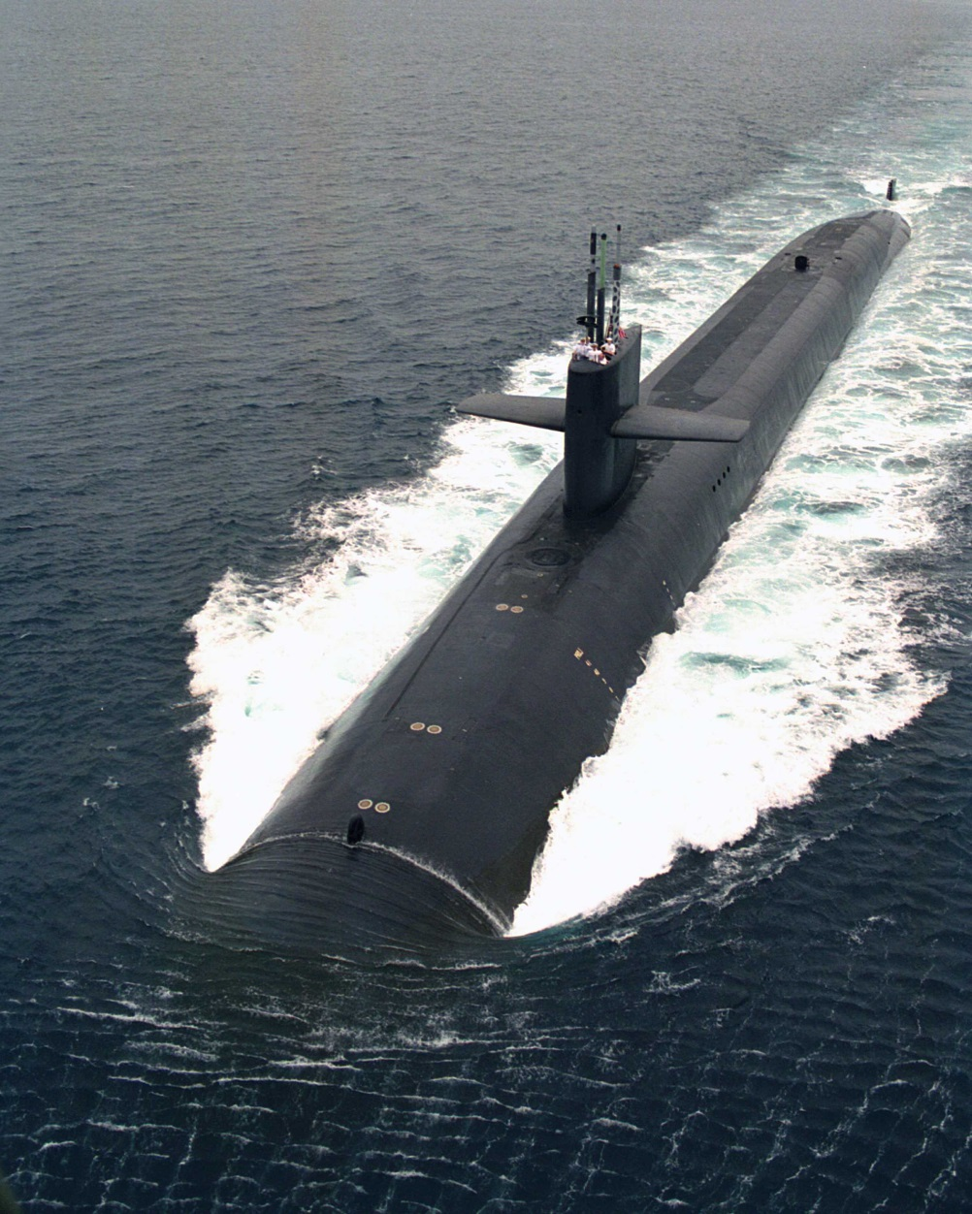
2018 Winners
Sea Service Adoption
Large Council
Honolulu
Medium Council
Denver
Memphis
Pittsburgh
Small Council
New Mexico
Broward County
Marin County
Greater Chattanooga
North Dakota

Slide 16
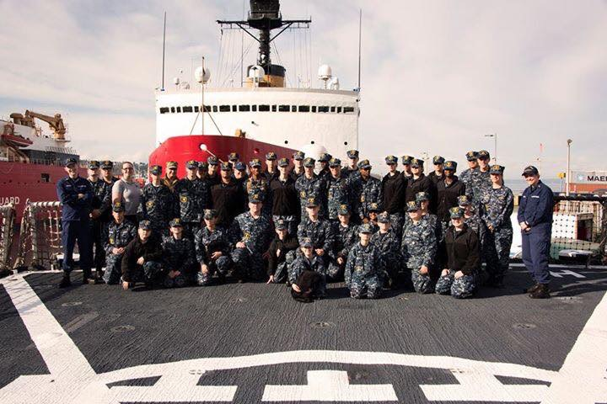
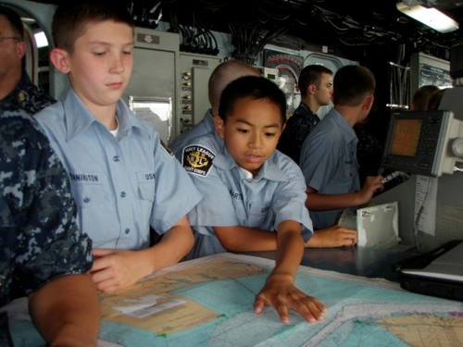
Questions?
Sea Service Adoption
Layout EXAMPLE ONLY
Refer to: Kevin Torcolini; ktorcolini@wavecable.com

