Slide 1
Ship Commissioning Guide
Presented by
Bobby Ferguson
21 June 2019

Slide 2
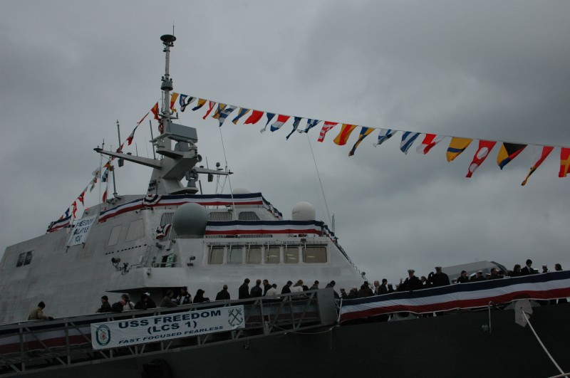
Background
Ship Commissioning Guide
Existing commissioning guide outdated and limited
National President established a new committee to redesign and rewrite guide
Ship Commissioning Committee formed in February 2017
Later, Adoptions was added; renamed Ship Commissioning and Adoption Committee
Layout EXAMPLE ONLY

Slide 3
Background (cont’d)
Ship Commissioning Guide
Purpose (Commissionings)
Update guide for current Navy/Coast Guard requirements
Add new resources to help commissioning committees get started
Define roles of Navy and Coast Guard, NAVSEA, McKean Defense, Commissioning Committee
Avoid as much as possible reinventing the wheel
Share lessons learned from recent commissionings
Layout EXAMPLE ONLY

Slide 4
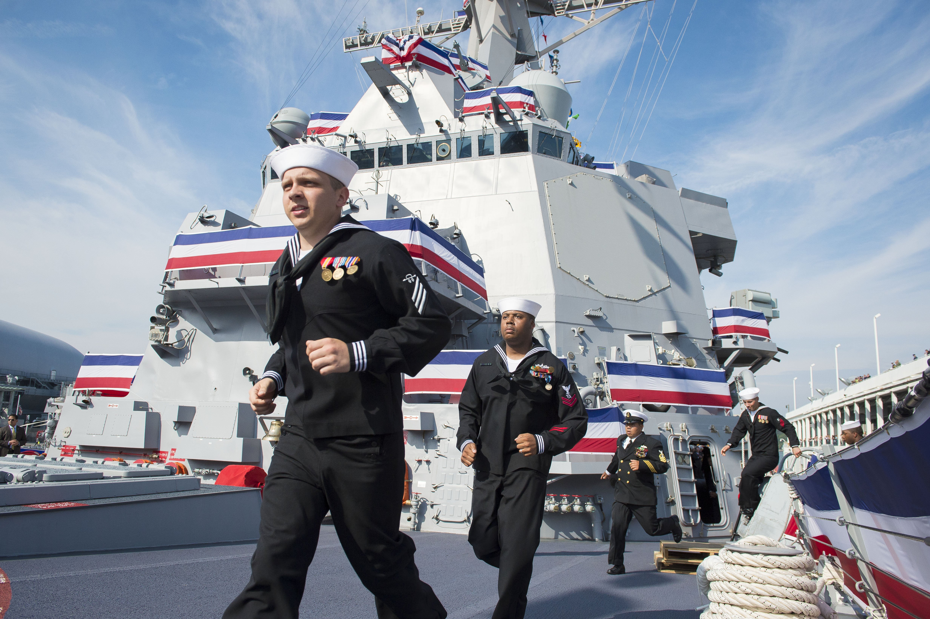
Status
Ship Commissioning Guide
-- Currently in final draft
-- Being submitted to HQ for review
-- To be submitted to NAVSEA, PEOs, McKean Defense for review
-- Publication on NL website: July 2019?

Slide 5
What’s in it?
Ship Commissioning Guide
-- Twenty one pages of text
-- Twenty appendices with specific information and examples
Layout EXAMPLE ONLY

Slide 6
Appendix B: Experts and POCs
Ship Commissioning Guide
Several experienced Navy Leaguers have offered to help new committees:
Maryellen Baldwin, 757-486-7654, meb.NL@earthlink.net. Maryellen, President of the Hampton Roads Council, has personally worked on more than 25 commissionings and assisted perhaps twice that many commissioning committees. She’s been involved in numerous classes of ships commissioned in the Hampton Roads area. Linda Ermen, 757-486-7654, navyleague@earthlink.net is also at the Hampton Roads Council
Bobby Ferguson, 847-217-5717, bvferguson@sbcglobal.net. Bobby is Chairman of the Navy League’s Ship Commissioning and Adoption Committee. He personally supported various LCS’ in the Marinette, WI area, was Chairman for LCS-1 and Co-Chairman for SSN-786.
Hal Pierce, 251-604-0613, capthal@bellsouth.net. Hal has excellent contacts with Austal in Mobile, AL for Independence variant of LCS. He does many events for crews while there for construction. Also has helped many committees with commissionings of this class.
Carrie Barnecut, 510-351-8107, cbbarnecut@sonic.net. Carrie has been involved in several commissionings in the San Francisco Bay area.
Richard Hoffner, pauscg@gmail.com, is a member of the Universal Ship Cancellation Society (www.uscs.org), a non-profit philatelic organization which designs the pictorial postmarks and produced through the U S Postal Service is available to discuss the process.
Ernie Connor, ernieandmo@supertzar.net. Involved with 10 commissioning’s both USN and USCG, serving in all positions from Chairman on down.
Layout EXAMPLE ONLY

Slide 7
Appendix F: Budget Example
Ship Commissioning Guide

Slide 8
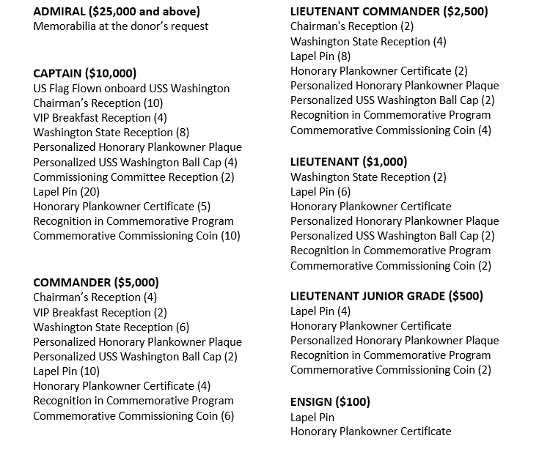
Appendix J: Donor Level Examples
Ship Commissioning Guide

Slide 9
Appendix K: Defense Contractor POCs for Sponsorships
Ship Commissioning Guide
BAE Systems
Mr. Charlie McCullough
Director, Maritime Business Development
BAE Systems
2000 N 15th Street, Suite 1000
Arlington, VA 22201
Cell: 703-851-0799
Office : 703-907-8310
Email: Charlie.McCullough@baesystems.com
BWXT: Babcock & Wilcox Nuclear Operations Group, Inc. (Reactor Manufacturer)
Mr. Peyton S. (Sandy) Baker
President & CEO BWXT
2016 Mt. Athos Road
Lynchburg, VA 24504
psbaker@bwxt.com
434-522-6000 (switchboard)
Layout EXAMPLE ONLY

Slide 10
Appendix K: Defense Contractor POCs (cont’d)
Ship Commissioning Guide
General Dynamics Electric Boat Division
Ms. Lisa L. Trolan
Public Affairs Sr. Specialist
General Dynamics Electric Boat Division
75 Eastern Point Road, J88-10
Groton, CT 06340-4989
Office: 860-433-6913
Cell: 860-303-0692
Email: ltrolan@gdeb.com
Huntington Ingalls Industries, Newport News Shipbuilding
Ms. Jennifer Dunn
Director, Communications
Newport News Shipbuilding
4101 Washington Avenue
Building 520/1
Newport News, VA 23607
Office: 757-380-3558
Cell: 757-880-8405
Email: Jennifer.Dunn@hii-nns.com
Layout EXAMPLE ONLY

Slide 11
Questions?
Ship Commissioning Guide
Layout EXAMPLE ONLY

