Slide 1
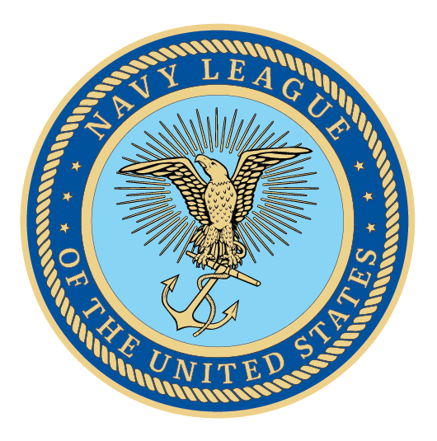
Notes:
We are here because America is at a dangerous inflection point in regards to our national and economic security. As we focus on great power competitors like China and Russia, it is impossible to overlook the fact that the sea services will be the tip of the spear in projecting U.S. power and deterring conflict with an aggressive forward posture. Today, we will cover the most important needs of the sea services and explain how they secure America’s interests.

Slide 2
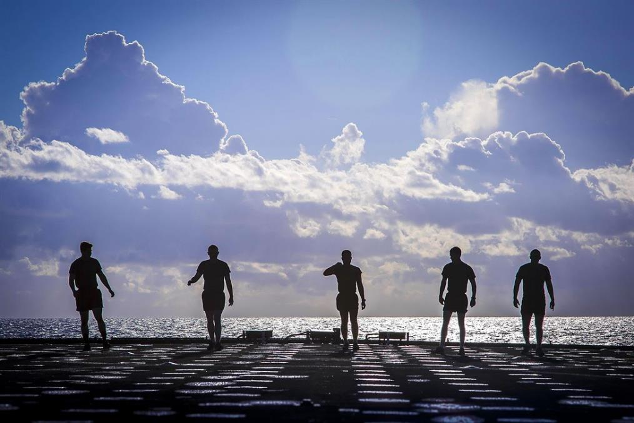
Agenda
About the Navy League of the United States
Our Purpose: America is a Maritime Nation
The Needs of the Sea Services
Navy Readiness, Capacity, and Infrastructure
Marine Corps Unfunded Priorities
Coast Guard Infrastructure and Shipbuilding
U.S. Flag/Merchant Marine Needs
Future Sailors
Opportunities to work with us
Notes:
Agenda for the 20-30 minute meeting. Feel free to focus more on the areas which you feel are most relevant to the member of Congress you are briefing based on their committee assignments, location of district/state (do they come from a Coastal region or are they close to a major port?), or background (did they serve in the sea services or have family that served?). Identifying these connections will make the presentation more memorable to the Member of Congress. Use this agenda as a guide to ensure that you cover all of the key topics listed here, even if you go off script throughout the meeting.

Slide 3
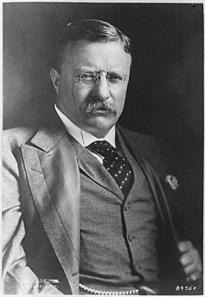
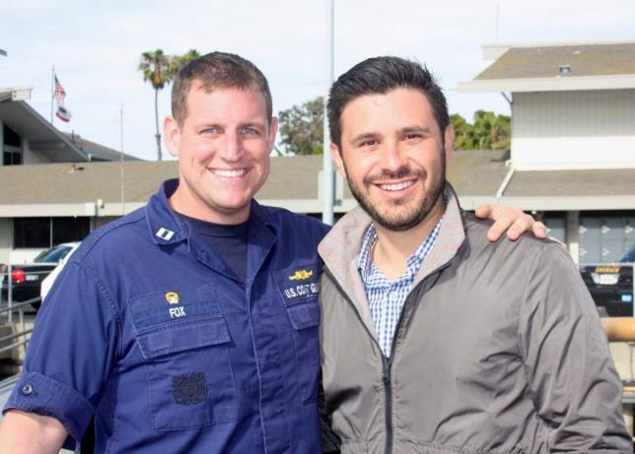
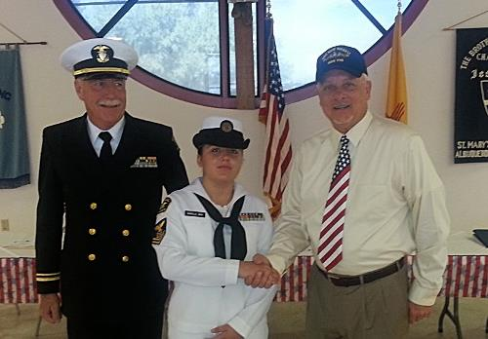
About the Navy League
Founded 1902, in New York Yacht Club, Teddy Roosevelt
Promotes the need for strong sea services
Citizen-led organization (civilian/veteran/active-duty memberships)
180 local councils
Over 30,000 members worldwide
Supports and advocates for members of the Navy, Marine Corps, Coast Guard, and U.S. Flag-Merchant Marine
Local Council Initiatives: youth programs, ship commissionings, educating the public, scholarship programs, legislative advocacy, etc.
Notes:
Please tailor the discussion to address your personal involvement in the Navy League, your local council’s involvement, and what the Member of Congress should know about the efforts and actions of your local councils regarding the sea services:
Identify the number of Navy League members in your district or state and share that number with the Member of Congress.
“We are __#__ NL members-strong; more than __ in the state of -----. Our volunteers come from a variety of backgrounds, but all believe in strong sea services.”
Key Activities: Junior Navy and Marine Corps ROTC, Adopt-a-Ship, public education on sea services, ship commissionings, Naval Sea Cadets Corps
We highly recommend that you send your Council Fact Sheet to the Congressional office prior to the meeting.
Try to make this section as local as possible. This is the most important part—you want the member to understand your role and your council’s role in the community. Any youth programs are especially of interest, and feel free to invite them to your next meeting as a speaker!

Slide 4
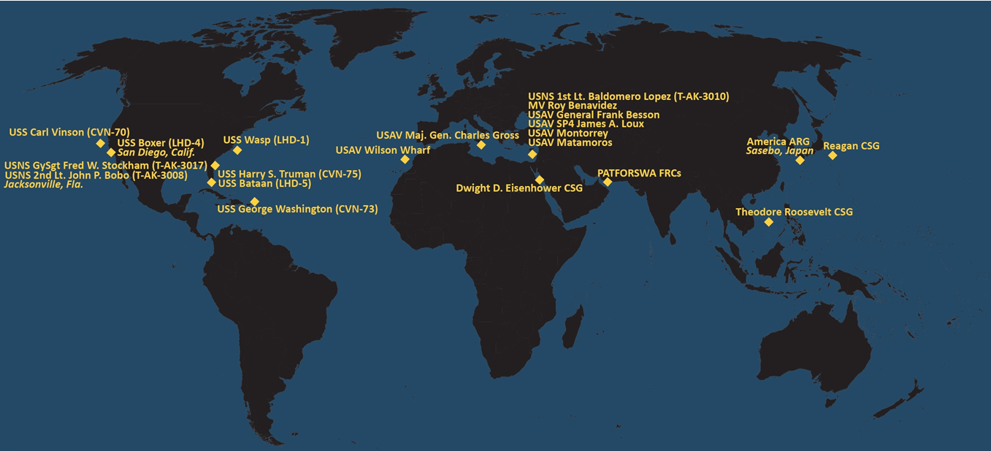
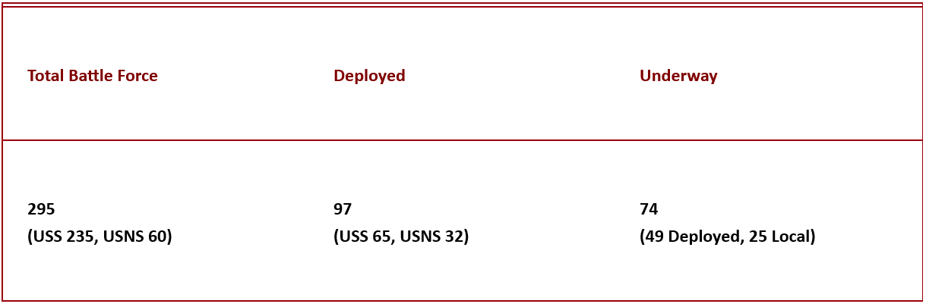
America is a Maritime Nation
“Forward-deployed forces give decision-makers their most precious commodities: options and
time.”
-- Navy League Maritime Policy
Our nation’s first line of defense is far from our shores, thanks to the forward presence of our sea services.
Keeping the seas open for global commerce ensures global economic stability.
The U.S. fleet ensures:
Conflict Deterrence
Forward Presence
Maritime Security
Freedom of Navigation
Humanitarian Assistance/Disaster Response
Notes:
In this section, talk about how all the sea services have an important role to play in American national and economic security. We are tied to the oceans by nature of our geography and must invest in our sea services. Forward presence—having ships deployed---means that our first response to conflict happens far from our shores, and keeps our sea lanes open. These global maritime forces also lead the charge in responding to humanitarian disasters around the world.
Don’t spend too much time on this slide. You want to get to the major asks for the sea services. Just emphasize that America is a maritime nation and our security and our economy depend on the defense of our maritime interests.
This year we really want to hit this slide before moving on to the asks. Really hammer home the point that having a forward presence keeps our adversaries on their turf and on their heels. Having a strong presence is the best means of deterring conflict. The most likely cause of great power conflict is a miscalculation on the part of the aggressor. Let’s make sure that Russia and China have no misunderstanding of our force and our intent. If they want to start trouble we will end it and quickly. And also emphasize that in the midst of supply chain disruptions we can see clearly that ocean trade lanes must be secured by Naval freedom of navigation maneuvers and overreliance on Chinese shipping lines creates substantial vulnerability.
So, in essence, America’s economy is dependent on ocean-borne trade, our national security is dependent on the forward presence that only maritime forces can provide in places like the South China Sea, the Indo-Pacific, or the Baltic sea.
We need look no further than the disruption to global trade caused by Houthi strikes on ships transiting the Red Sea to understand that global trade is dependent on safe and free sea lanes.

Slide 5
Sea Service Needs FY25

Slide 6
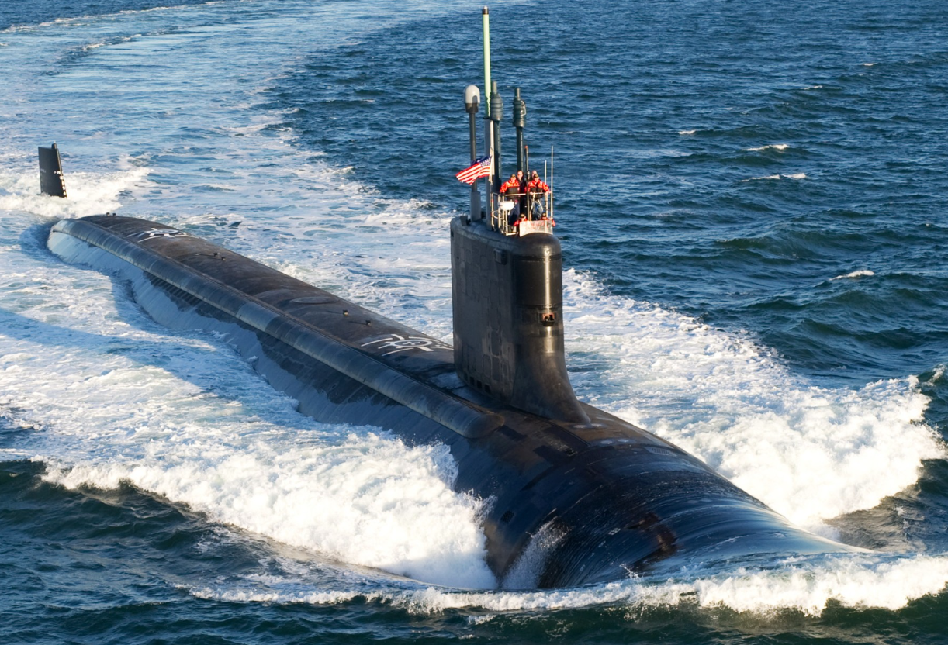
Navy Readiness, Capacity, and Infrastructure
Two Virginia-class Submarines in FY25
Undersea capabilities essential to China fight
AUKUS will require 3-5 Virginia-class subs
THANK YOU to Members for providing additional funds for the Submarine Industrial Base in the recent supplemental funding bills
Congress should write a “SHIPS Act”
Modeled on CHIPS Act
Based on findings of CNA Strategy
Address gaps in public and private shipyards
Annual SCN Budget of at least $35 billion
Notes:
The Virginia-class submarine is critical to America’s undersea strength and ability to deter or defeat a great power competitor like China. The DOD FY25 budget request broke the anticipated two-per-year Virginia-class funding and instead seeks to fund only one such vessel. In a bipartisan letter, members of the House Armed Services Committee stated clearly that now is not the time to create instability and uncertainty in the supply chain at home and in deterrence abroad. We have also committed to providing 3-5 of our Virginia-class submarines to Australia in the coming years as a result of the AUKUS agreement. Simply put, the Virginia-class submarine is too valuable a weapon system to underfund. Any concerns about shipyard capacity have been ameliorated by the recent appropriation of over $3 billion for the submarine industrial base included in the supplemental bills which passed Congress in April.
As the Center for Naval Analyses completes the National Maritime Transportation Strategy study as mandated by Congress and outsourced by the Maritime Administration, it is imperative that the study’s findings be compiled into a bipartisan bill to strengthen America’s shipbuilding capacity just as the CHIPs Act strengthened America’s ability to produce microchips domestically. The CHIPs act restored vital manufacturing and production capacity to the United States while also strengthening supply chains to ensure American security in this vital technology. The same must be done for shipbuilding, which is a national security imperative. This bill must address the gaps in our shipbuilding industrial base, and ways to make us competitive with other global shipbuilding superpowers by incentivizing investment from the public and private sectors.
To accomplish all of these things, from the Virginia-class to the demand signal needed for expanded DOD shipbuilding overall, we find that an annual Navy SCN budget of at least $35 billion is required.

Slide 7
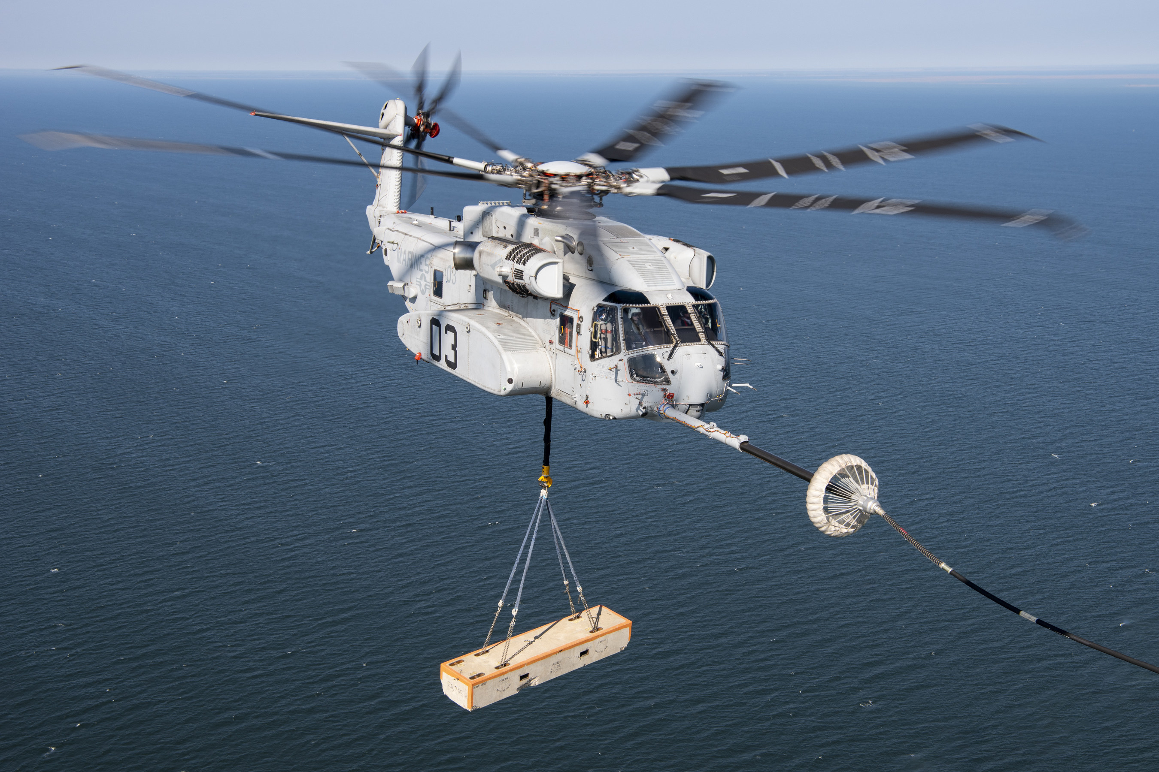
Marine Corps Unfunded Priorities
Quality of Life ($642m)
Barracks restoration and modernization
Base operating support
Facilities modernization
Force Design (~$1.2b)
Autonomous Low Profile Vessel
Long-range anti-ship missiles
2 additional CH-53K heavy-lift helicopters
Military Construction ($492m)
Hangar, flightline, electrical systems repairs
Total: ~$2.3b for needed equipment and base modernization
Notes:
The total amount sought in the Marine Corps’ FY25 Unfunded Priorities List comes to $2.3b, a rounding error in terms of the overall federal budget. Every item in this list is of critical importance to our Marines who are on the front lines of every conflict, and who will play a vital role in any potential conflict in the Pacific. The UPL includes necessary Quality of Life improvements to barracks, base operations support, and facilities modernization. It also includes requests for essential weapon systems. Some examples of these include the Autonomous Low-Profile Vessel which could be important to resupply operations in contested waters, long range anti-ship missiles, and additional heavy-lift helicopters. The UPL also seeks military construction funds for improvements to hangars, flightlines, and electrical systems. All together, this total UPL is a small price to pay for the greatest fighting force on the planet.

Slide 8
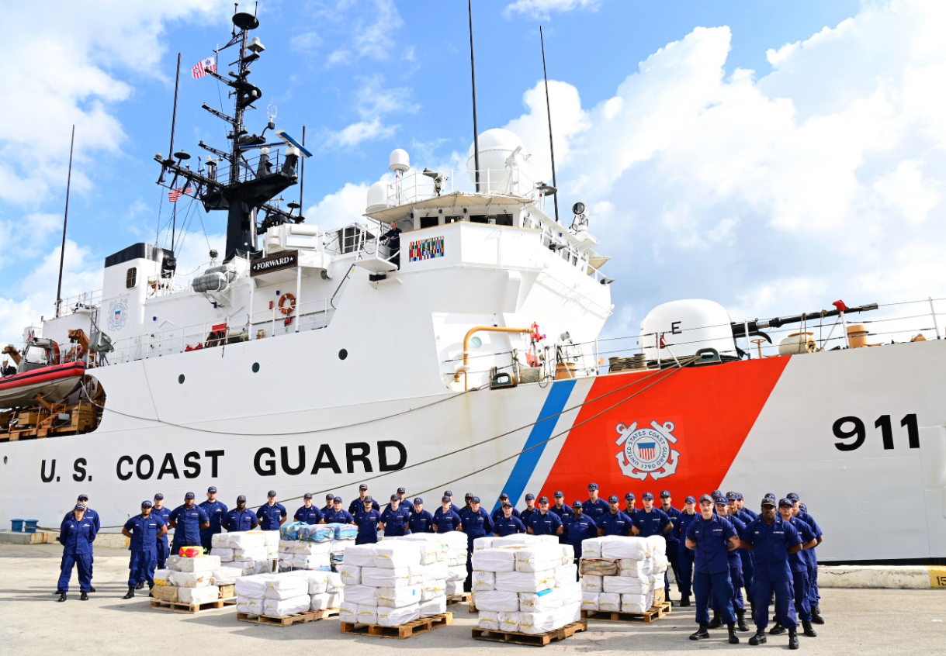
Coast Guard Infrastructure and Shipbuilding
Shoreside Infrastructure
~$600 million for shoreside infrastructure in USCG UPL
Homeport Improvements/ Housing and Quality of Life facilities/ facility deficiencies
Icebreakers
$50 million in UPL for modifications to commercially available polar icebreaker, and long lead items for Great Lakes icebreaker
Cutters
Expedite development, construction, and operability
$50 million for National Security Cutters
$40 million for Waterways Commerce Cutters
Notes:
The Coast Guard is in need of investment in shoreside infrastructure due not only to the deteriorated condition of many of their facilities but also to the need for improvements to facilitate new and larger ships like the Polar Security Cutter. The USCG’s UPL includes approximately $600m in funding needs for such shoreside infrastructure as well as quality of life improvements to housing and facilities. These improvements are absolutely necessary to ensure that the quality of Coast Guard facilities meets the needs of servicemembers, their families, and the vessels they require.
Speaking of vessels, the Unfunded Priorities List includes money for modifying a commercially viable polar icebreaker as well as procuring long lead items for a new Great Lakes icebreaker. It also includes funding requests for expediting the development and construction of National Security Cutters which are essential to numerous homeland security missions, as well as Waterways Commerce Cutters which ensure that our Marine Transportation System is able to transport goods with maximum efficiency.

Slide 9
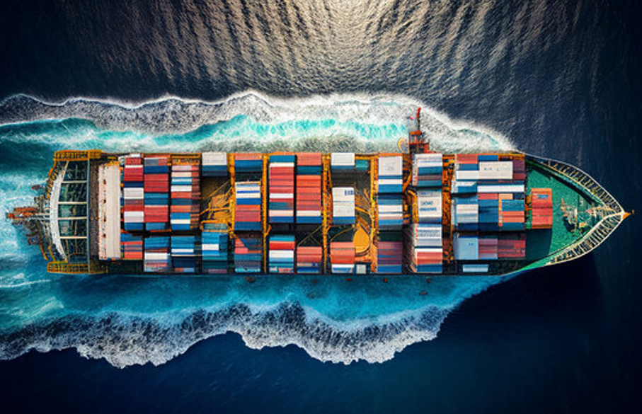
U.S. Flag/Merchant Marine
Expand Tanker Security Program funding to 20 vessels and increase the stipend per vessel
Currently authorized for 20 but funded for 10
Defend the Jones Act
Provides 650,000 jobs across the country
Critical to American shipbuilding
Essential to national and economic security
Fund MARAD Sealift program for design and construction of 10 new U.S. built ships
Given $12m in FY24 for design
Purchasing used ships for Ready Reserve Force recapitalization will result in sellers purchasing replacements from China bolstering their industrial base rather than ours.
Notes:
The Tanker Security Program (TSP) is vital to America’s ability to transport petroleum between its ports to support the domestic economy and to resupply forces afloat and ashore overseas in the event of a long-term military conflict in the Indo-Pacific. Under the TSP, the United States pays a $6m annual stipend to operate a tanker under U.S.-flag and to agree to support American contingency operations in times of need. The program is authorized for 20 vessels but only funded for 10 and the $6M stipend/ship needs to be increased (likely to somewhere between $7.5 million-$10 million) to cover several years of inflation and periodic training of crews to conduct refueling operations at sea with Navy oilers. We ask that Congress provide the funding needed for 20 tankers and increase the annual stipend per the forthcoming Congressionally mandated TSP Report.
The Navy League strongly supports the Jones Act which ensures that ships transporting goods between American ports are American-built, American-owned, and American-crewed. This law is vital to American economic and national security, it provides hundreds of thousands of jobs, it is a vital lifeline to our domestic shipbuilding industrial base, and it prevents nations like Russia and China from traversing our vulnerable waterways. Until the forthcoming National Maritime Strategy called for in the 2023 NDAA is provided in 2025, the Jones Act provides the majority of crews needed for operating the Ready Reserve Force in time of war.
We also ask that Congress fully fund a previously authorized program to allow the Maritime Administration to design and build new sealift ships to be constructed in the USA. This would be instead of allowing the Navy to recapitalize the Ready Reserve Force with used ships at a price that allows the sellers of the used ships to buy their replacements with new one built in China, supporting the Chinese industrial base instead of ours!

Slide 10
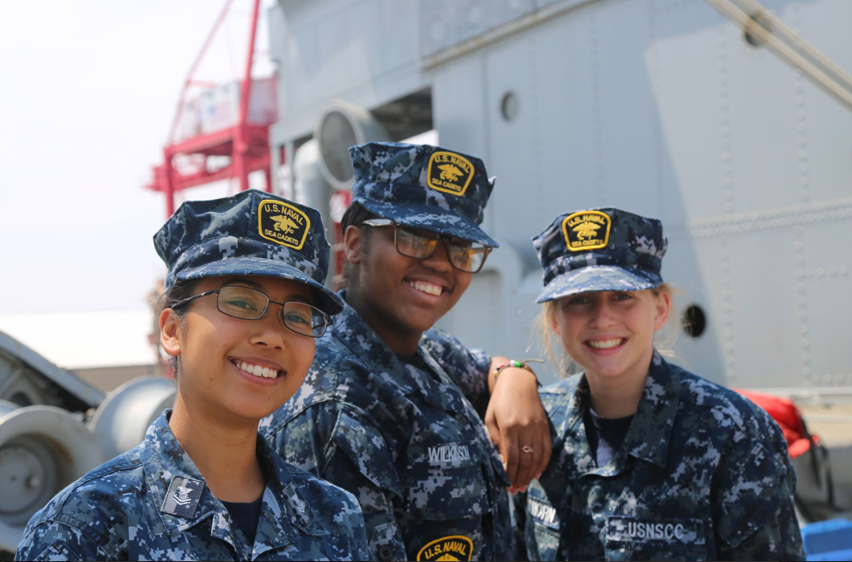
Future Sailors
Future Sailors, Marines and Mariners
Support the Sea Cadets ($7.7m in Congressional funding)
Support the Young Marines ($4m in Congressional funding)
Support Funding State Maritime Academies Student Incentive Program to $4.8 million in Congressional funding
Notes:
As our sea services face difficulties recruiting the next generation of Sailors, Marines, and Mariners, we ask that you support proven programs that develop future leaders of character and help young Americans to pursue the sea services as a career. Both the Sea Cadets and the Young Marines provide vital pipelines for young Americans, particularly those in difficult circumstances, to learn about the sea services and to embark on a career in the sea services. Both programs rely on grants made possible through Congress to include $6 million for the Sea Cadets (above the $1.7m in the budget) and $4 million for the Young Marines. The Sea Cadets receive their funding under Navy Operations and Maintenance, Recruiting and Advertising, of which over 90% is directly attributed to training program expenses. The grant that the Young Marines receives has been placed in the annual Defense Appropriations Bill under Title VI, Other Defense Programs, Drug Interdiction and Counter-Drug Activities Defense (DICD), Drug Demand Reduction. According to the NSCC website, 12% of the 2019 class at the U.S. Naval Academy were once Sea Cadets.
We also ask that you support doubling the State Merchant Marine Academy Student Incentive Program payments to students from $8,000 to $16,000 per year to compensate for growth in tuition and training costs since 2008. In exchange, students agree to receive Navy Reserve commissions as officers in the Strategic Sealift Officer Program, the same requirement that graduates from the US Merchant Marine Academy incur at a much higher cost to the Government and helps make the academies affordable to a greater range of students. It is imperative that we not allow costs to inhibit the recruitment of the next generation of mariners.

Slide 11
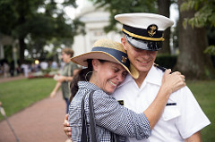


The Navy League Asks You To:
In summary:
Two Virginia-class subs in FY25
Develop SHIPS Act based on CNA study
SCN of at least $35 billion annually
Fund USMC UPL
Fund USCG UPL shoreside infrastructure, icebreakers, and cutters
Expand the TSP to 20 tankers with increased stipend
Support the U.S. Flag Fleet, the Jones Act, and domestic shipbuilding
Provide funds for Sea Cadets and Young Marines, and Student Incentive Program
Notes:
This is just a brief summary of the points already mentioned throughout the presentation.

Slide 12
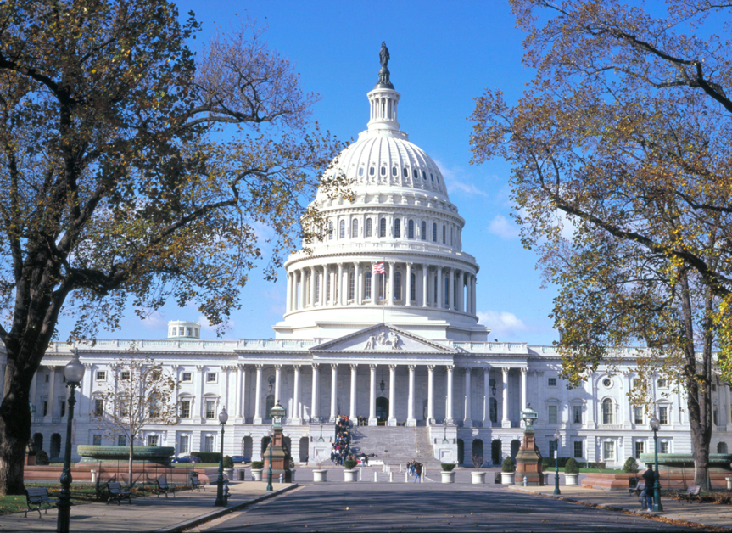
Opportunities To Work With The Navy League
Join our supported Caucuses:
Shipbuilding, Navy-Marine Corps, Coast Guard, Navy Education, and Sea Cadet
Military Service Academy Nominations
Assist Selection Board Assist with Academy days
Center for Maritime Strategy (CMS)
The Center for Maritime Strategy (CMS) is a non-profit, non-partisan think tank and research institution dedicated to studying maritime issues and their context within wider American national security policy. Through its research and analysis, external outreach, publications, and high-level events, CMS engages key stakeholders across government, academia, and industry.
centerformaritimestrategy.org
Notes:
Encourage your Representative to join the Congressional Shipbuilding Caucus, if they haven’t already. The Navy League sponsors a quarterly breakfast series with them to explore topics of interest to the shipbuilding community. It’s bipartisan, co-chaired by Rep. Rob Wittman (R-VA) and Rep. Joe Courtney (D-CT). We can also help them in selecting nominees for the service academies. And the Center for Maritime Strategy, housed within the Navy League, is a thought leader on all matters in the maritime realm. The Center for Maritime Strategy (CMS) is a non-profit, non-partisan think tank and research institution dedicated to studying maritime issues and their context within wider American national security policy. Through its research and analysis, external outreach, publications, and high-level events, CMS engages key stakeholders across government, academia, and industry.

Slide 13
Thank You!

