Slide 1
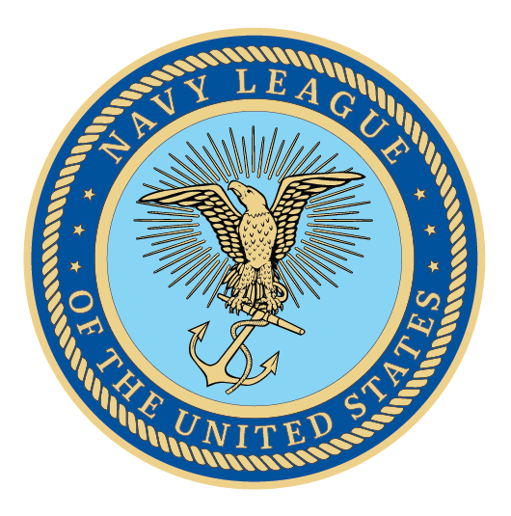
Notes:
We are here because America is at a dangerous inflection point in regards to our national and economic security. As we focus on great power competitors like China and Russia, it is impossible to overlook the fact that the sea services will be the tip of the spear in projecting U.S. power and deterring conflict with an aggressive forward posture. Today, we will cover the most important needs of the sea services and explain how they secure America’s interests.

Slide 2
Fundraising Tips
It’s always about the “F” Word!
Right Size the Ask
Think Small – Costco/SAMS – on line asks
Think Bigger – Walmart/Target/Home Depot
Describe the Ask –
Hosting MilSpouse Event
Return to/Change of Home Port
Sea Cadet Com Rel Day
Wounded Warrior or Veterans Day Event
Be Careful What You Ask For –
Large Grants = Large Reporting
Who else uses my EIN
Notes:
Encourage your Representative to join the Congressional Shipbuilding Caucus, if they haven’t already. The Navy League sponsors a quarterly breakfast series with them to explore topics of interest to the shipbuilding community. It’s bipartisan, co-chaired by Rep. Rob Wittman (R-VA) and Rep. Joe Courtney (D-CT). We can also help them in selecting nominees for the service academies. And the Center for Maritime Strategy, housed within the Navy League, is a thought leader on all matters in the maritime realm. The Center for Maritime Strategy (CMS) is a non-profit, non-partisan think tank and research institution dedicated to studying maritime issues and their context within wider American national security policy. Through its research and analysis, external outreach, publications, and high-level events, CMS engages key stakeholders across government, academia, and industry.

Slide 3
Resources
Members are good resources
Make membership worth more
Cross Pollinate
Veteran Organizations – vfw.org
Auxiliaries - cgaux.org
Cadet & active duty parent organizations – usna.edu
Event Fundraisers
One size does not fit all – ID who and what you can celebrate
Outreach
Who won contracts in your AOR
Who are the newly opened businesses
Congratulate and make an intro to Navy League
- New Partners, Members and donors
Notes:
Encourage your Representative to join the Congressional Shipbuilding Caucus, if they haven’t already. The Navy League sponsors a quarterly breakfast series with them to explore topics of interest to the shipbuilding community. It’s bipartisan, co-chaired by Rep. Rob Wittman (R-VA) and Rep. Joe Courtney (D-CT). We can also help them in selecting nominees for the service academies. And the Center for Maritime Strategy, housed within the Navy League, is a thought leader on all matters in the maritime realm. The Center for Maritime Strategy (CMS) is a non-profit, non-partisan think tank and research institution dedicated to studying maritime issues and their context within wider American national security policy. Through its research and analysis, external outreach, publications, and high-level events, CMS engages key stakeholders across government, academia, and industry.

Slide 4
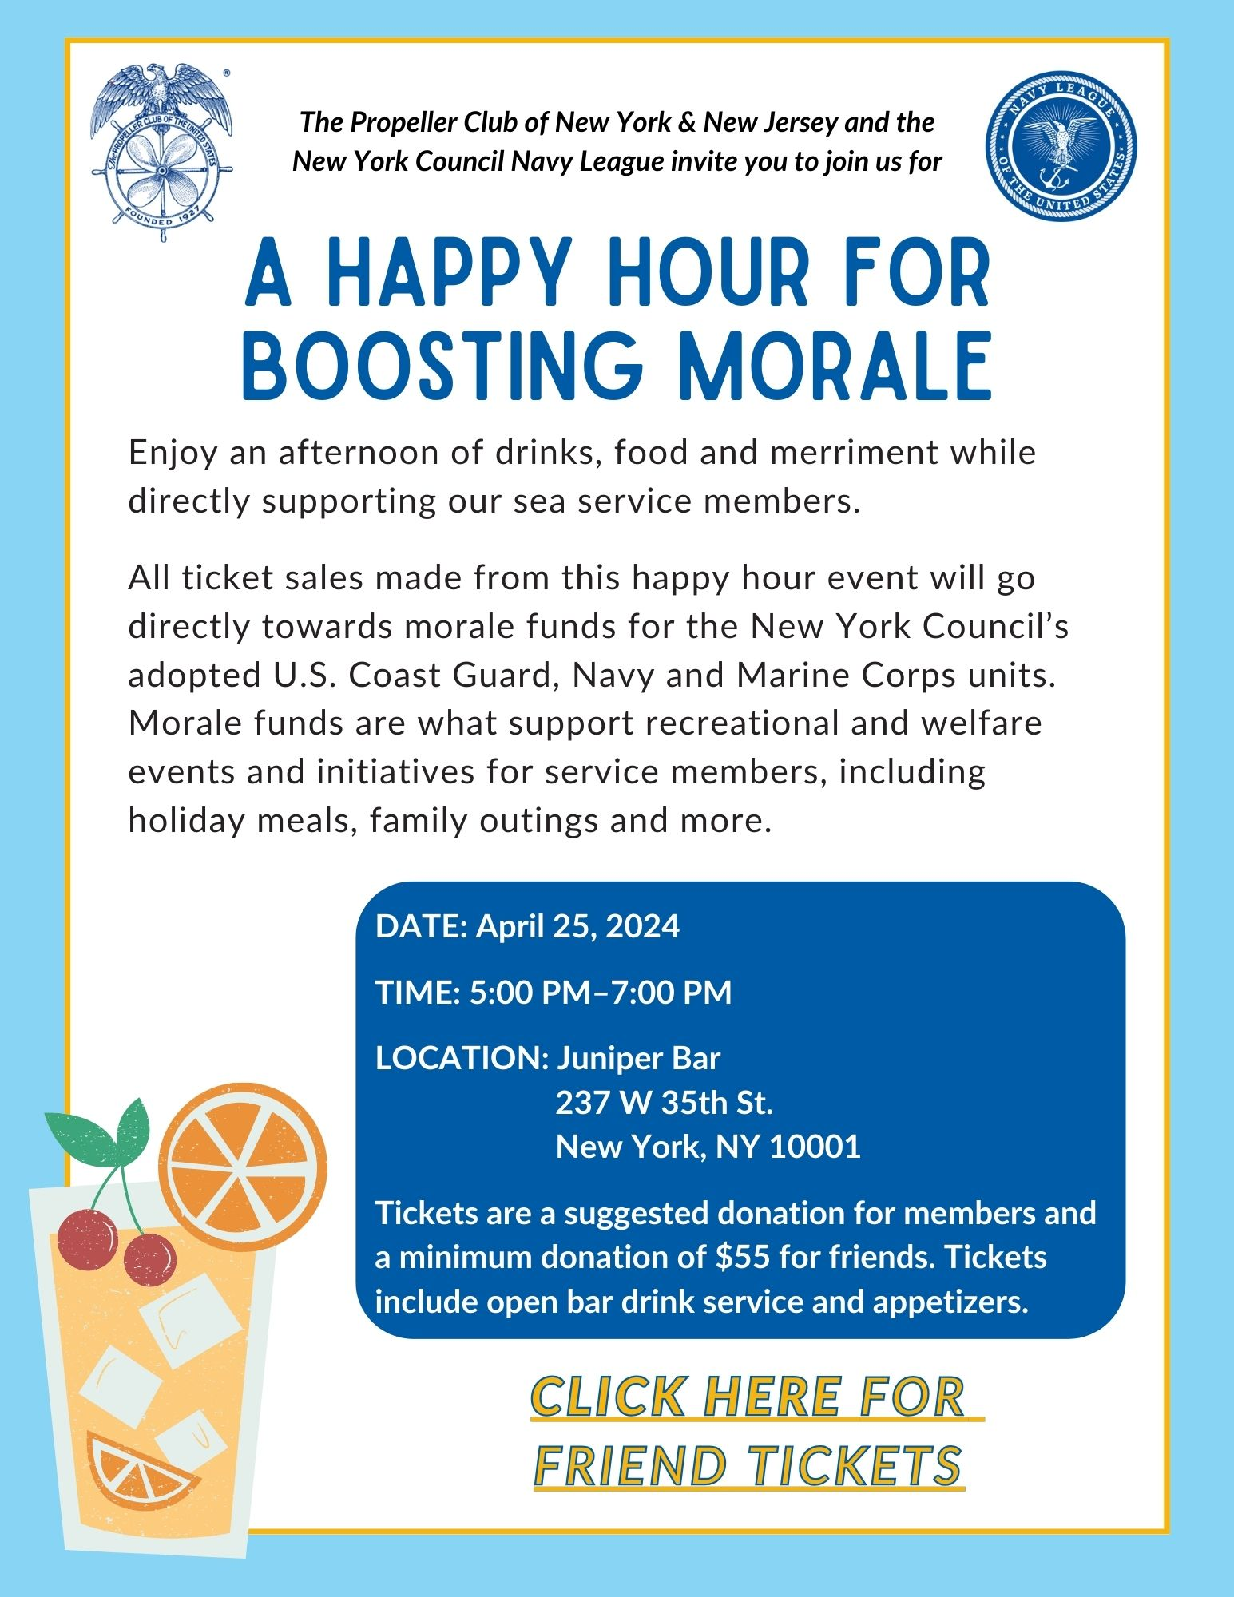

Slide 5
Ri

Slide 6
The Tool Box
One ask at a time
Know the mission and be relative
Speak to the impact
Make it scalable
Everything the Navy League does is made possible through donations
Be passionate, be excited, be informed – it’s contagious
Notes:
Encourage your Representative to join the Congressional Shipbuilding Caucus, if they haven’t already. The Navy League sponsors a quarterly breakfast series with them to explore topics of interest to the shipbuilding community. It’s bipartisan, co-chaired by Rep. Rob Wittman (R-VA) and Rep. Joe Courtney (D-CT). We can also help them in selecting nominees for the service academies. And the Center for Maritime Strategy, housed within the Navy League, is a thought leader on all matters in the maritime realm. The Center for Maritime Strategy (CMS) is a non-profit, non-partisan think tank and research institution dedicated to studying maritime issues and their context within wider American national security policy. Through its research and analysis, external outreach, publications, and high-level events, CMS engages key stakeholders across government, academia, and industry.

Slide 7
Thank You!

