Slide 1

Strategic Planning
Bill James, Area President
January 10, 2024

Slide 2
Speakers
William (Bill) James, Area President, MN Council – VP Legislative Affairs

Slide 3
Why a Strategic plan?
Helps your councils set a roadmap for your priorities
By setting priorities, you can file a flight plan for execution
With a flight plan you can align your crewmembers by position/responsibility areas
Having a coordinated flight plan and crew assignments helps ensure mission success

Slide 4
Keep It Simple
The best plans are simple to understand and are clear in communication
Don’t feel like you have to ”boil the ocean” all at once
Focus on 3 core broad set of objectives to start
Consider supporting objectives specific to your Council
Write them down and socialize them within your Council for inputs

Slide 5
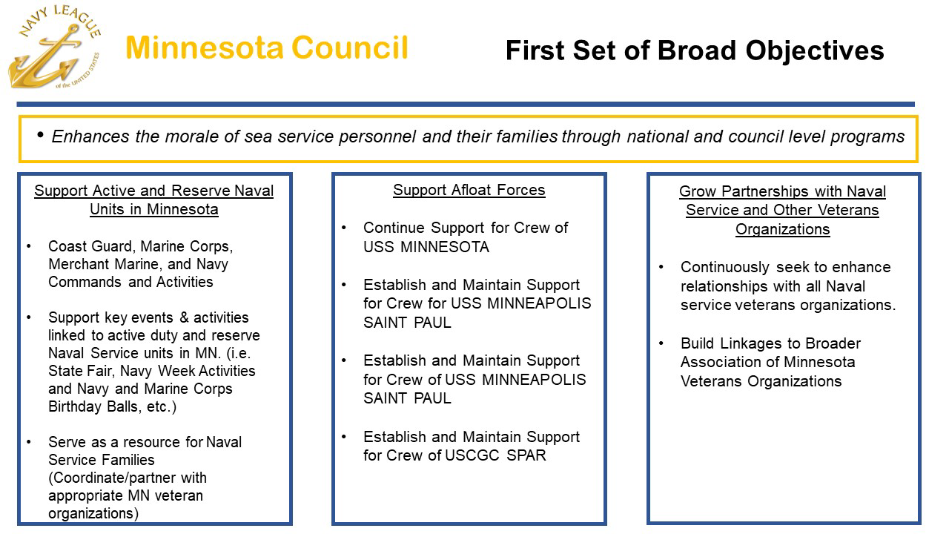
First Set of Broad Objectives

Slide 6
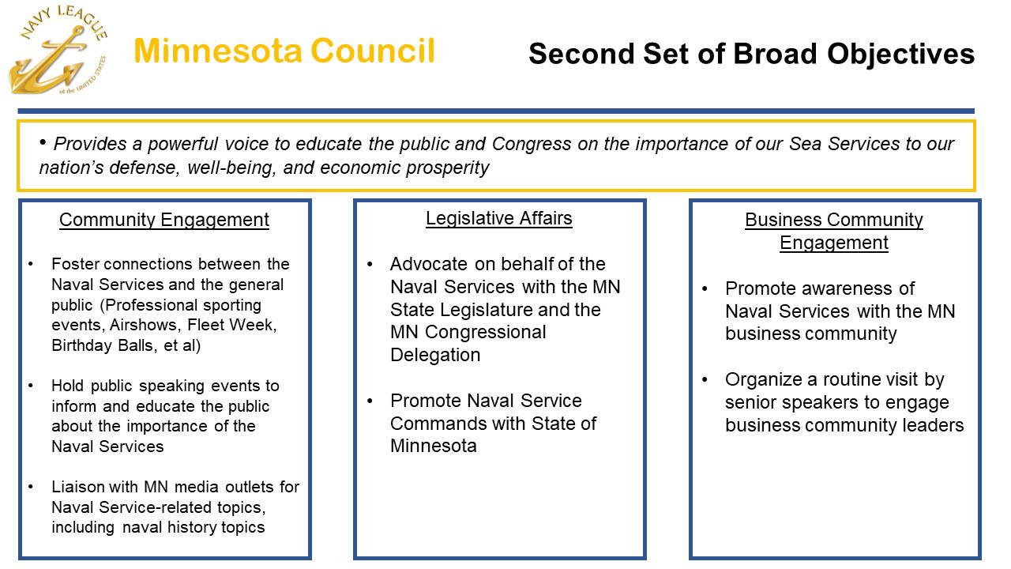
Second Set of Broad Objectives

Slide 7
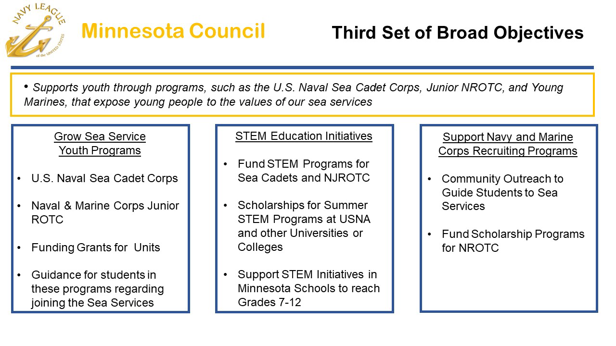
Third Set of Broad Objectives

Slide 8
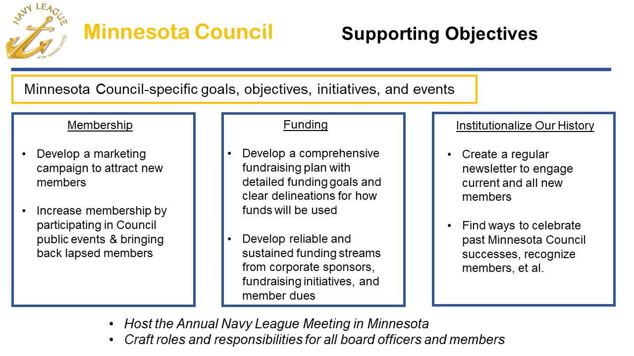
Supporting Council Objectives

Slide 9
Minnesota Council Resources
https://navyleaguemn.org/governing-documents

