Slide 1

Building Public Relations for Member Recruitment
Kevin Button, Pacific Southwest Region President

Slide 2
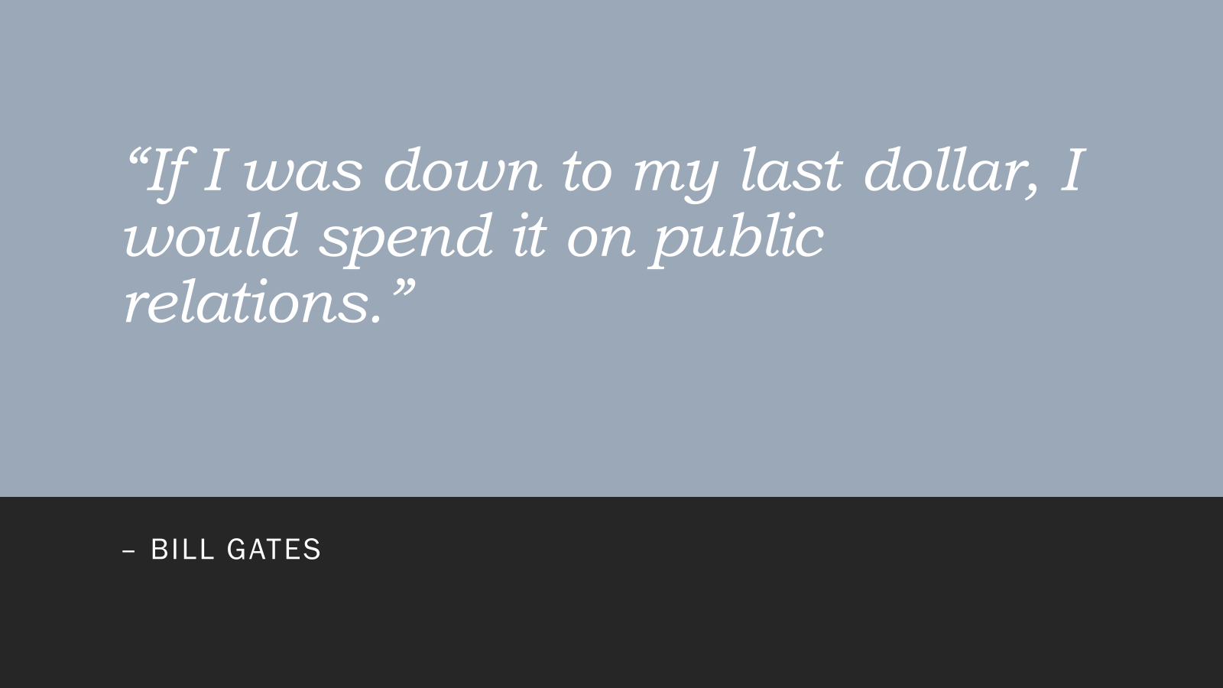

Slide 3
Publicity, public relation, and public image
Publicity:
is the activity of creating a good opinion among people about a person, product, company or institution, or information that makes people notice a person, product, company, or institution.
Public Relations:
Is the relationship between an organization and the public.
Public Image:
Is the concept that the ideas and opinions that the public may have about a person, or an organization may not be what they really are.

Slide 4
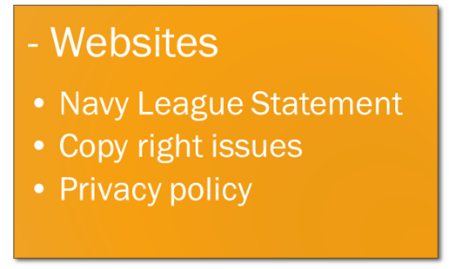
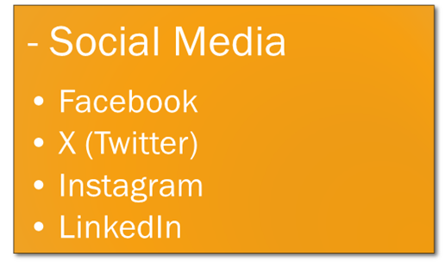

Public Relations

Slide 5
Speakers
Kevin Button, Pacific Southwest Region President
Tracey Owens, San Diego Council President

Slide 6

Websites

Slide 7



Social Media
To Reach all the demographics in your area, you should be posting on several different social media platforms.
You need to assign a committee member to each of the social media platforms and have them posting council activity at least twice a week.
Social Media Platforms:
Facebook
Instagram
X (Twitter)
LinkedIn

Slide 8
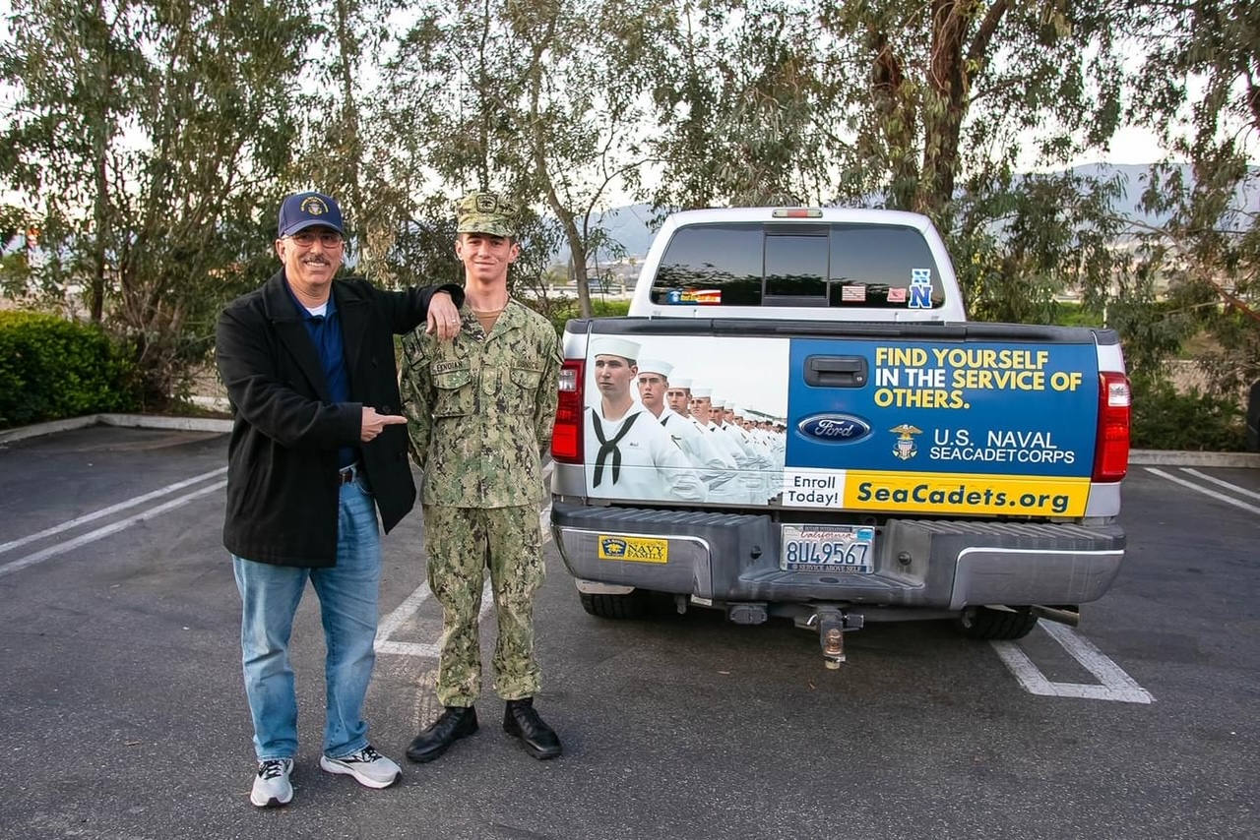
Press Releases
Newspaper:
You should be sending in articles to your local newspaper at least twice a month.
Invite them to your projects and fundraisers.
Radio:
Use a portion of your council budget to purchase small amounts of time on your local radio station.
Invite radio hosts to your council as speakers and develop a relationship with them
Be a guest on the local radio talk show.
Billboards:
Find free space on the billboards along the freeway.
Budget money to purchase billboard space.

Slide 9
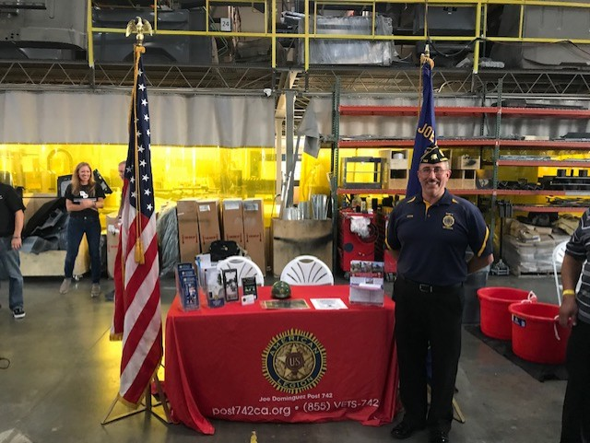
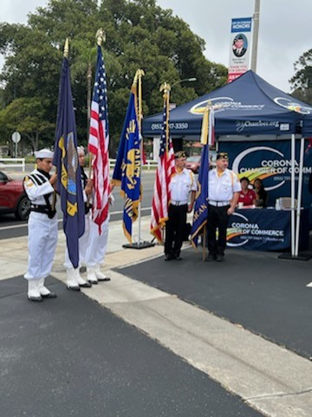
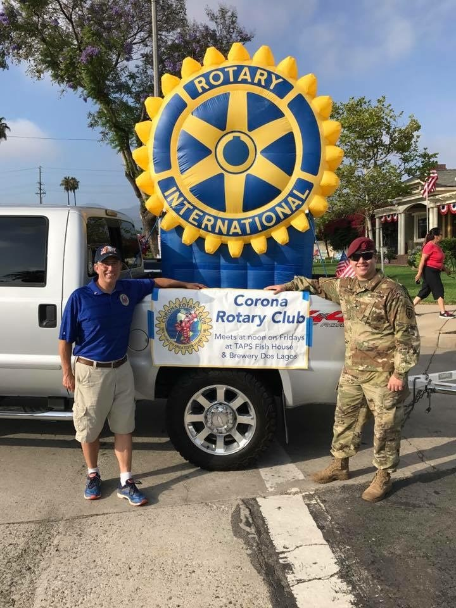
Community Organizations
Chamber of Commerce:
Get involved with your local Chamber of Commerce.
Attend their events and network.
Community Service Clubs:
Rotary Clubs
Kiwanis Clubs
Lions Clubs
Veterans Organizations:
American Legion
VFW
Wounded Warrior Project
Vietnam Veterans of America

Slide 10
THANK YOU FOR ATTENDING
“DO WHAT YOU CAN, WITH WHAT YOU HAVE,
WHERE YOU ARE.”
- THEODORE ROOSEVELT

