Slide 1
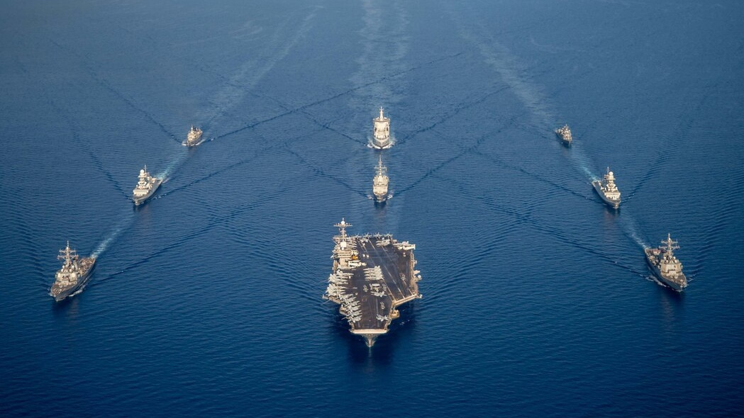
Commander Naval Air Forces
Naval Aviation and underway embark brief
Steve Fiebing, Deputy Public Affairs Officer,
Commander Naval Air Forces U.S. Pacific Fleet

Slide 2
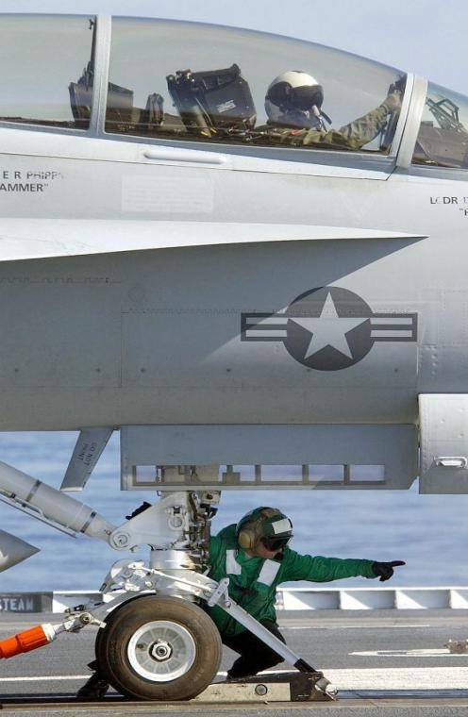
Briefing Overview
Why do we need a Navy?
Naval Air Forces Mission
Navy’s Aviation Assets
Employing Naval Aviation
Underway Embarks

Slide 3
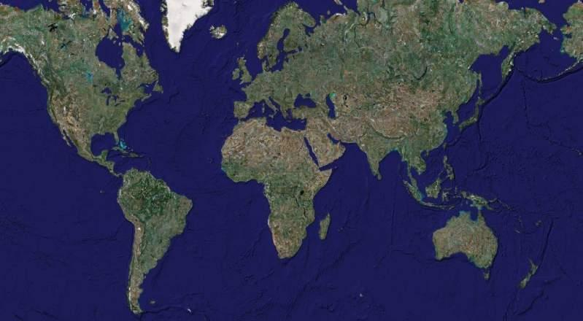
Why Do We Need a Navy?
70 %
Of the World is covered in water
-- 12 miles off coast is international waters
80 %
Of the World’s population lives within 100 miles of a coastline
-- CVN’s aircraft travel 600+ miles

Slide 4
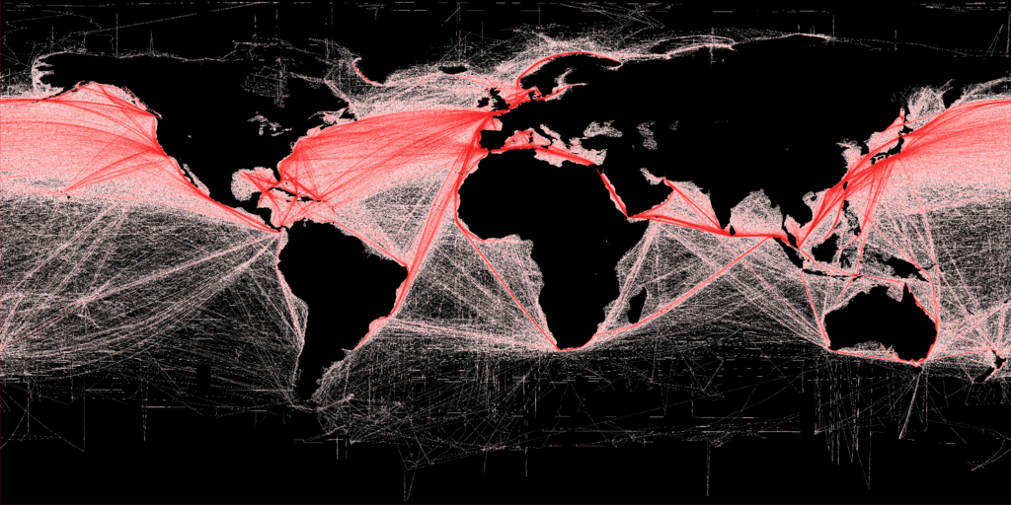
Why Do We Need a Navy?
90 %
Of the World’s commerce travels over the oceans
90% of global trade by volume travels by water
70% of global trade by value travels by water
Without open sea lanes, our only trading partners would be Canada and Mexico
Notes:
Note global choke points (Red Sea, Suez Canal, Straits of Gibraltar, Straits of Mallaca). Keeping those sea lanes open is not only of vital interest to US interests, but also to global interests.

Slide 5
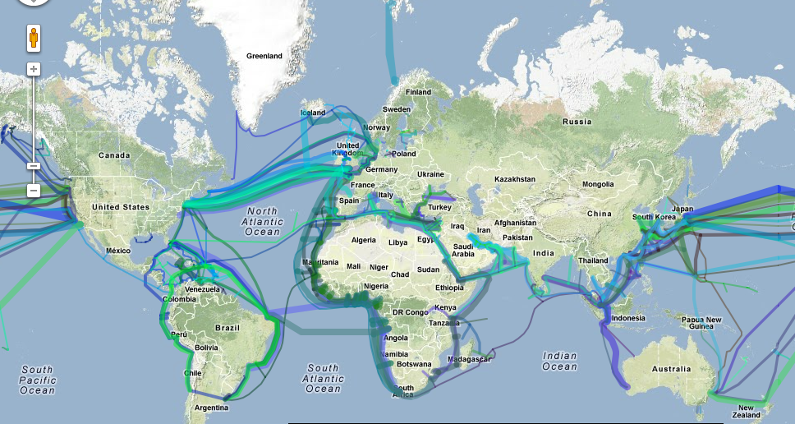
Why Do We Need a Navy?
90 %
Of the World’s communications lines pass under the oceans
-- People assume communications are by satellite
-- The Navy ensures uninterrupted flow
100 %
Of the time, the U.S. Navy is steaming around the world
Notes:
Communication cables are protected by international treaty. Any nation, with a semi-sophisticated submarine, can tap, monitor, or even severe those; and in times of conflict, desperate actors will take desperate actions when needed. Our submarine forces makes sure those desperate nations do not take those actions.

Slide 6
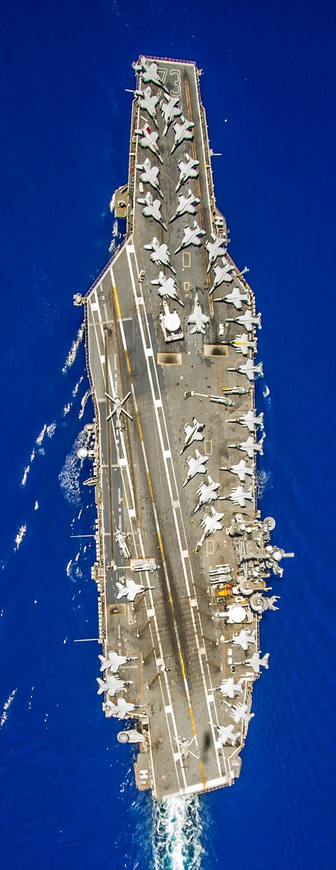
Today’s Navy
As of June 3, 2024:
328,363 active duty officers, Sailors and midshipmen
296 deployable Battle Force ships in service
Ships Underway:
Underway or Overseas: 80 (27%)
Underway for Training (local): 28 (10%)
Underway Overseas: 52 (18%)
Aircraft Carriers at sea: 5
USS Eisenhower (CVN 69) - Mediterranean
USS Theodore Roosevelt (CVN 71) – Western Pacific
USS Abraham Lincoln (CVN 72) – Eastern Pacific
USS George Washington (CVN 73) – South Atlantic
USS Ronald Reagan (CVN 76) – Western Pacific
Amphibious Assault Ships (LHA/LHDs) at sea: 2
Notes:
Slide should be updated weekly.

Slide 7
Briefing Overview
Why do we need a Navy?
Naval Air Forces Mission
Navy’s Aviation Assets
Employing Naval Aviation
Underway Embarks

Slide 8
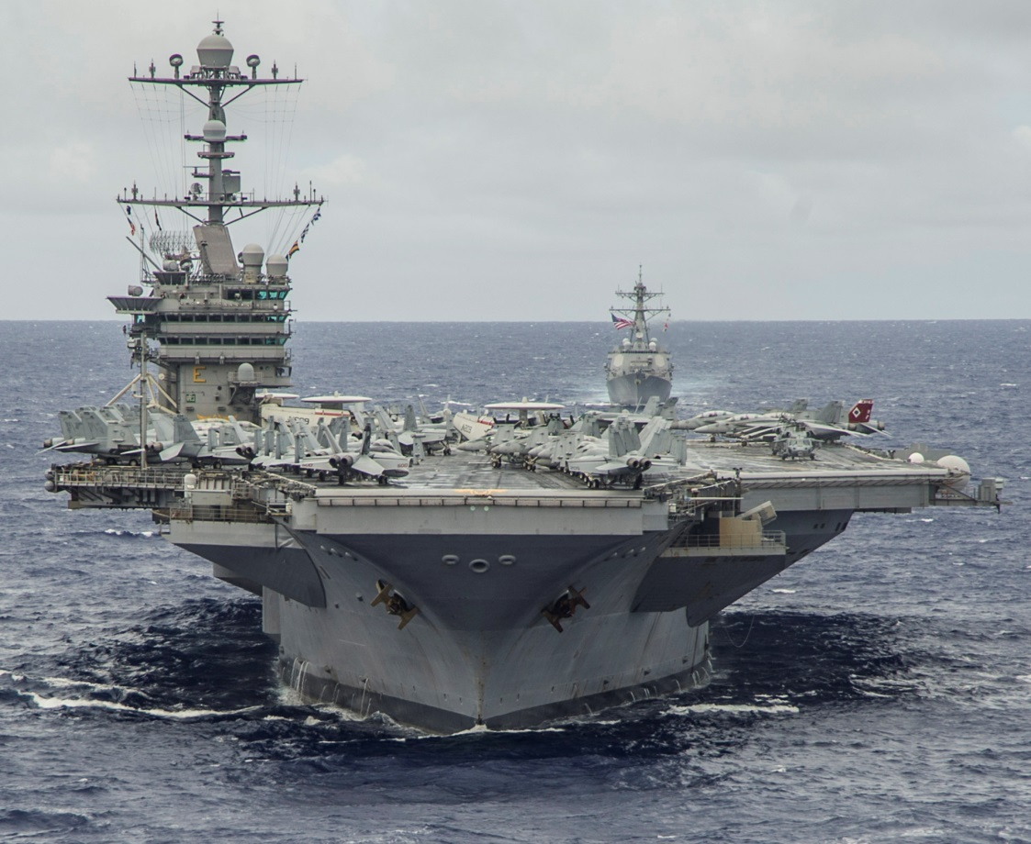
Naval Air Forces Mission
Mission Statement: “Man, train, and equip, deployable combat-ready Naval Aviation forces that win in combat.”
-- When ships and squadrons are stateside, they fall under operational control of Naval Air Forces.
-- Our job is to properly man, train, and equip units; certify them as combat ready, and make them available to operational commanders overseas
Notes:
[What CNAF does]

Slide 9
Naval Air Forces
What We manage:
Commander Naval Air Forces
+100,000 Sailors / Personnel
11 Aircraft Carriers
22 Aviation Type-Wings
22 Naval Air Stations
170 Fleet, Reserve & Training Squadrons
~3,700 Aircraft of various types
Notes:
This is what CNAF Oversees.
Number of Squadrons:
168 Fleet, Reserve, and Training Squadrons. Includes Blue Angels.

Slide 10
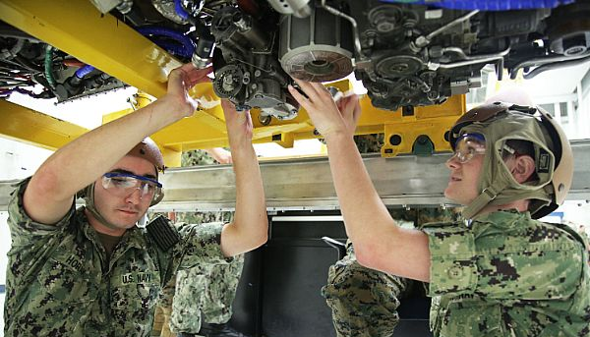
Training Sailors
Training: All hands, all the time
-- Todays Navy is a “technical force”
--- Operating and maintaining equipment and aircraft requires advanced skills
--- Training includes formal classroom (Class A- and C-Schools) and on-the-job
-- +35% annual crew turnover, every command, every year.
--- Perpetual cycle of job rotations with increasing roles and responsibilities
-- Skill proficiency:
--- Persistent training and drilling of the crew ensures combat readiness
-- Sailors in today’s Navy are best-educated and trained EVER!
Notes:
Training Sailors is what we do EVERY day.
Note crew turnover stat. Ask group if there are any business owners in group. Then ask them what they would do, if they had 35% of their workforces turning over every year.
Note to guests: if they need someone to train people, hire a Sailor.

Slide 11
Briefing Overview
Why do we need a Navy?
Naval Air Forces Mission
Navy’s Aviation Assets
-- Aircraft
Employing Naval Aviation
Underway Embarks

Slide 12
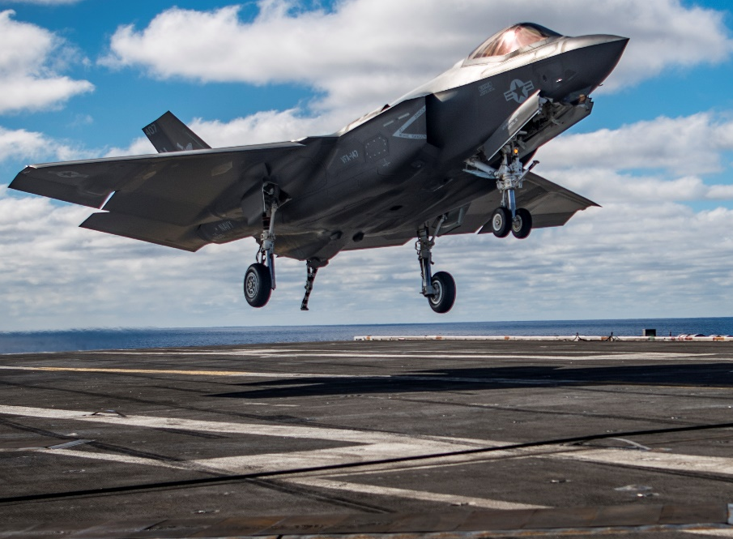
Navy Aircraft: Carrier-Based
4 things that make Carrier-Based Aircraft Unique:
Tailhook
Structural Strength
Landing Gear
Folding Wings
1) Tailhook withstands force of engines at full power while the cable stops the aircraft on the flight deck.
2) Structurally framed/reinforced to withstand the arresting and launching forces.
3) Landing gear with oversized wheels to absorb impact of landing on CVN flight deck.
4) Wings fold to conserve space when moving on flight deck and while stored.
These items add weight. CVN aircraft may not fly as fast Air Force aircraft; but with a CVNs ability to move around the world, they don’t have to fly great distances to engage an enemy.
Future Milestones for F-35C:
CVN operational integration 2020
Deploying on USS Carl Vinson
1st CVN deployment in 2021

Slide 13
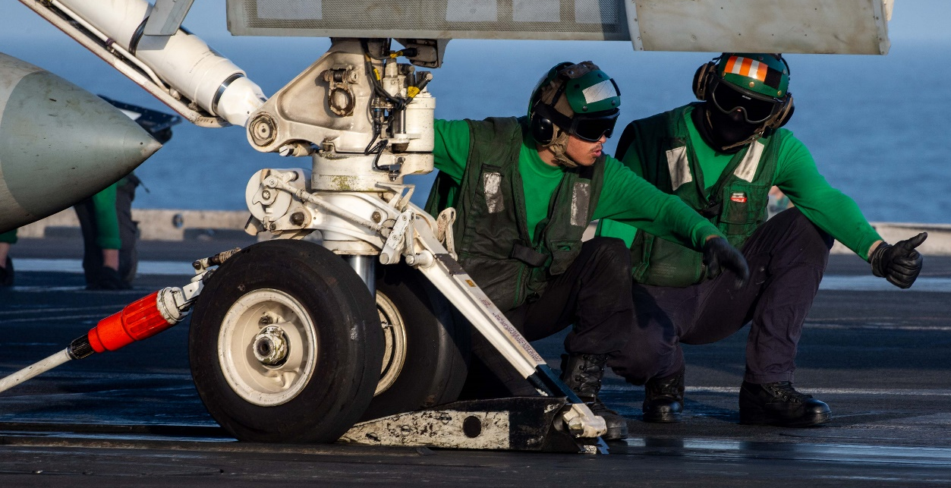
Navy Aircraft: Carrier-Based
Catapult Launch: How it works
Front landing gear has 2 wheels
with a launch arm on front
Precise roll-up to catapult w/launch
arm in up position
Pilot lowers launch arm to connect
to catapult
Catapult grabs launch arm: 2 hooks
Holdback bar attached (red bar)
Pilot conducts control checks, runs up engines, and salutes catapult officer
Catapult officer salutes, checks with crew, then touches deck.
Catapult engaged. Holdback bar separates. Aircraft is pushed down runway.

Slide 14
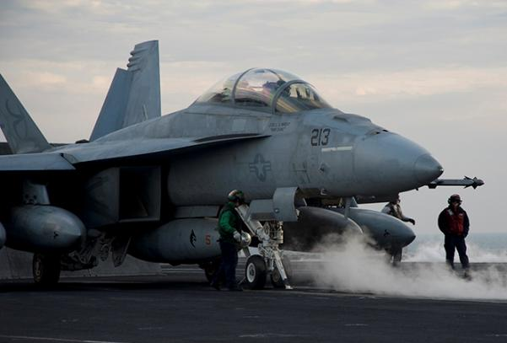
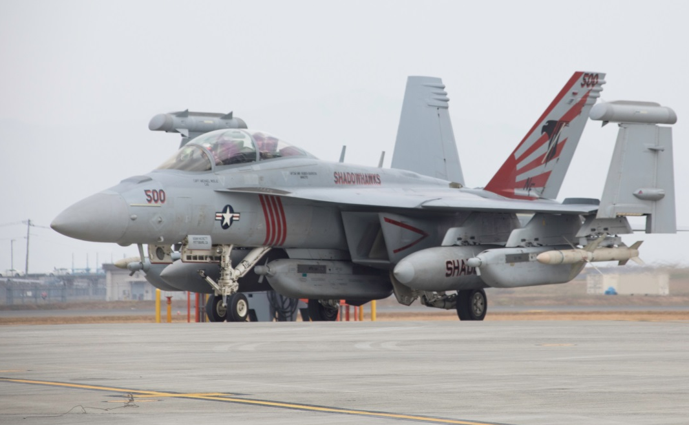
Carrier-Based Aircraft
F/A-18 E-F ‘Super Hornet’
(Advanced Strike-Fighter)
Highly capable across the full mission spectrum, longer range, and aerial refueling capability.
IOC: Sept 2001
EA-18G ‘Growler’
(Electronic Warfare)
Integrates electronic warfare technology, communication countermeasures, satellite communications and offensive weapons.
IOC: Sept 2009
Notes:
Describe each airframe and its associated missions/roles.
Super Hornets (E & Fs) are the workhorses of the aircraft carrier: Air-to-ground, air-to-air, and refueling missions.
Growlers are built on the Super Hornet airframe and fight in the electro-magnetic spectrum. The way you can tell a Growler from a Super Hornet, is to look at the wing tips: if there is a missile, or missile rail – it’s a Super Hornet. If it has a canister-look, it’s a Growler. The can detect, jam, and destroy enemy radars, allowing Super Hornets to ingress and egress combat regions safely. They can also be used in expeditionary missions.

Slide 15
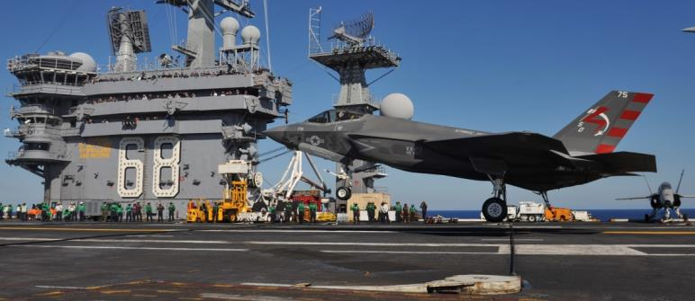
Navy Aircraft: Carrier-Based
F-35C ‘Lightning II” Joint Strike Fighter (JSF)
F-35C - Navy (folding wings & tailhook)
- Navy’s 1st supersonic stealth aircraft
- 5th Generation aircraft
Commonality of avionics and
parts reduces costs
- Carries internal or external
weapons
- Robust communications suite
- Increased lethality and
survivability
CVNs Operating with F-35C:
USS Carl Vinson (CVN 70)
USS Abraham Lincoln (CVN 72)
This year: USS George Washington (CVN 73)
Notes:
Three variants of the F-35.
Air Force variant was the first to go into production, because it was the easiest to build.
For the Marine Corps and the Navy, this is our first stealth aircraft, and we’re learning a lot of lessons over how the stealth coating react in a salt-water environment.
Marine variant was the next to be produced. It’s different from the AF variant, in that it has a fan behind the cockpit that pushes air down to lift the nose; while the engine in back features vectoring exhaust, which can be turned almost straight down, allowing the aircraft to take off and land vertically. For the Marines, the area behind the cockpit is one of the primary fuel storage areas, so the Marine variant will not fly as far as the Air Force variant, but for the Marines, they don’t care. They’re not using the plan to fly hundreds of miles to take out strategic targets; that’s the Navy’s job. They’re using the it to fly ahead of their Marines to take out tactical targets to keep their Marines safe, as then ingress a combat zone, and they’re doing it with a stealth aircraft.
The Navy variant was the last to go into production because is was the hardest to build. The Navy had to reframe the aircraft from the inside-out, to withstand the rigors of landing on an aircraft carrier. A tailhook had to be designed that would stop the aircraft without ruining the air frame. The landing gear had to be redesigned with over-sized wheels to withstand the impact of landing on an aircraft carrier, with wheels that will roll over arresting cables and not get caught in them. Additionally, the wings were redesigned to allow them to fold, to save space on the flight deck when taxiing.
The Navy variant will not fly as fast as the Air Force variant due to the extra weight, but it will fly farther due to the redesigned wings. And because it operate from an aircraft carrier and not a land, it’s far more effective in it’s role, by being closer to the enemy.

Slide 16
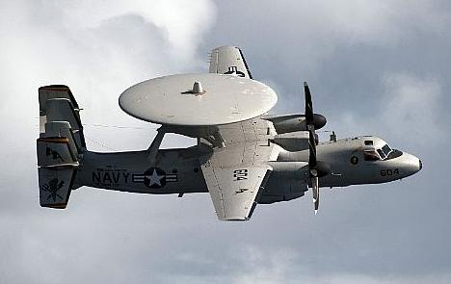
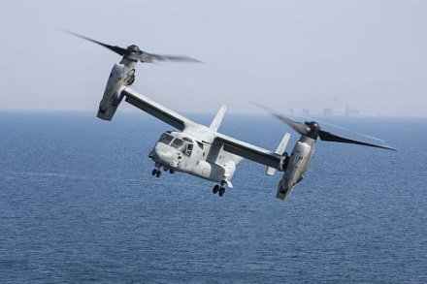
Carrier-Based Aircraft
E-2D ‘Hawkeye’
(Airborne Early Warning)
Tactical battle management, airborne early warning, command and control aircraft. IOC: Jan 1964 (E-2A).
CMV-22 ‘Osprey’
(Logistics / Personnel)
Tilt-rotor aircraft that will replace the C-2A Greyhound by mid-2020s. Transport of high-priority cargo, mail and passengers.
Notes:
The E-2D Hawkeye is the Navy’s eye-in-the-sky. When conducting flight ops overseas, the E-2 is one of the first aircraft off the deck. Atop of the plane is a radar/senor dome. The ship’s radar does a great job of searching around the ship, but when the E-2 is airborne, it paints a picture of air and surface targets hundreds of miles around the ship. Additionally, when the ship launches strike aircraft to fly hundreds of miles away, the E-2 can data-link with those aircraft, and relay in real-time what’s happening with those aircraft, to leadership on the aircraft carrier.
The CMV-22B Osprey is assuming the role of delivering personnel and cargo to the aircraft carrier while at sea. Has a crew of four, and can carry up to 22 passengers. This is the aircraft that you will be flying out to the aircraft carrier in 2023.

Slide 17
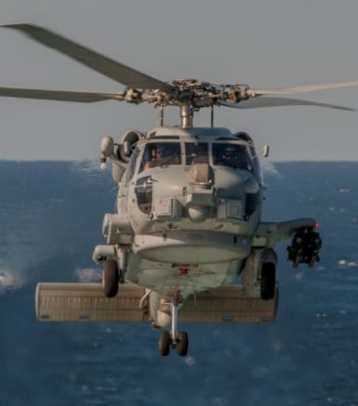
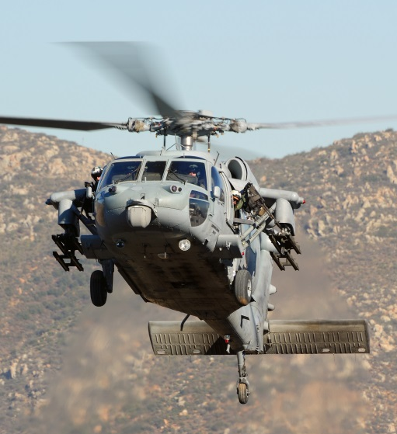
Navy Aircraft: Carrier-Based
MH-60R Seahawk
Multi-Mission helicopters capable of a full range of mission tasks including:
Anti-Submarine and Anti-Surface Warfare, Search and Rescue, Combat Search and Rescue, and Logistics.
Operating from all surface combat ships
(Blackhawk helicopter in Army and Air Force)
MH-60S Knighthawk
Primary Function: Anti-Submarine & Surface Warfare
Date Deployed: 2006
Crew: Three
H-60S Primary Function: Anti-Surface, Combat Support, Logistics, Search and Rescue
Date Deployed: 2002
Crew: Four
Notes:
The Navy has migrated to a single airframe for all of it’s medium-lift capabilities: the H-60. The Army and Air Force also use the H-60 airframe, and call the helos “Black Hawk” helicopters. The only difference between the Navy, Air Force and Army variants is the avionics that are built into each.
The H-60S (Sierra), like the Super Hornet, is the work horse variant. It is hollow inside, and can carry combat troops, conduct search and rescue operations, CSAR, and because it’s hollow, it can carry cargo internally, or externally.
The H-60R (Romeo), like the Growler, is the electronic variant of the H-60 airframe. The helo features a radar/sensor zone at the bottom of the aircraft. It can use a dipping sonar and drop sonobouys to detect submarines and carry torpedoes to engage those submarines.
Both aircraft can carry air-to-surface missiles and take out small targets/vessels.

Slide 18
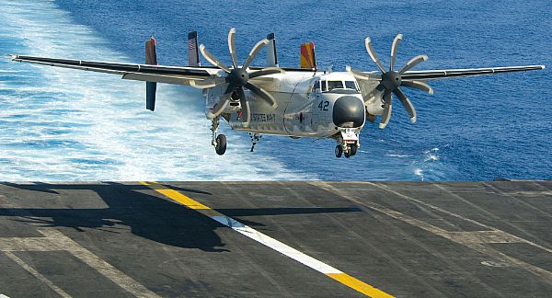
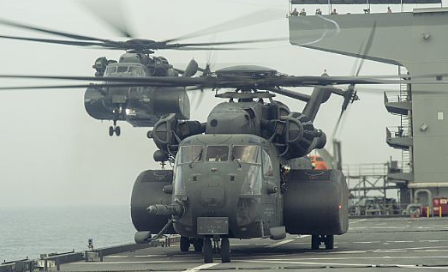
Ship / Shore-Based Aircraft
C-2A ‘Greyhound’
(Logistics / Personnel)
Transport of high-priority cargo, mail and passengers. Referred to as the ‘COD’ (Carrier On board Delivery). IOC 1964; current aircraft purchased in the 1980s.
MH-53E ‘Sea Dragon’
(Anti-Mine Helicopter)
Airborne Mine Countermeasures aircraft. Vertical shipboard logistics and assault support capable.
Notes:
The C-2 is the oldest aircraft flown out to an aircraft carrier. It first flew in 1964. The aircraft currently flying were purchased in the 1980s. The Greyhound for decades was the primary aircraft used to carry passengers and cargo to the aircraft carrier, and is being replaced by the CMV-22B Osprey.
The MH-53E is used for anti-mine warfare, and drags larges skids across open water to detect and detonate underwater mines.

Slide 19
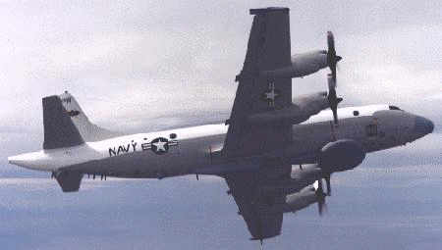
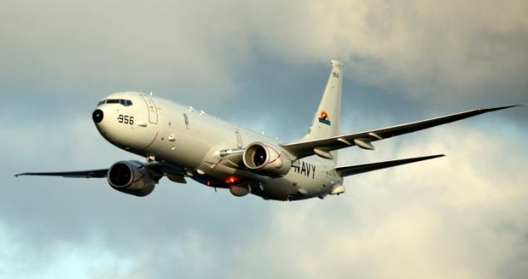
Shore-Based Aircraft
EP-3E ‘Aries II’
Intelligence & Reconnaissance
Navy’ Navy's only land-based signals intelligence (SIGINT) reconnaissance aircraft. Built on P-3 Orion airframe.
P-8 ‘Poseidon’
Multi-Mission Maritime Surveillance
Patrol and reconnaissance aircraft capable of conducting a variety of combat warfare missions. These capabilities are enhanced through secure, interoperable, net-ready systems.
Notes:
The EP-3E ARIES II is the Navy's only land-based signals intelligence (SIGINT) reconnaissance aircraft. The aircraft is based on the Orion P-3 airframe and provides fleet and theater commanders with near real-time tactical SIGINT. With sensitive receivers and high-gain dish antennas, the EP-3E exploits a wide range of electronic emissions from deep within targeted territory. EP-3Es will remain in service through 2019.

Slide 20
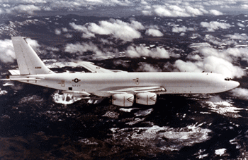
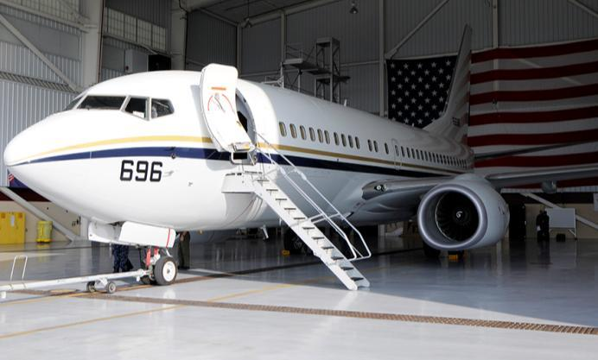
Shore-Based Aircraft
E-6A/B ‘Mercury’
Airborne Command Post
Communications and Strategic Airborne Command Post. Survivable, reliable, and endurable; provides comms between the National Command Authority (NCA) and U.S. strategic forces (Boeing 707)
C-40 ‘Clipper’
Personnel / cargo transport
Cost effective, proven and reliable airframe, with low maintenance costs due to the prevalence of aircraft around the world.
(Boeing 737)
Notes:
E-6B Mercury airborne command post is a communications relay and strategic airborne command post aircraft that provides survivable, reliable, and endurable airborne command, control, and communications between the National Command Authority (NCA) and U.S. strategic and non-strategic forces. These aircraft are based at Tinker Air Force Base near Oklahoma City, OK.
The C-40A Clipper provides critical logistics support to the Navy. It is a Boeing 737-700 convertible, cost effective aircraft. Proven and reliable airframe, with low maintenance costs due to the prevalence of aircraft around the world.

Slide 21
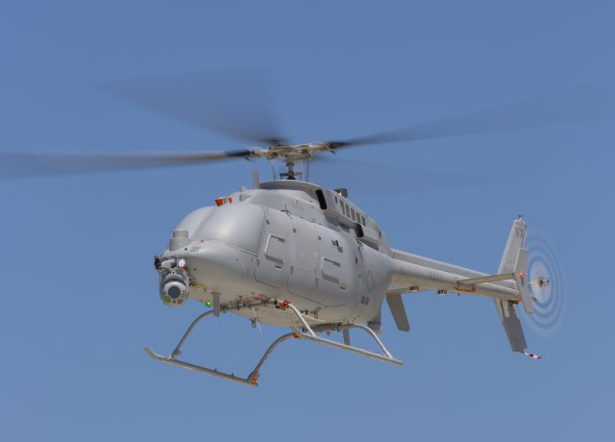
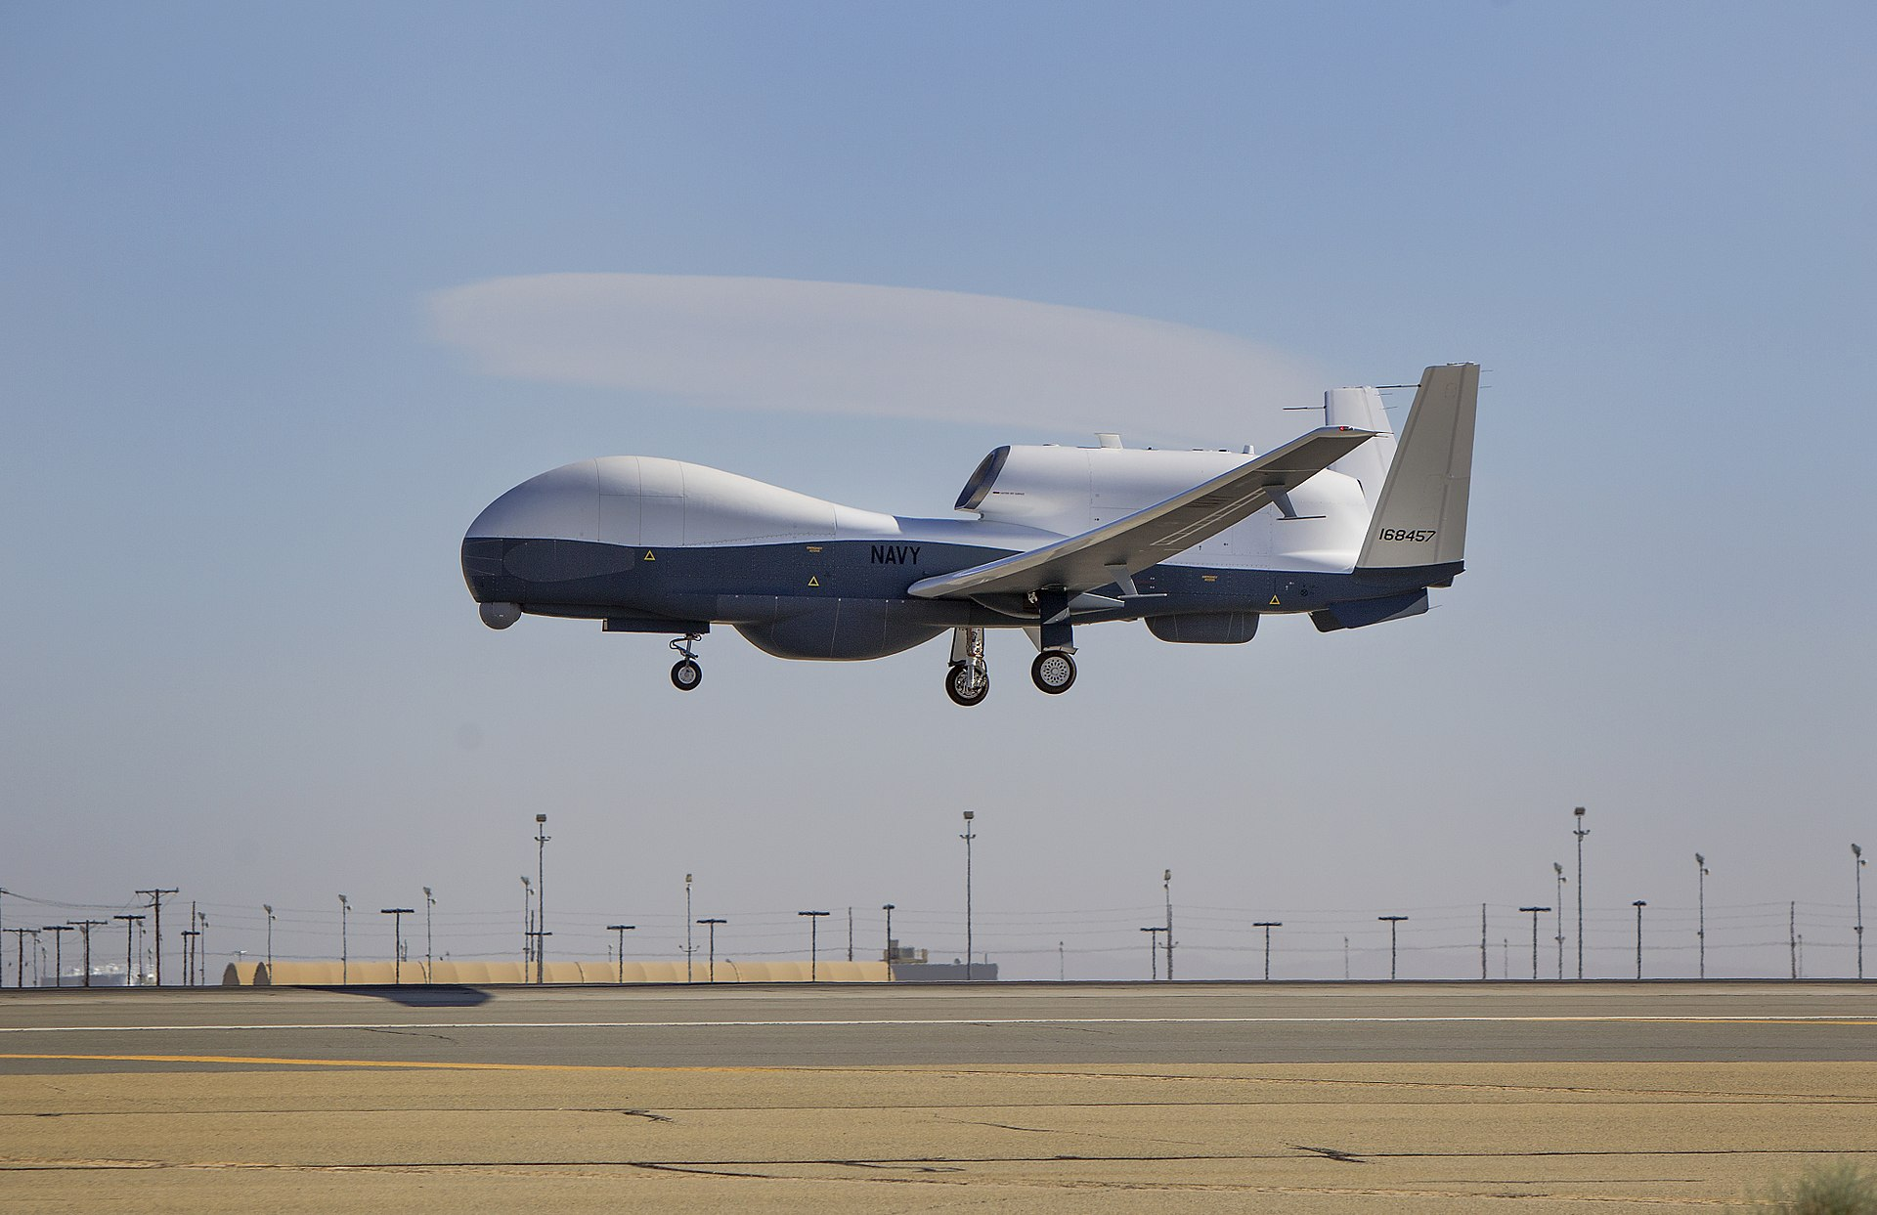
Unmanned Aircraft
MQ-8C ‘Fire Scout’
Fire Scout operates from air-capable surface ships and significantly improves over-the-horizon surveillance capability
MQ-4C ‘Triton’
Triton provides operational and tactical users a continuous source of information to maintain a tactical overview of the maritime battle space.
Notes:
As an adjunct to the P-8A, the MQ-4C Triton, formerly known as BAMS, will provide combat information to operational and tactical users such as the Expeditionary Strike Group (ESG), Carrier Strike Group (CSG) and the Joint Forces Maritime Component Commander (JFMCC) intelligence based on a more continuous source of information to maintain the Common Operational and Tactical Picture (COTP) of the maritime battle space. Additionally, collected data can be posted to the Global Information Grid (GIG), which will support a variety of intelligence activities and nodes. The MQ-4C Triton will also be used alone or in conjunction with other assets to respond to theater-level operational or national strategic tasking.
RQ-8A/MQ-8B Fire Scout will operate from air-capable ships with initial deployment on the Littoral Combat Ship (LCS). The system is capable of 12 continuous hours of operations providing coverage 110 nautical miles from the launch site.

Slide 22
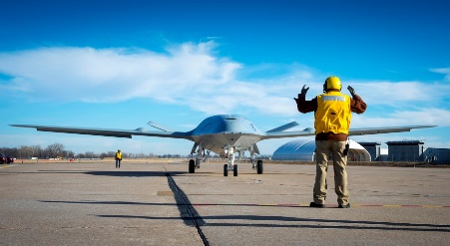
Future Aircraft
MQ-25 ‘Stingray’
Navy’s first unmanned carrier-based aircraft, which will provided airborne tanking capability with airborne surveillance and reconnaissance capability.
Notes:
People ask: why hasn’t the Navy integrated unmanned aircraft to the CVN? The answer is safety, and luxury of space.
The Navy has take very deliberate steps to introduce unmanned aircraft to the CVN environment.
The hard part of unmanned aircraft, is not landing them on the ship. The Navy has had the technology to autonomously land aircraft on a CVN since the 1990’s with the introduction of Super Hornets. Landing was easy. The harder part was, how do you taxi it on flight deck without running into things. The Navy, unlike the Air Force does not have 2-mile long runways, with nothing on either side. The Navy was able to prove theability to do that with the X-47B drone. The hardest part, was how do you hook the drone into a catapult, when the tolerances are only inches? That was the biggest leap we ahd to make to introduce drones to the CVN environment.
The Navy already can autonomously land aircraft on an aircraft carrier. F/A-18s have that ability. The hard part is safely moving that aircraft around a 4.5-arce flight deck with 60 other aircraft in the way. The X-47B will test the software and systems to allow for future integration of unmanned systems onto an aircraft carrier flight deck.

Slide 23
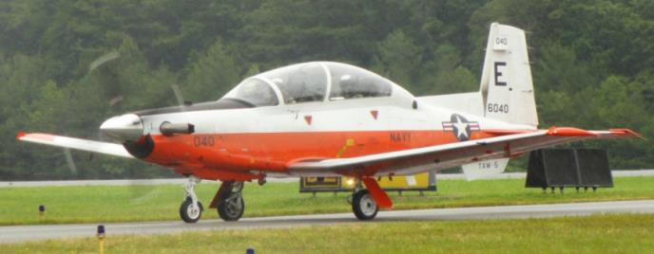
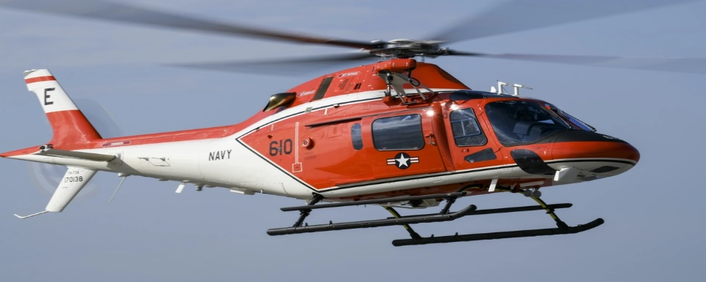
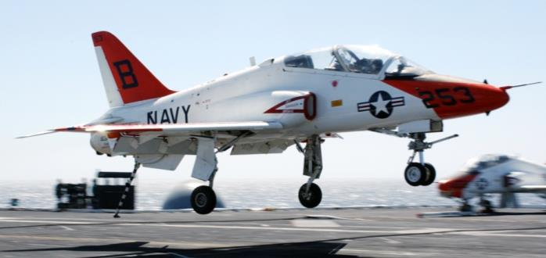
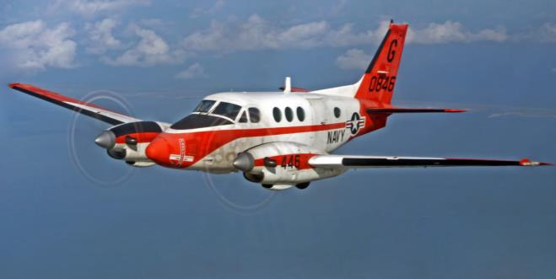
Navy Training Aircraft
T-6B II Texan Basic Flight Trainer
TH-73 Thrasher Helicopter Trainer
T-45 Goshawk Basic Jet Trainer – first 10 aircraft carrier landings before F/A-18 flights
T-44 Pegasus Multi-engine Trainer for future E-2C, C-2, and multi-engine pilots
Notes:
Many guests ask briefers about their pilot training pipeline and the aircraft they flew. This slide will help with describing the pilot training evolution.

Slide 24
Briefing Overview
Why do we need a Navy?
Naval Air Forces Mission
Navy’s Aviation Assets
-- Aircraft Carriers
Employing Naval Aviation
Underway Embarks

Slide 25
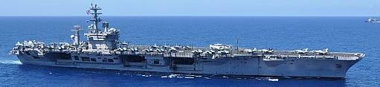
U.S. Navy Aircraft Carriers
Nimitz Class Statistics
Flight Deck Area: 4.5 acres
Displacement: 97,000 tons
Speed: 30+ knots
Aircraft: 65+
Personnel: Ship 2,800
Air Wing 2,000
Staff 200
Catapults: 4, steam powered
Cost: ~$8.5B FY12 (CVN77)
USS Nimitz (CVN 68), Bremerton, WA (first in class)
USS Eisenhower (CVN 69), Norfolk, VA
USS Carl Vinson (CVN 70), San Diego, CA
USS Theodore Roosevelt (CVN 71), Bremerton, WA
USS Abraham Lincoln (CVN 72), San Diego, CA
USS George Washington (CVN 73), Hampton, VA
USS John C. Stennis (CVN 74), Hampton, VA (refuel)
USS Harry S. Truman (CVN 75), Norfolk, VA
USS Ronald Reagan (CVN 76), Yokosuka, Japan
USS George H.W. Bush (CVN 77), Norfolk, VA
USS Gerald R. Ford (CVN 78), Norfolk, VA
Ford Class Statistics
Flight Deck Area: 4.6 acres
Displacement: 100,000 tons
Speed: 30+ knots
Aircraft: 65+
Personnel: Ship 2,440
Air Wing 2,000
Staff 200
Catapults: 4, Electromagnetic
Cost: ~$12.6B FY15 (1st 3 CVNs)
Notes:
Review where each aircraft carrier is home ported and note what state the ship is currently: Deployed, home port, training, etc.

Slide 26
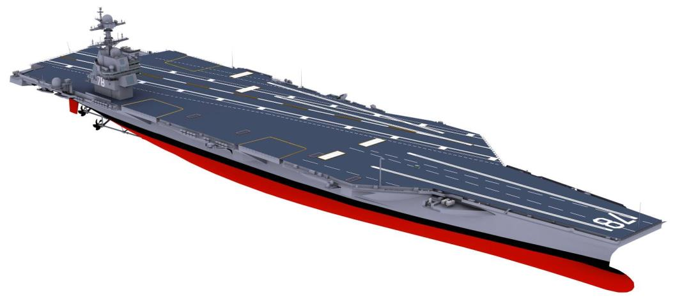
Gerald R. Ford Class CVN
Integrated Island
New Propulsion/Electric Plant
Smaller Island Re-Positioned Aft & Outboard
Dual Band Radar
Joint Precision Approach and Landing System
All Electric Aux Services
Zonal Electrical Distribution System
New Propulsion Plants
Improved Weapon & Material Handling
Enlarged Flight Deck Footprint
“Pit Stop”
Advanced Weapons Elevators
Advanced Arresting Gear
Aircraft Elevators (3)
Stbd Sponson Redesign
Enhanced Flight Deck
2 Hangar Bays
Electromagnetic Aircraft Launching System (4)
Underwater Protection
Evolved Sea Sparrow Missile
#4 Catapult Unrestricted
Improved Survivability
Enhanced Ship Self Defense
USS Gerald R. Ford (CVN 78), USS John F. Kennedy (CVN 79), USS Enterprise (CVN 80)
(Commissioned) (Launched) (Keel Laid)
Notes:
How valuable and vulnerable are Aircraft carriers? Recent discussion about viability of the CVN revolve around finding cheaper solutions, using cheaper platforms armed with cruise missiles.
OK, if the only mission is power projection or strike, missiles could work. BUT, there’s much more to suppressing foes and influencing nations than pointing a missile at them. Missiles cannot stay aloft. Once fired, they seek a target and are used up. Aircraft from aircraft carriers can fly many times, fire many missiles, drop many bombs, and move across vast oceans.
-- If the only tool in your toolbox is a hammer, you better hope that every problem is a Nail
-- CVN/CSG operation spans the spectrum of scenarios.
-- Look at what we get for the investment – 50 year service life designed into each aircraft carrier – the FORD Class may serve into the 22nd century!
-- Another perspective: the LAST commanding officer of the USS FORD, is no more than a toddler TODAY.

Slide 27
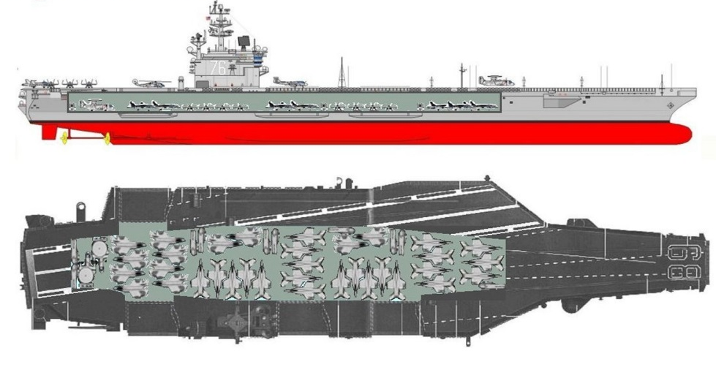
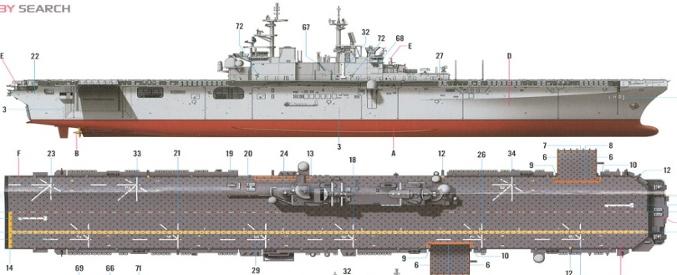
Aircraft Carrier vs LHD/LHA
Nimitz-Class Aircraft Carrier (Super Carrier)
Displacement: 97,000 tons
Aircraft: F/A-18E/F Super Hornet, F/A-18C Hornet, EA-18G Growlers, E-2C/D Hawkeyes, C-2 Greyhound, SH-60R/S Seahawk
Dimensions: 1,092 x 252 feet
Speed: 30 knots
Ship’s Personnel: 2,800 With Air Wing & Staff: 5,000
Mission: Support and operate aircraft that engage in attacks on airborne, afloat and ashore targets that threaten free use of the sea; and engage in sustained power projection operations in support of U.S. and coalition forces.
(1,092)
America-Class Amphibious Assault Ship
Displacement : 45,000 tons
Aircraft: F-35B Lightning II, MV-22 Osprey, CH-53E Sea Stallion, UH-1 Huey, AH-1Z Super Cobra, MH-60S Seahawk
Dimensions: 844 x 106 feet
Speed: 20 knots
Ship’s Personnel: 1,059 Marine Contingent: 2,500
Mission: Provide the U.S. Marine Corps with a means of ship-to-shore movement by helicopter in addition to movement by landing craft.
(844)

Slide 28
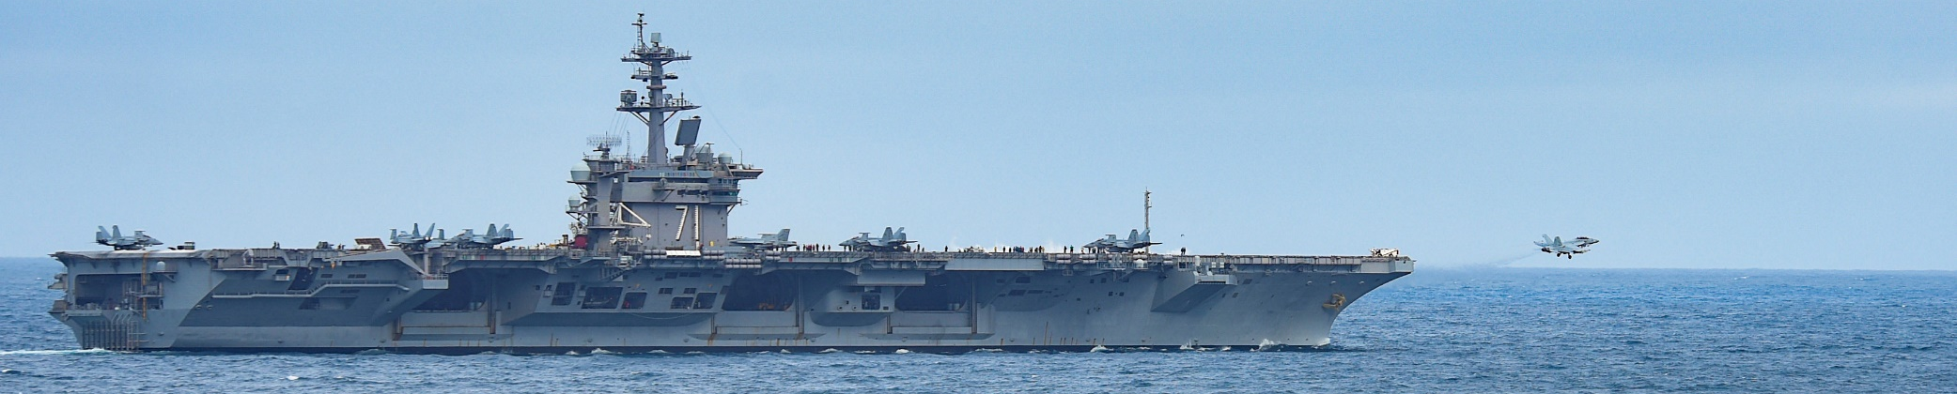
U.S. Navy Aircraft Carriers
Nuclear-Powered Aircraft Carrier Value:
Unmatched Superiority: No other nation can put to sea on a single ship, the maritime combat power of a CVN and its Air Wing.
Size: Supports +65 aircraft and adaptable to future air wing growth
Deploy & redeploy: Endurance & flexibility are hallmarks of a nuclear aircraft carrier.
Mobile airfield: Makes adversary targeting a complex problem.
Survivable: Can evade enemy attack, more so than land-based locations.
Sovereign U.S. territory: Does not require host nation permission to employ forces.
Notes:
How valuable and vulnerable are Aircraft carriers? Recent discussion about viability of the CVN revolve around finding cheaper solutions, using cheaper platforms armed with cruise missiles.
OK, if the only mission is power projection or strike, missiles could work. BUT, there’s much more to suppressing foes and influencing nations than pointing a missile at them. Missiles cannot stay aloft. Once fired, they seek a target and are used up. Aircraft from aircraft carriers can fly many times, fire many missiles, drop many bombs, and move across vast oceans.
-- If the only tool in your toolbox is a hammer, you better hope that every problem is a Nail
-- CVN/CSG operation spans the spectrum of scenarios.
-- Look at what we get for the investment – 50 year service life designed into each aircraft carrier – the FORD Class may serve into the 22nd century!
-- Another perspective: the LAST commanding officer of the USS FORD, is probably in pre-school TODAY.

Slide 29




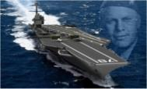






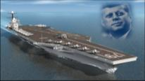

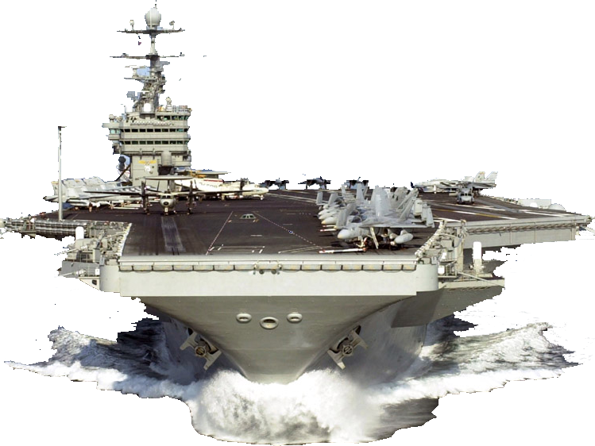
Value of CVNs: 50 years of service
NIMITZ Class: 10 Aircraft carriers spanning 84 years in service, from 1975 through 2059
- Over half way through the service life of the NIMITZ Class CVN force
- When a CVN retires, it retires as an unequalled, world-class combat ship. Their importance does not diminish with age
FORD Class: 4 aircraft carriers (10 planned), serving 2017 until 2110 (Planned)
CVN 71
CVN 74
CVN 76
CVN 68
CVN 78
CVN 80 – USS ENTERPRISE
CVN 77
CVN 70
CVN 73
Years CVNs scheduled to retire:
RCOH
2015
2025
2035
2045
2055
2065
2075
CVN 69
CVN 72
CVN 79 – USS Kennedy
CVN 75

Slide 30
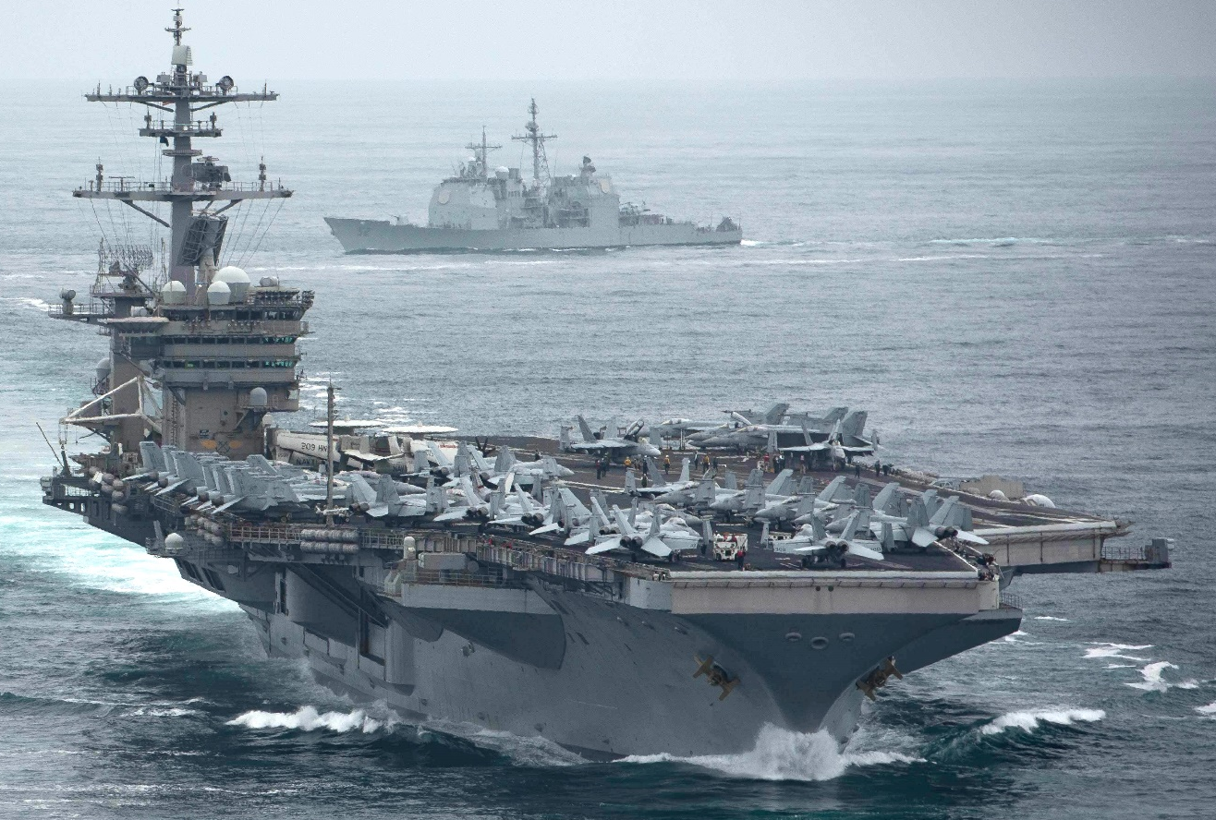
U.S. Navy Aircraft Carriers
Nuclear-Powered Aircraft Carrier Value:
Lethality: A large-deck nuclear aircraft carrier with an embarked carrier air wing is a lethal military force:
Speed: Reduces transit time, hard to target.
Reach: Combat ops exceed 1,000 nm, with in-flight refueling
Mass: Strike/fighter aircraft can engage multiple targets
Precision: Pinpoint accuracy and tailored warheads
Sustained Operations: Weeks of operations without resupply.

Slide 31

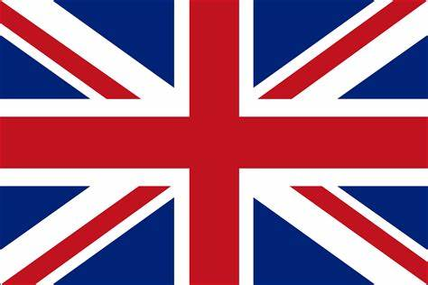



World Aircraft Carriers
World maritime powers recognize the value of aircraft carriers, and are actively expanding their existing fleets.
China: Two active aircraft carriers (no catapults). A larger aircraft carrier with catapults under construction. Announced plans for a fourth aircraft carrier.
United Kingdom: Two active aircraft carriers (no catapults).
India: Two active aircraft carriers (no catapults). Considering building a third.
France: One active aircraft carrier (two catapults). Only other nation with a nuclear-powered aircraft carrier
Russia: One active aircraft carrier (no catapults).

Slide 32
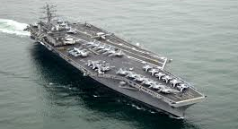
U.S. Navy Aircraft Carriers
Chain of Command
Commanding Officer
Command Master Chief
Executive Officer
Admin Officer
  Educational Services
  Personnel Officer
  Ship’s Secretary
Chaplain
& Public Affairs
Air Department
AIMD (Aircraft Maintenance.)
Deck Department
Dental Department
Engineering Department
Legal Department
Medical Department
Navigation
Department
Operations Department
Reactor
Department
Safety Department
Supply Department
Training Department
Weapons Department

Slide 33
Briefing Overview
Why do we need a Navy?
Naval Air Forces Mission
Navy’s Aviation Assets
-- Carrier Air Wings
Employing Naval Aviation
Underway Embarks

Slide 34
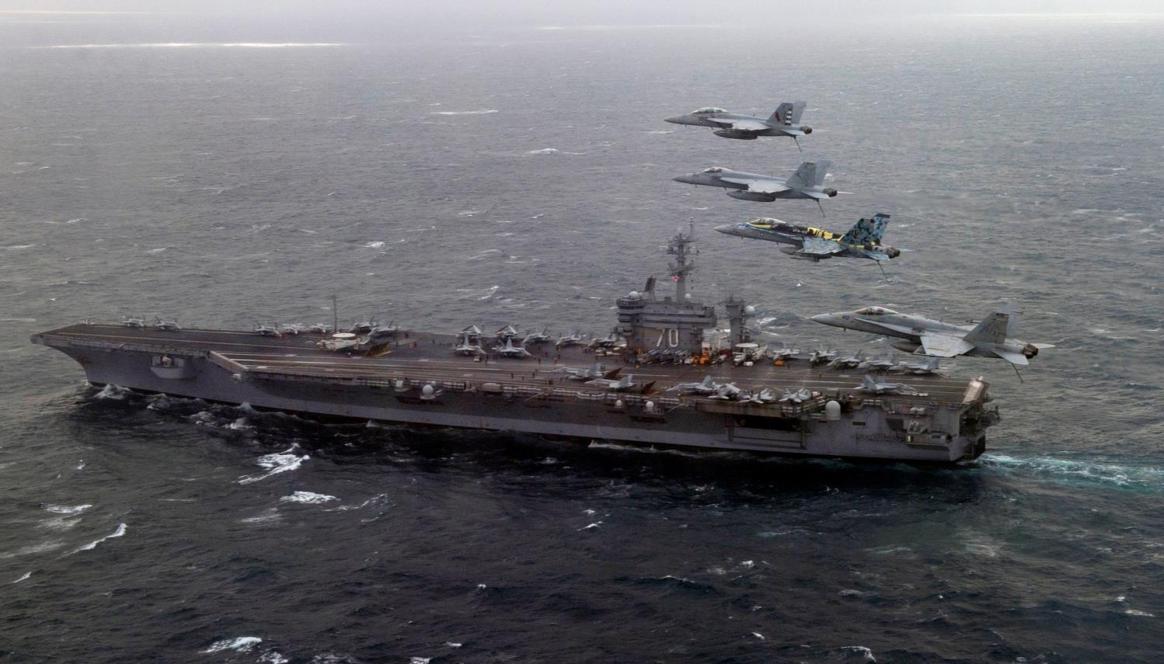
Carrier Air Wing composition
VFA-1 12 x F/A-18E or F-35C
VFA-2 12 x F/A-18E
VFA-3 10 x F/A-18F
VFA-4 10 x F/A-18F
VAQ-5 5 x EA-18G
VAW-6 4 x E-2D
HSC-7 8 x MH-60S
HSM-8 11 x MH-60R
VRC-9 2 x C-2A or 3 CMV-22B
Fighter/Attack
Electronic Warfare
Airborne Early Warning
Multi-use helicopters
Logistics
- Nuclear Powered Aircraft Carrier - Ticonderoga-Class Cruisers
- Arleigh Burke-Class Destroyers - Combat Stores Ship
~ Los Angeles-Class Submarine ~ Perry Class Frigates
~ 74 aircraft, with helicopters on escorting ships
Notes:
This slide provides a visual breakdown of the number and type of squadrons on a CVN.

Slide 35
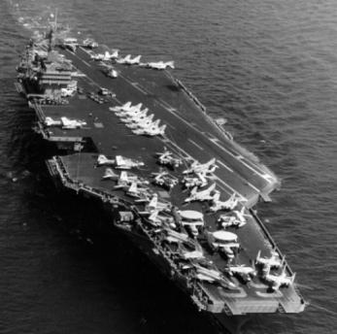
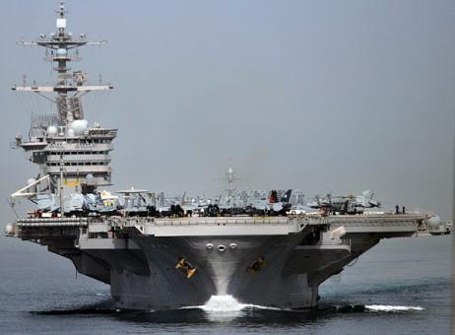
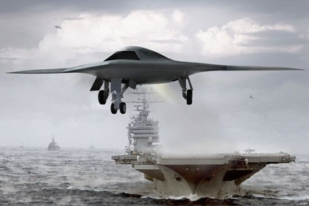
Air Wings Continually Evolve
Nimitz New – 1975
F-4J Phantom / F-14 Tomcat
A-6 Intruder / A-7 Corsair II
S-3 Viking
RA-5 Vigilante
E-2B Hawkeye
EA-6B Prowler
C-2 Greyhound
SH-3 Sea King /
SH-46 Sea Knight
NIMITZ – 2000s
F/A-18E/F Super Hornet
F-14D Super Tomcat
F/A-18 A/C Hornet
E-2C Hawkeye
EA-6B Prowler
SH-60B/F Sea Hawk
C-2 Greyhound
NIMITZ Retires – 2025
F-35C Lightning II
F/A-18E/F Super Hornet
E-2D Advanced Hawkeye
EA-18G Growler
MH-60R/S Sea Hawk
CMV-22 Osprey
MQ-25 Stingray
  A CVN and Carrier Strike Group remains relevant as its Air Wing EVOLVES to match changing threats and technologies
Notes:
Other ships are retired when the primary weapons system is obsolete.
The CVN and CVW evolve – look at how the NIMITZ Class CVW has changed…
FORD’s Air Wing in 2066 will be radically different from FORD Air Wing in 2016
CVN remains relevant over 50 years BECAUSE it evolves to integrate changing Air Wing.
This is what keeps the CVN Viable, Credible and Necessary…

Slide 36
Briefing Overview
Why do we need a Navy?
Naval Air Forces Mission
Navy’s Aviation Assets
Employing Naval Aviation
-- Carrier Strike Groups
Underway Embarks

Slide 37
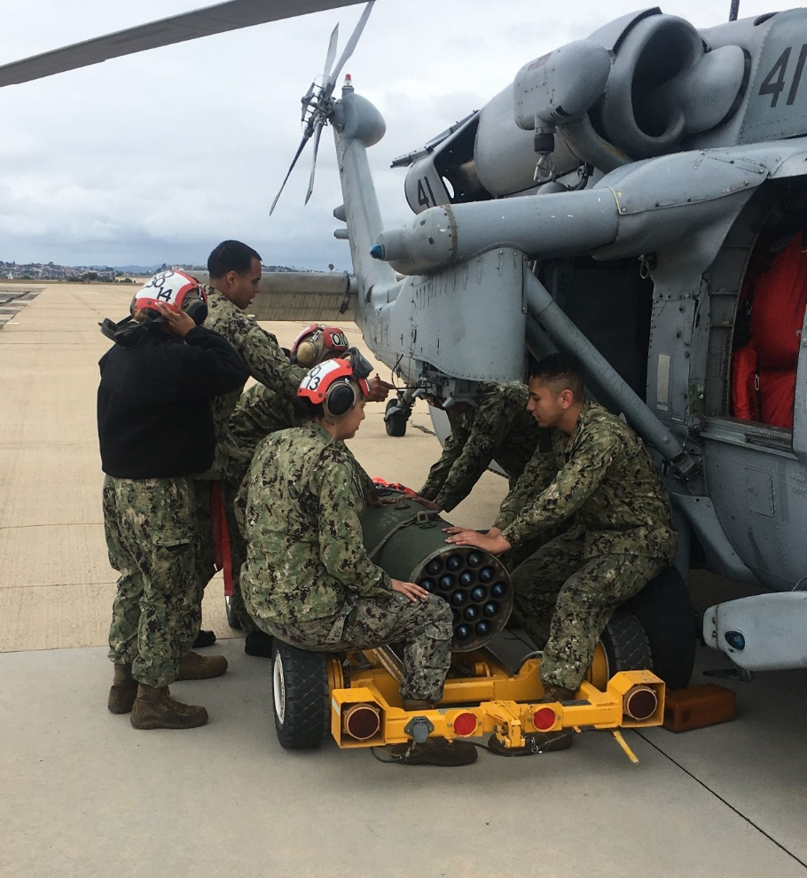
Why We Deploy
To provide a world-wide presence of credible combat forces that support operational and diplomatic objectives.
-- Diplomacy in action
-- Visible presence for allies
-- Crisis response
    Armed response
    Humanitarian aide

Slide 38
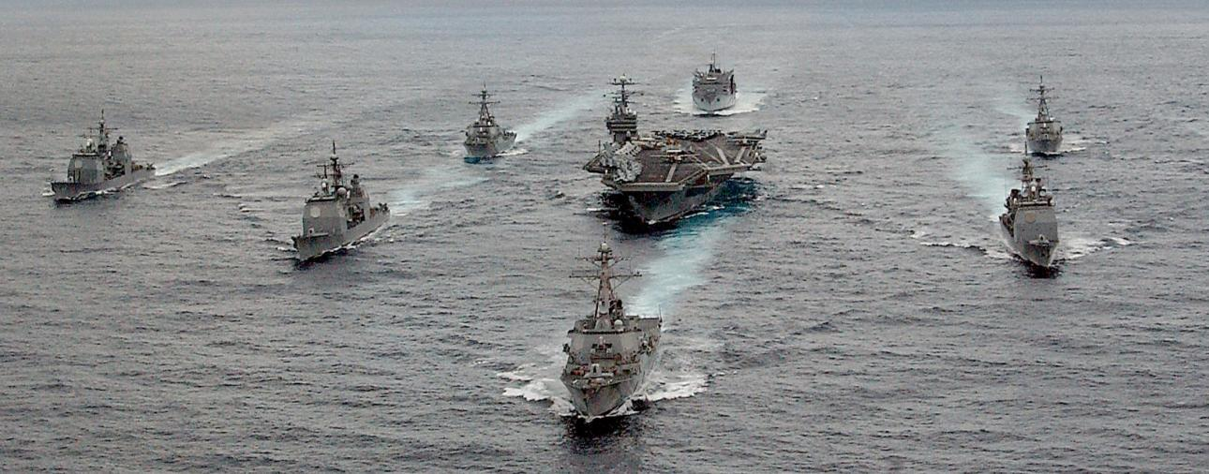
Carrier Strike Group
A CSG is of a mix of 6 – 8 ships including:
- Nuclear Powered Aircraft Carrier - Ticonderoga-Class Cruiser
- Arleigh Burke-Class Destroyers - Combat Stores Ship (close proximity)
~ Fast Attack Class Submarine (Close proximity)
Notes:
Point out each type of ship, and describe its role in the Battle Group.
You will NEVER see an aircraft carrier battle group steaming like this, unless its for a family photo, like this one.
Battle Group is centered around an aircraft carrier.
Cruisers are the group’s Air Defense platforms. If any hostile aircraft approached the aircraft carrier and there were no aircraft flying to engage them, the Cruisers would engage with missiles to remove the threat.
Destroyers are highly-versatile missile platforms. Each Arleigh Burke destroyer carries up to 96 missiles and torpedoes to engage sub-surface, surface, and air targets.
A combat stores ship accompanies each CSG, and conducts underway replenishments every 3-5 days when deployed. It’s always good to stay “topped-off” on fuel and supplies, because the CSG may be called elsewhere and could potentially out-pace its supply ship.
A Los Angeles class submarine may, or may not, be assigned to a CSG. Only the Admiral’s staff or any of the Destroyers that happen to ‘hear’ it on passive sonar would know where it’s at.

Slide 39
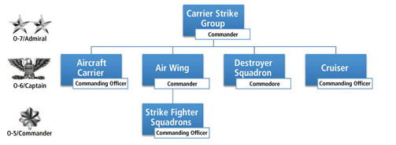
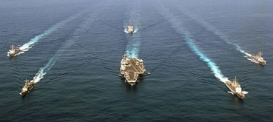
Carrier Strike Group
Notes:
Number of Squadrons:
168 Fleet, Reserve, and Training Squadrons. Includes Blue Angels.

Slide 40
The Carrier Strike Group Value
Combatant Commanders know the value of CSGs, and are unrelenting in their requests for aircraft carrier deployments to protect, deter, fight, and win, within their theater of operations.
In high-end warfare, Carrier Strike Groups constantly move, complicating an enemy's targeting; and can launch strikes in collaboration with Joint Forces.
CSGs are one of the most requested assets among Fleet and combatant commanders.
“You must be present to win.” The mobility and flexibility that a CSG can bring to a region with its surface ships and aircraft carrier, can influence nations for hundreds of miles.
The CSG provides national command authority and regional commanders: options, access, and forward presence that allows for a rapid response to a wide spectrum of threats.
CSG escort ships ensure the survivability of the aircraft carrier, enabling the U.S. to continue its role as a key guarantor of peace and stability around the world.

Slide 41
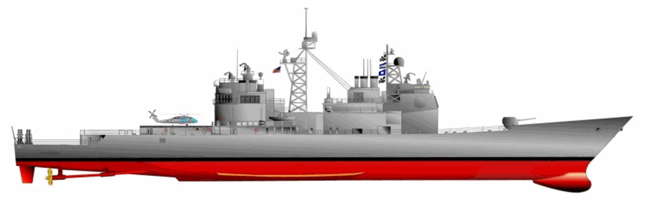

The Carrier Strike Group ships
Ticonderoga Class Cruiser
Multi-mission Air Warfare (AW), Undersea Warfare (USW), Naval Surface Fire Support (NSFS) and Surface Warfare (SUW) capable. Supports carrier battle groups, amphibious forces, or operates alone and as flagships of surface action groups.
Arleigh Burke Destroyer
Guided missile destroyers provide multi-mission offensive and defensive capabilities. They can operate independently or as part of Carrier Strike Groups, Surface Action Groups, and Expeditionary Strike Groups.

Slide 42

Employing Naval Aviation
We are a force provider
2nd
6th
3rd
USINDOPACOM
7th
4th
5th
10th
The DoD Unified Command Plan sets missions and geographic responsibilities among combatant commanders. The Navy’s numbered Fleets report to those DoD commanders and provide a worldwide presence, unmatched deterrence, and allows for control of the seas
Notes:
Our mission is to man, train, equip and maintain a Naval Air Force that is: Forward deployed, Immediately employable, and Engaged.
We support the Unified and Fleet Commanders by delivering the right force with the right readiness at the right time.

Slide 43

Employing Naval Aviation
Forward Presence, Deterrence, and Sea Control
Deployed aircraft carrier in 6th or 5th Fleet
CVNs deploy from San Diego, CA
CVN s deploy from Norfolk, VA
Forward deployed aircraft carrier in Japan
Aircraft Carrier mobility is critical to mission success
7 Day Response: ~3360 Nautical Miles @ 20 knots
Notes:
We use the sea as maneuvering space to our advantage
-- Brings us credible power over a range of naval Missions
-- Slide shows that within one week, we can position a carrier strike groups across much of the globe
-- That goes to the responsiveness of our CSG Forces and highlights the problem for the enemy: It is difficult to find, fix, track and target a moving vessel at sea.

Slide 44



Employing Naval Aviation
Power Projection
700
600
400
400
200
20 to 30 days to transit
200
On station up to six months
CVN-based combat missions against ISIS aggression in Northern Iraq and Syria
Notes:
Power projection is what a Carrier Strike Group does best.
It takes West coast Aircraft Carrier about 30 days to transit more than half way around the world to support operations in the 5th Fleet Area of Operations (top-left map)
When supporting operations in Afghanistan, it’s important to note the geography involved (middle map). Afghanistan is a land-locked country. Our aircraft have to overfly Pakistan to reach Afghanistan. To the West of Afghanistan is Iran, which will not allow overflights of it’s territory, and approaching the country from the North involves flying over a half-dozen other “stans” and getting their approval and coordination for the flights.
Our carriers operate 75-100 miles off the coast (right map). Just to reach their area of operation in Afghanistan takes more than an hour to get there. They top off fuel with a tanker, conduct whatever missions they’re assigned for several hours, refuel again, and fly back to the carrier to land on the ship. Pilots spend 6 – 8 hours in the cockpit when conducting operations.
- In 2013 The Navy saved the nation of Iraq from ISIS. An entire Iraqi brigade in Northern Iraq walked away from their base, leaving all gear behind. ISIS swooped in, and gathered that material, and began a campaign heading south to Bagdad. CVN77 was diverted from Afghanistan to Persian Gulf, and bombed ISIS on outskirts of Bagdad. Air Force is in Saudi Arabia, but could not secure host nation permission to launch into Iraq. As long as CVN is in international water, we do not need any nations permission to launch. Only the Presidents. It was the Navy that save Iraq from falling to ISIS

Slide 45

Employing Naval Aviation
Underway Replenishment
The ability of U.S. Navy ships to remain ‘on station’ is vital to sustained operations and U.S. interests

Slide 46


Employing Naval Aviation
Maritime Security & Humanitarian Assistance
Humanitarian Aid Relief provides an immediate disaster response that saves lives. CVNs and LHDs can deliver water, food, and survival items to a devastated region within days, prior to relief organizations.
Maritime Security efforts focus on common, global threats including: proliferation, smuggling, piracy, and terrorism. Naval Aviation assets provide long-range patrol and escort security for vessels transiting around the world
Navy Humanitarian Aid successes:
2014 Philippines Typhoon
2011 Japan Earthquake & Tsunami
2010 Haiti Earthquake
2004 Indian Ocean Tsunami
Notes:
U.S. maritime forces build confidence and trust among nations through collective maritime security efforts that focus on common threats: proliferation, smuggling, piracy, terrorism; and mutual interests.

Slide 47
Briefing Overview
Why do we need a Navy?
Naval Air Forces Mission
Navy’s Aviation Assets
Employing Naval Aviation
-- Life at Sea
Underway Embarks

Slide 48
Daily Life at Sea
Busy schedule & long days: +12 hours daily
  Watch standing -- Flying
  Maintenance -- Administration
  Training, training, training
Four meals per day / every day:
  Breakfast -- Lunch
  Dinner -- “MIDRATS”
Off duty time:
  Email (limited wifi) -- Gym
  Comradery -- Study
  Professional development -- Shipboard Television

Slide 49

The Flight Deck

Slide 50


Carrier Landing

Slide 51








Flight Deck Rainbow Wardrobe
Catapult Officers / Directors
Safety / Medical & Observers
Crash / Ordnance
Color defines job
Maintenance
Fuels
Plane Captains
Handlers
Notes:
When viewing flight operations, one of the first things you’ll notice besides the aircraft, will be the hard-working Sailors and the variety of colors they wear while working on the flight deck. They color shirt they wear indicates the type of work they do on the flight deck.
Yellow Shirts, or Directors, are the senior-most people on the flight deck. They’re officers or Chiefs and usually wear khaki pants. They work for the ship.
White Shirts are for Safety, Medical, and Observers. They can be ship, squadron, or Wing personnel. You’ll be wearing white float coats when on the flight deck.
Red Shirts are Crash or Ordnance workers. They operate the small fire trucks on the flight deck, as well as build, load, and unload munitions from the aircraft. They can be ship or squadron personnel.
Green Shirts are maintainers. They work on repairing aircraft as well as shipboard equipment on the flight deck. They can be ship or squadron personnel.
Purple Shirts, or Grapes, are the fuelers. They haul thick, heavy black hoses around the flight deck to fuel and de-fuel aircraft. They can be ship or squadron personnel.
Brown Shirts are Plane Captains. They are assigned to the squadron, and are usually responsible for prepping aircraft for flight, and scheduling work/maintenance for aircraft when needed. They’re responsible for ensuring aircraft are ready for flight.
Blue Shirts are the Handlers. They’re generally the most junior Sailors on the flight deck. They move aircraft using tow tractors and chalk and chain the aircraft to the flight deck. They typically aspire to become one of the other “shirts” on the flight deck.

Slide 52
Briefing Overview
Why do we need a Navy?
Naval Air Forces Mission
Navy’s Aviation Assets
Employing Naval Aviation
Underway Embarks

Slide 53
Navy Underway Embarks
Purpose of Embarks
Because U.S. Navy assets and personnel predominately operate at sea, over the horizon, and out of sight, the service is challenged to demonstrate and communicate its mission in an impactful way to U.S. citizens.
The purpose of embarks is to increase public awareness, knowledge and favorability; and inspire support to the service and it’s Sailors by affording citizens the opportunity to view the daily operations of a vessel at sea.
-- Embarking civilian guests furthers public awareness of the U.S. Navy and its mission, by helping to facilitate a greater understanding of the role and mission of the Navy.
-- Embarks provide guests the opportunity to view their Navy in action, have direct dialogue with Officers and Sailors, and experience first-hand, the unique capabilities of at-sea operations.
-- Embarks allow Sailors to demonstrate their professionalism in a manner that can only be experienced in an at-sea environment.

Slide 54
Navy Underway Embarks
Participation Criteria
Embark opportunities are limited. While the Navy would like to invite every American to see the professionalism of our officers and Sailors firsthand, that isn’t possible.
-- Due to high-interest and the low number of guests the Navy can host annually, selecting a good cross-section of people from various backgrounds is critical to the program’s success.
-- A guest's ability to communicate their experience to a significant secondary audience, either professionally or personally is considered when selecting guests for participation.
Participants should be active and influential in their community, business, or government. Examples include: Presidents/Deans of colleges, influential civic and community leaders, educators, Congressional representatives, mayors, governors, presidents or chief executive officers of corporations and businesses, select news media, and leaders of community-based organizations who have not had exposure to the Navy, or at-sea operations.

Slide 55
Navy Underway Embarks
Nomination Process
Anyone can nominate a guest in accordance with the Navy’s eligibility criteria.
-- Anyone involved in making a nomination cannot sell, barter, trade, auction, or seek favor for making an individual, or group nomination.
There are three primary ways to nominate someone:
1) Nominations made via CHINFO or Navy PAOs.
-- Those nominations are made using this link: https://forms.office.com/r/Ti8mh6quZ1
-- Nominations must be entered by a Navy PAO, or service member.
-- Guests nominated via this link are placed on a separate waiting list and afforded a higher priority when embarks are available.
2) General guest nominations made / submitted directly to CNAP / CNAL PAO.
-- Those nominations are made using this link: https://forms.office.com/r/GF9tcUTKg7
-- Guests nominated via this link are placed on a general waiting list and are solicited when seats are available.
3) Direct to Navy Commands / Public Affairs staffs.

Slide 56
Navy Underway Embarks
Selecting Embark Participants
Participants are selected by Type Commands and numbered Fleet Commanders.
-- The Navy’s goal is to target educators, youth influencers, and community leaders.
-- Filing embark seats is an arduous process for Navy staffs and entails reviewing waiting lists, sending email solicitations, waiting for responses, and then registering participants.
-- When a guest accepts, they’re sent information / screening documents to complete & return

Slide 57
Navy Underway Embarks
Guest Screening
All embark guests must complete and submit some type of embark registration / screening form.
-- Each command / platform uses a different screening process.
Screening data generally includes: Personal contact, employment, NOK data, health / medical responses, waivers, and releases.
Guest profile responses / data is reviewed by Navy staffs:
-- If there are no screening issues, the guest is manifested.
-- If concerns are identified (usually medical), the profile data is sent to the appropriate medical staff for review & recommendation.
-- Submarine embarks require that an undersea medical officer review all medical screening responses.
-- Guest data is protected as much as possible throughout the screening process.

Slide 58

Navy Underway Embarks
Aircraft Carrier Embark
A typical CVN embark entails:
-- Guests escorted onto installation by PAO
-- Presented a pre-embark brief by O-6, or O-5
-- Fly to CVN via C-2, CMV-22, or helo
-- Meet & engage leaders (CO, XO, CMC, and Flag Officer / staff)
-- Observe flight operations
-- Remain over one night in staterooms
-- Dine with the crew
-- Guests are charged meals provided by ship
-- Tour bow to stern
-- Return to NAS via C-2, CMV-22B, or helo
-- Escorted off installation by PAO

Slide 59

Navy Underway Embarks
Surface Ship Embark
A surface ship embark entails:
-- Guests met by PAO
-- Given a pre-embark brief by Admiral or COS
-- Breakfast and harbor tour aboard the Admirals’ Barge
-- Flown to host ship via helicopter
-- Meet & engage with ship’s leadership
-- Tours highlighting principal ship operations
-- Lunch in Wardroom. Guests charged for meal
-- Return to NAS via helicopter same day
-- Escorted off installation by PAO

Slide 60

Navy Underway Embarks
Submarine Embark
A Submarine daylight embark entails:
-- Arrive submarine, met by CO
-- In-brief with XO
-- Submarine gets underway
-- Tour Bridge and Forward Compartment
-- Lunch
-- Observe Submerging from Control
-- Observe Angles from Control
-- Tour Engine Room and aft spaces
-- Surface, meet with Crew
-- Photo Op in Bridge
-- Return to pier
-- Civilian guests depart

Slide 61

QUESTIONS?
QR code to CNAP & CNAL online Nomination Form

Slide 62
Back-up Slides:

Slide 63
Navy Comparison
Russia’s Navy:
1 aircraft carrier
1 battlecruiser
3 cruisers
15 destroyers
10 frigates
81 corvettes
20 landing ship tanks
32 landing craft
15 special-purpose ships
1 patrol ships
42 patrol boats
46 mine countermeasures
3 special-ops subs
64 submarines
China’s Navy:
2 aircraft carriers
33 destroyers
50 frigates
41 corvettes
109 missile boats
6 Amphibious transport
32 landing ship tanks
31 landing ship medium
94 submarine chasers
17 gunboats
29 mine countermeasure
75 submarines
12 replenishment ships
United States’ Navy:
20 Aircraft Carriers (+LHA/LHD)
22 Cruisers
69 Guided Missile Destroyers
19 Littoral Combat Ships
2 Command Ships
11 Amphibious Transport (LPD)
12 Landing ship Dock (LSD)
73 Submarines
13 Coastal Patrol (PC)
10 Mine Countermeasure
25 Supply/Replenishment
(+77 Auxiliary, non-combat)

Slide 64
Squadrons and Designations
Squadron Types:
HSC = Helicopter Sea Combat Squadron
HSM = Helicopter Maritime Strike Squadron
HT = Helicopter Training Squadron
VAQ = Electronics Warfare Squadron
VAW = Airborne Early Warning Squadron
VFA = Fighter Attack Squadron
VP/VPU/VUP = Patrol Squadron
VQ = Fleet Air Reconnaissance
VR/VRC = Fleet Logistics Support Squadron
VT = Training Squadron
VX = Research / Experimental
Squadron Designations:
The letters specify the mission or type of squadron
A: Attack
C: Composite / Transport
E: Electronic
F: Fighter
H: Helicopter
M: Multi-mission / Mine
P: Patrol
Q: Electronics / Intelligence
R: Logistics
S: Strike / Sea / Submarine
T: Trainer
U: Utility
V: Fixed-Wing
X: Special Research
W: Warning / Radar
Notes:
The present system of designating naval aircraft was initiated in late 1962. This system applies to all U.S. military aircraft. All the aircraft designations have one thing in common—a hyphen. The letter just before the hyphen specifies the basic mission, or type, of aircraft. The basic mission letters are as follows:
A—Attack
C—Transport
E—Special electronic installation
F—Fighter
H—Helicopter
K—Tanker
P—Patrol
R—Reconnaissance
S—Antisubmarine
T—Trainer
U—Utility
V—VTOL and STOL
X—Research
If the aircraft has been modified from its original mission, a letter in front of the basic mission letter indicates its modified mission. Mission modification letters are as follows:
A—Attack
C—Transport
D—Director (for controlling drone aircraft or missiles)
E—Special electronic installation
H—Search/rescue
K—Tanker
L—Cold-weather aircraft (for Arctic or Antarctic operations)
M—Mine countermeasures
O—Observation
P—Patrol
Q—Drone
R—Reconnaissance
S—Antisubmarine
T—Trainer
U—Utility
V—Staff
W—Weather

Slide 65
Aircraft and Designations
Aircraft Types:
F/A-18E/F Super Hornet
F-35C Lightning II
E/A-18G Growler
MH-60R Seahawk
MH-60S Knighthawk
E-2C/D Hawkeye
C-2A Greyhound > CMV-22B Osprey
P-3C Orion > P-8 Poseidon
EP-3 Aries II
MQ-8 Fire Scout (UAV)
MQ-25 Stingray
E-6A/B Mercury
C-40 Clipper
Aircraft designations:
The letter(s) before the hyphen specifies the mission or type of aircraft.
A: Attack
C: Transport
E: Electronic
F: Fighter
H: Helicopter
K: Tanker
M: Multi-mission
P: Patrol
Q: Unmanned / Intelligence
T: Trainer
V: Vertical
Notes:
The present system of designating naval aircraft was initiated in late 1962. This system applies to all U.S. military aircraft. All the aircraft designations have one thing in common—a hyphen. The letter just before the hyphen specifies the basic mission, or type, of aircraft. The basic mission letters are as follows:
A—Attack
C—Transport
E—Special electronic installation
F—Fighter
H—Helicopter
K—Tanker
P—Patrol
R—Reconnaissance
S—Antisubmarine
T—Trainer
U—Utility
V—VTOL and STOL
X—Research
If the aircraft has been modified from its original mission, a letter in front of the basic mission letter indicates its modified mission. Mission modification letters are as follows:
A—Attack
C—Transport
D—Director (for controlling drone aircraft or missiles)
E—Special electronic installation
H—Search/rescue
K—Tanker
L—Cold-weather aircraft (for Arctic or Antarctic operations)
M—Mine countermeasures
O—Observation
P—Patrol
Q—Drone
R—Reconnaissance
S—Antisubmarine
T—Trainer
U—Utility
V—Staff
W—Weather

Slide 66
Navy Aircraft: Carrier-Based
F/A-18 E-F ‘Super Hornet’
(Advanced Strike-Fighter)
Highly capable across the full mission spectrum, long range, and aerial refueling capability
Primary Function: Multi-role attack and fighter aircraft.
Initial Operational Capability (IOC): Sept 2001.
Unit Cost: ~$57 million
Propulsion: Two F414-GE-400 turbofan engines. 22,000 pounds (9,977 kg) static thrust per engine.
Length: 60.3 feet (18.5 meters).
Height: 16 feet (4.87 meters).
Wingspan: 44.9 feet (13.68 meters).
Weight: Maximum Take Off Gross Weight is 66,000 pounds (29,932 kg).
Airspeed: Mach 1.8+.
Ceiling: 50,000+ feet.
Range: Combat: 1,275 nautical miles (2,346 kilometers)
Notes:
Describe each airframe and its associated missions/roles.
Super Hornets (E & Fs) are about 30% larger than the older A-D models. They can be differentiated by the shape of their air intakes. Super Hornets are squared intakes while the older Hornets have rounded intakes.

Slide 67
Navy Aircraft: Carrier-Based
Primary Function: Airborne Electronic Attack
Initial operational capability (IOC) Sept 2009
Unit Cost: ~$67 million
Propulsion: Two F414-GE-400 turbofan engines. 22,000 pounds (9,977 kg) static thrust per engine
Length: 60.2 feet (18.5 meters)
Height: 16 feet (4.87 meters)
Wingspan: 44.9 feet (13.68 meters)
Weight: 48,000 lbs..
Ceiling: 50,000 feet
Range: Combat: 850+ nautical miles Crew: 2
EA-18G ‘Growler’
(Electronic Warfare)
Integrates electronic attack technology, communication countermeasures, satellite communications and offensive weapons

Slide 68
Navy Aircraft: Carrier-Based
E-2D ‘Hawkeye’
(Airborne Early Warning)
Tactical battle management, airborne early warning, command and control aircraft
Primary Function: Airborne Command & Control, Battle Space Management.
Date Deployed: January 1964 (E-2A)
Unit Cost: $80 million.
Propulsion: Two Allison T-56-A427 turboprop engines; (5,100 shaft horsepower each).
Length: 57 feet 6 inches (17.5 meters).
Height: 18 feet 3 inches (5.6 meters).
Wingspan: 80 feet 7 inches (28 meters).
Weight: Max. gross, take-off: 53,000 lbs.. (23,850 kg) 40,200 lbs. basic (18,090 kg).
Airspeed: 300+ knots (345 miles, 552 km. per hour).
Ceiling: 30,000 feet (9,100 meters).
Crew: Five.

Slide 69
Navy Aircraft: Carrier-Based
C-2A ‘Greyhound’
(Logistics / Personnel)
Transport of high-priority cargo, mail, and passengers to aircraft carriers. Referred to as the ‘COD’ (Carrier On board Delivery)
Primary Function: Carrier On-board Delivery (COD) aircraft
Unit Cost: ~$38.96 million (1980s)
Propulsion: Two Allison T56-A-425 turboprop engines; 4,600 horsepower each
Length: 56 feet 10 inches (17.3 meters)
Height: 17 feet 2 inches (5.28 meters)
Wingspan: 80 feet 7 inches (24.5 meters)
Weight: Max. Gross, take-off: 57,500 lbs. (26,082 kg)
Airspeed: Cruise - Approximately 260 knots; Max - Approximately 343 knots
Ceiling: 30,000 feet (9,144 meters)
Range: 1,000 nautical miles (1150.78 statute miles)
Crew: Four

Slide 70
Navy Aircraft: Carrier-Based
CMV-22 ‘Osprey’
(Logistics / Personnel)
Replacing C-2A Greyhound starting in 2021. Transport of high-priority cargo, mail, and passengers.
Primary Function: Long-range resupply missions for CVNs at sea.
Date Deployed: 2009 (Marine Corps)
Propulsion: Two, Rolls-Royce Liberty AE1107C engines, 6,200 shaft horsepower
Length: 63 feet
Height: 22 feet, w/nacelles vertical.
Wingspan: 84.6 feet with rotors turning
Weight: Max. gross, vertical take-off: 52,600 lbs.. Short take-off 57,000 lbs.
Airspeed: Cruise: 280 knots
Ceiling: 25,000 feet (7,620 meters).
Range: 2,100 nautical miles with auxiliary fuel tanks
Crew: 4
Cargo: 22 Personnel

Slide 71

Navy Aircraft: Shore-Based
P-3C ‘Orion’
Maritime Surveillance (retiring)
Primary Function: Anti-Submarine warfare and Anti-Surface Warfare
Propulsion: Four Allison T-56-A-14 turboprop engines (4,600 hp each)
Length: 116.7 feet (35.57 meters)
Height: 33.7 feet (10.27 meters)
Wingspan: 99.6 feet (30.38 meters)
Weight: Maximum takeoff, 139,760 pounds (63,394 kilograms)
Airspeed: 411 knots; Cruise, 328 knots
Ceiling: 28,300 feet (8,626 meters)
Range: 2,380 nautical mile radius
Crew: 3 pilots, 2 flight officers, 2 engineers, 3 sensor operators and 1 in-flight technician
EP-3E ‘Aries II’
Signals Intelligence/ Reconnaissance
Notes:
The P-3 Orion has been the Navy’s frontline, land-based maritime patrol aircraft since the 1960s. Originally designed as a land-based, long-range, anti-submarine warfare (ASW) patrol aircraft, the P-3's mission evolved in the late 1990s to include surveillance and management of the battlespace, either at sea or over land.
The P-8A Poseidon is a modified Boeing 737-800ERX that is now replacing the aging P-3 Orion. The Poseidon will provide long-range maritime patrol capability. The aircraft features next-generation sensors that will dramatically improve anti-submarine warfare (ASW), and anti-surface warfare (ASuW) capabilities.
The EP-3E ARIES II is the Navy's only land-based signals intelligence (SIGINT) reconnaissance aircraft. The aircraft is based on the Orion P-3 airframe and provides fleet and theater commanders with near real-time tactical SIGINT. With sensitive receivers and high-gain dish antennas, the EP-3E exploits a wide range of electronic emissions from deep within targeted territory. EP-3Es will remain in service through 2019.

Slide 72
Navy Aircraft: Shore-Based
P-8 ‘Poseidon’
Maritime Surveillance (new)
Multi-mission maritime patrol and reconnaissance aircraft. Efficiently conducts anti-submarine warfare, anti-surface warfare, intelligence, surveillance, reconnaissance, and humanitarian response.
Primary Function: Anti-Submarine Warfare (ASW) and Anti-surface Warfare (ASuW), Intelligence, Surveillance and Reconnaissance (ISR)
Propulsion: 2 CFM 56-7B engines. 27,300 lbs.. thrust
Length: 129.5 feet (39.47 m).
Height: 42.1 feet (12.83 m).
Wingspan: 123.6 feet (37.64 m)
Weight: Maximum gross takeoff, 189,200 pounds (85,820 kg)
Airspeed: 490 knots
Ceiling: 41,000 feet
Range: 1,200 nautical miles radius with four hours on station
Crew: Nine
Notes:
The P-3 Orion has been the Navy’s frontline, land-based maritime patrol aircraft since the 1960s. Originally designed as a land-based, long-range, anti-submarine warfare (ASW) patrol aircraft, the P-3's mission evolved in the late 1990s to include surveillance and management of the battlespace, either at sea or over land.
The P-8A Poseidon is a modified Boeing 737-800ERX that is now replacing the aging P-3 Orion. The Poseidon will provide long-range maritime patrol capability. The aircraft features next-generation sensors that will dramatically improve anti-submarine warfare (ASW), and anti-surface warfare (ASuW) capabilities.
The EP-3E ARIES II is the Navy's only land-based signals intelligence (SIGINT) reconnaissance aircraft. The aircraft is based on the Orion P-3 airframe and provides fleet and theater commanders with near real-time tactical SIGINT. With sensitive receivers and high-gain dish antennas, the EP-3E exploits a wide range of electronic emissions from deep within targeted territory. EP-3Es will remain in service through 2019.

Slide 73
Navy Aircraft: Shore-Based
E-6A/B ‘Mercury’
Communications and Strategic Forces Airborne Command Post, known as TACAMO: Take Charge and Move Out
(Boeing 707)
Primary Function: Communications relay for fleet ballistic missile submarines and airborne command post for U.S. Strategic forces.
Date Deployed: October 1998.
Unit Cost: 141.7 million.
Propulsion: Four CFM-56-2A-2 High bypass turbofans.
Length: 150 feet, 4 inches (45.8 meters).
Height: 42 feet 5 inches (12.9 meters).
Wingspan: 148 feet, 4 inches (45.2 m).
Weight: Max gross, take-off. 342,000 lbs. (154,400 kg).
Airspeed: 522 knots, 600 miles (960 km)
Ceiling: Above 40,000 feet.
Range: 7,590 statute miles
Crew: 22
Notes:
E-6B Mercury airborne command post is a communications relay and strategic airborne command post aircraft that provides survivable, reliable, and endurable airborne command, control, and communications between the National Command Authority (NCA) and U.S. strategic and non-strategic forces. These aircraft are based at Tinker Air Force Base near Oklahoma City, OK.
The C-40A Clipper provides critical logistics support to the Navy. It is a Boeing 737-700 convertible, cost effective aircraft. Proven and reliable airframe, with low maintenance costs due to the prevalence of aircraft around the world.

Slide 74
Navy Aircraft: Shore-Based
C-40 ‘Clipper’
Personnel / cargo transport. Boeing 737 airframe. 3 configurations: All-passenger configuration, all-cargo, or combination of pallets and passengers.
Primary Function: Fleet logistics support.
Date Deployed: April 2001
Propulsion: Two CFM56-7 SLST engines.
Length: 110 feet 4 inches (33.63 meters).
Height: 41 feet 2 inches (12.55 meters).
Wingspan: 117 feet 5 inches (35.8 m).
Weight: Max. 171,000 lbs. (77,564 kg)
Taxi: 171,000 lbs. (77,564 kg)
Landing: 134,000 lbs. (60,781 kg)
Zero fuel: 126,000 lbs. (57,153 kg).
Airspeed: Range: 0.78 to 0.82 Mach (585 to 615 mph, 940 to 990 kph).
Ceiling: 41,000 feet (12,497 meters).
Range: 3,142 nautical miles (3,452 statute miles) with 121 passengers or 40,000 lbs.. (18,144 kg) of cargo.
Crew: Four.
Notes:
E-6B Mercury airborne command post is a communications relay and strategic airborne command post aircraft that provides survivable, reliable, and endurable airborne command, control, and communications between the National Command Authority (NCA) and U.S. strategic and non-strategic forces. These aircraft are based at Tinker Air Force Base near Oklahoma City, OK.
The C-40A Clipper provides critical logistics support to the Navy. It is a Boeing 737-700 convertible, cost effective aircraft. Proven and reliable airframe, with low maintenance costs due to the prevalence of aircraft around the world.

Slide 75
Navy Unmanned Aircraft
Primary Function: Maritime Intelligence, Surveillance, and Reconnaissance
Propulsion: Rolls-Royce AE3007H
Endurance: 24 + hours
Length: 47.6 feet (14.5 m)
Wingspan: 130.9 feet (39.9 m)
Height: 15.4 feet (4.7 m)
Speed: 320 knots
Crew: Five per ground station
MQ-4C ‘Triton’
Autonomously operated aircraft that provides a persistent maritime ISR capability using multiple sensors. Provides a continuous source of information to maintain a tactical overview of the maritime battle space.
Notes:
The Navy already can autonomously land aircraft on an aircraft carrier. F/A-18s have that ability. The hard part is safely moving that aircraft around a 4.5-arce flight deck with 60 other aircraft in the way. The X-47B will test the software and systems to allow for future integration of unmanned systems onto an aircraft carrier flight deck.
As an adjunct to the P-8A, the MQ-4C Triton, formerly known as BAMS, will provide combat information to operational and tactical users such as the Expeditionary Strike Group (ESG), Carrier Strike Group (CSG) and the Joint Forces Maritime Component Commander (JFMCC) intelligence based on a more continuous source of information to maintain the Common Operational and Tactical Picture (COTP) of the maritime battle space. Additionally, collected data can be posted to the Global Information Grid (GIG), which will support a variety of intelligence activities and nodes. The MQ-4C Triton will also be used alone or in conjunction with other assets to respond to theater-level operational or national strategic tasking.
RQ-8A/MQ-8B Fire Scout will operate from air-capable ships with initial deployment on the Littoral Combat Ship (LCS). The system is capable of 12 continuous hours of operations providing coverage 110 nautical miles from the launch site.

Slide 76

Navy Unmanned Aircraft
MQ-8B ‘Fire Scout’
MQ-8B currently operates from air-capable surface ships. Significantly improves over-the-horizon surveillance capability, with day and night real-time ISR target acquisition
MQ-8C ‘Fire Scout’
MQ-8C is being introduced to the Fleet with a range of 150 nautical miles and a 700 pounds payload capacity. Larger and more capable than the MQ-8B, it will be a force multiplier in the coming years.

Slide 77
Navy Unmanned Aircraft
MQ-25 ‘Stingray’
Navy’s first unmanned carrier-based aircraft, will provided airborne tanking capability with surveillance and reconnaissance capability which will enhance carrier capability and versatility.
The MQ-25 system will deliver a robust organic refueling capability to make better use of current combat strike fighters while extending the range of CVN combat aircraft.
Notes:
The Navy already can autonomously land aircraft on an aircraft carrier. F/A-18s have that ability. The hard part is safely moving that aircraft around a 4.5-arce flight deck with 60 other aircraft in the way. The X-47B will test the software and systems to allow for future integration of unmanned systems onto an aircraft carrier flight deck.
As an adjunct to the P-8A, the MQ-4C Triton, formerly known as BAMS, will provide combat information to operational and tactical users such as the Expeditionary Strike Group (ESG), Carrier Strike Group (CSG) and the Joint Forces Maritime Component Commander (JFMCC) intelligence based on a more continuous source of information to maintain the Common Operational and Tactical Picture (COTP) of the maritime battle space. Additionally, collected data can be posted to the Global Information Grid (GIG), which will support a variety of intelligence activities and nodes. The MQ-4C Triton will also be used alone or in conjunction with other assets to respond to theater-level operational or national strategic tasking.
RQ-8A/MQ-8B Fire Scout will operate from air-capable ships with initial deployment on the Littoral Combat Ship (LCS). The system is capable of 12 continuous hours of operations providing coverage 110 nautical miles from the launch site.

Slide 78

Navy Organization and Leaders
Chain of Command when on deployment
Air Wing Commander
(O-6)
Task Force Commander
(O-7 or O-8)
Numbered Fleet Commander
(O-9)
Commander Indo-Pacific Command
(DoD Unified Command)
(O-10)
President of the United States
(Elected)
Commander U.S. Pacific Fleet
(O-10)
Defense Secretary
(Appt’d)
Chain of Command when not deployed
Type Wing Commander
(O-6)
Commander Naval Air Forces
(O-8)
Chief of Naval Operations
(O-10)
Secretary of the Navy
(Appt’d)

