Slide 1

Strategic Planning
Bill James, Area President
January 10, 2024

Slide 2
Welcome!
We kindly request that you mute your phones.
If you have questions, we will take a moment after each speaker for discussion. You can also put them in the chat box.
This session will be recorded and available on the member dashboard.

Slide 3
Speakers
William (Bill) James, Area President, MN Council – VP Legislative Affairs

Slide 4
Why a Strategic plan?
Helps your councils set a roadmap for your priorities
By setting priorities, you can file a flight plan for execution
With a flight plan you can align your crewmembers by position/responsibility areas
Having a coordinated flight plan and crew assignments helps ensure mission success

Slide 5
Keep It Simple
The best plans are simple to understand and are clear in communication
Don’t feel like you have to ”boil the ocean” all at once
Focus on 3 core broad set of objectives to start
Consider supporting objectives specific to your Council
Write them down and socialize them within your Council for inputs

Slide 6
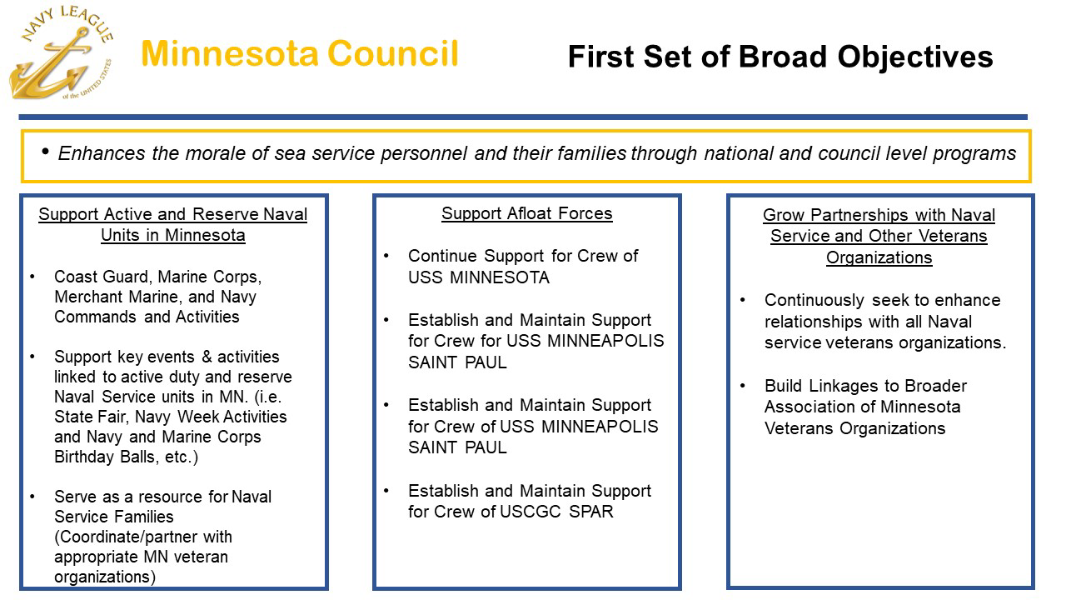
First Set of Broad Objectives

Slide 7
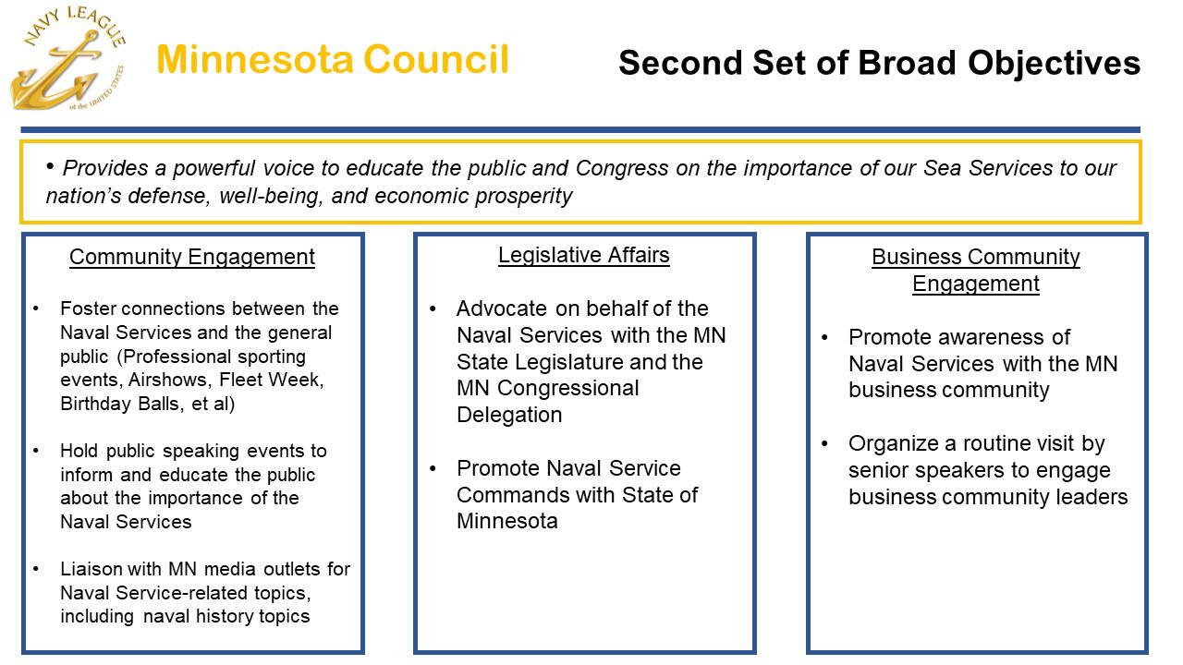
Second Set of Broad Objectives

Slide 8
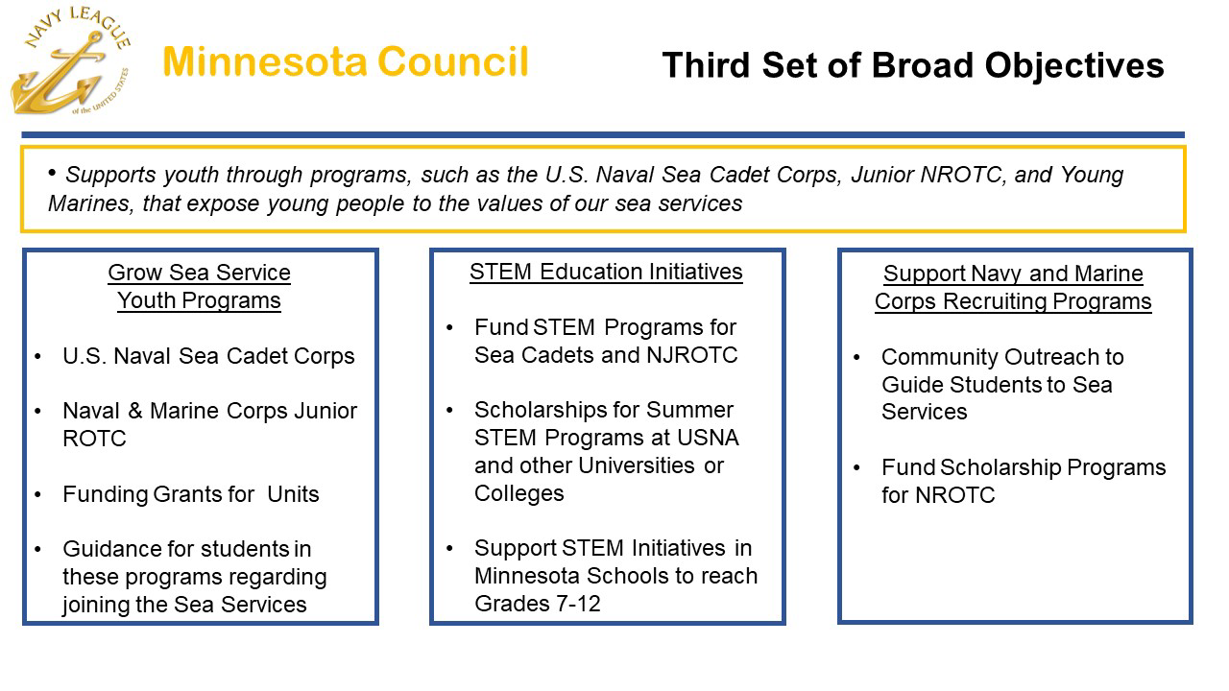
Third Set of Broad Objectives

Slide 9
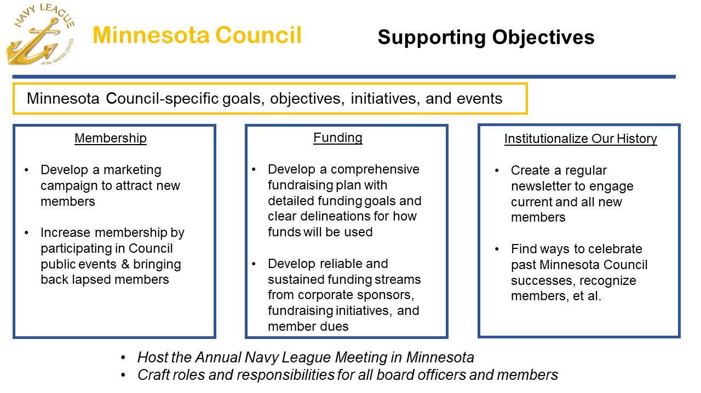
Supporting Council Objectives

Slide 10
Minnesota Council Resources
https://navyleaguemn.org/governing-documents

Slide 11
Upcoming webinars February: Recruitment March: Legislative Affairs, Luke Lorenz April: NL President and CEO (tentative) May: June: San Diego, National Convention

