Slide 1
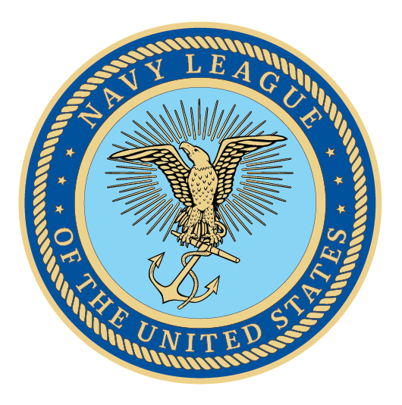

Recruitment and Retention Webinar

Slide 2
Welcome!
We kindly request that you mute your phones.
If you have questions, we will take a moment after each speaker
for discussion. You can also put them in the chat box.
This session will be recorded and available on the member
dashboard.

Slide 3
Using LinkedIn to Recruit New Members
Charles McCleskey
Region President, South Atlantic Coast

Slide 4
How to use LinkedIn to Identify Prospective Council Members
LinkedIn is free to use
Step 1: Create a LinkedIn Profile if you do not have one already
Step 2: Start search (see next slide) Use keyword depending on what you are seeking e.g.:
“Navy” for retired or Active Duty Navy, Veterans, or civilians who work with or for the Navy.
“Coast Guard” for the same as above but Coast Guard
“Marines” for the same as above but Marine
“Merchant Marine” to find those related to the Merchant Marine
Notes:
Encourage your Representative to join the Congressional Shipbuilding Caucus, if they haven’t already. The Navy League sponsors a quarterly breakfast series with them to explore topics of interest to the shipbuilding community. It’s bipartisan, co-chaired by Rep. Rob Wittman (R-VA) and Rep. Joe Courtney (D-CT). We can also help them in selecting nominees for the service academies. And the Center for Maritime Strategy, housed within the Navy League, is a thought leader on all matters in the maritime realm. The Center for Maritime Strategy (CMS) is a non-profit, non-partisan think tank and research institution dedicated to studying maritime issues and their context within wider American national security policy. Through its research and analysis, external outreach, publications, and high-level events, CMS engages key stakeholders across government, academia, and industry.

Slide 5
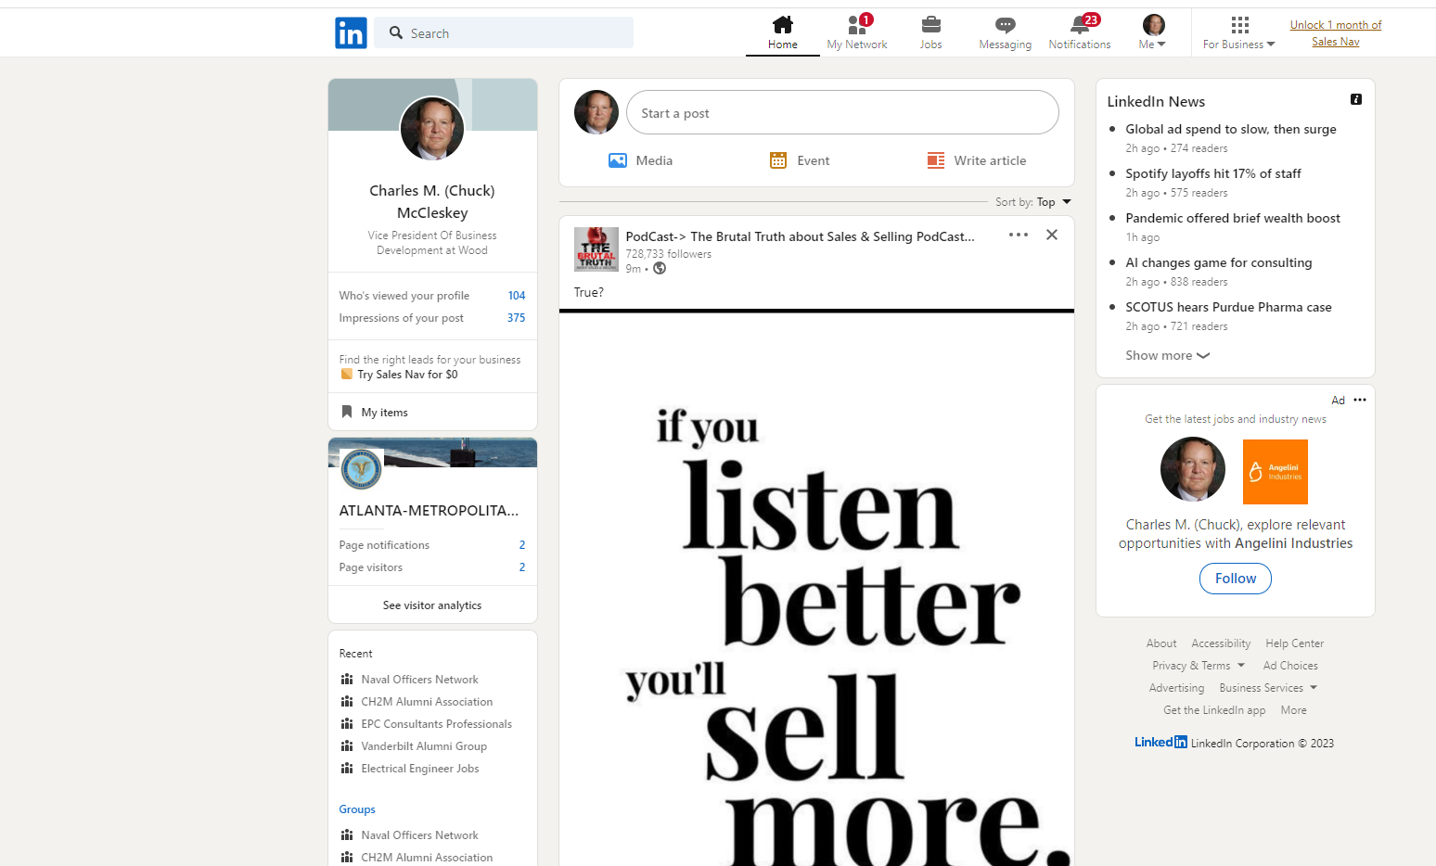
How to use LinkedIn to Identify Prospective Council Members
Enter “Navy” or other search term here
Notes:
Encourage your Representative to join the Congressional Shipbuilding Caucus, if they haven’t already. The Navy League sponsors a quarterly breakfast series with them to explore topics of interest to the shipbuilding community. It’s bipartisan, co-chaired by Rep. Rob Wittman (R-VA) and Rep. Joe Courtney (D-CT). We can also help them in selecting nominees for the service academies. And the Center for Maritime Strategy, housed within the Navy League, is a thought leader on all matters in the maritime realm. The Center for Maritime Strategy (CMS) is a non-profit, non-partisan think tank and research institution dedicated to studying maritime issues and their context within wider American national security policy. Through its research and analysis, external outreach, publications, and high-level events, CMS engages key stakeholders across government, academia, and industry.

Slide 6
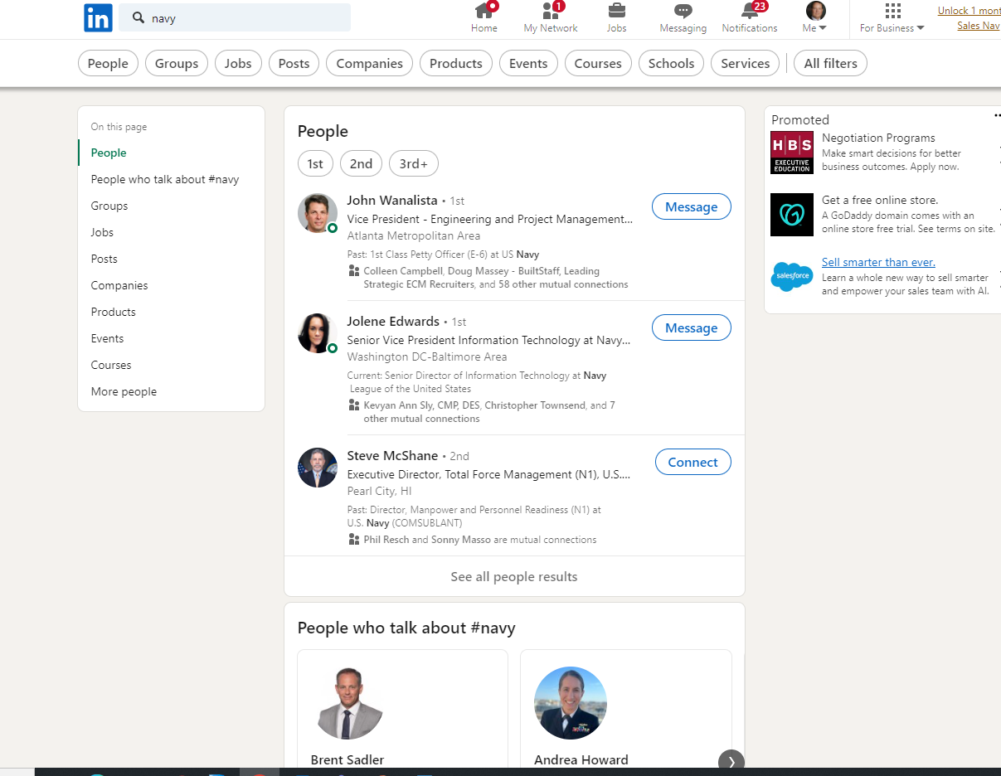
How to use LinkedIn to Identify Prospective Council Members
Select “People” for People search
Notes:
Encourage your Representative to join the Congressional Shipbuilding Caucus, if they haven’t already. The Navy League sponsors a quarterly breakfast series with them to explore topics of interest to the shipbuilding community. It’s bipartisan, co-chaired by Rep. Rob Wittman (R-VA) and Rep. Joe Courtney (D-CT). We can also help them in selecting nominees for the service academies. And the Center for Maritime Strategy, housed within the Navy League, is a thought leader on all matters in the maritime realm. The Center for Maritime Strategy (CMS) is a non-profit, non-partisan think tank and research institution dedicated to studying maritime issues and their context within wider American national security policy. Through its research and analysis, external outreach, publications, and high-level events, CMS engages key stakeholders across government, academia, and industry.

Slide 7
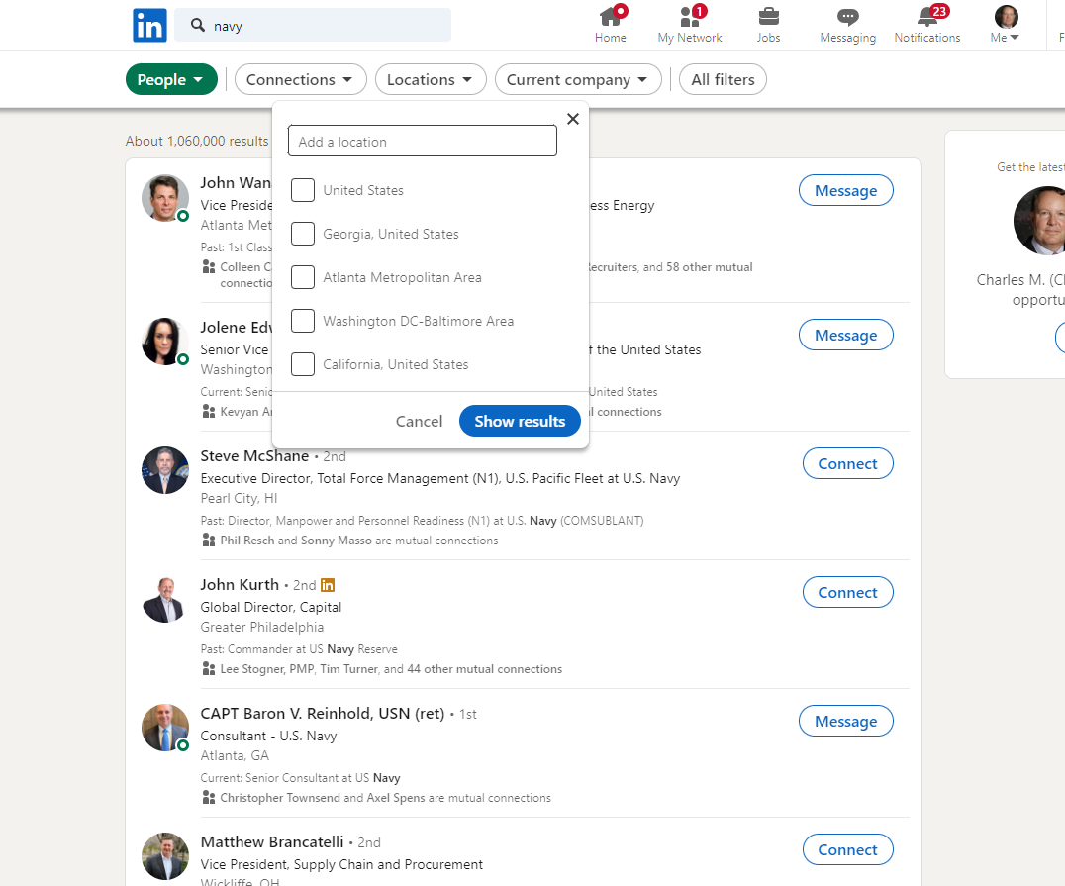
How to use LinkedIn to Identify Prospective Council Members
Click on Locations
Notes:
Encourage your Representative to join the Congressional Shipbuilding Caucus, if they haven’t already. The Navy League sponsors a quarterly breakfast series with them to explore topics of interest to the shipbuilding community. It’s bipartisan, co-chaired by Rep. Rob Wittman (R-VA) and Rep. Joe Courtney (D-CT). We can also help them in selecting nominees for the service academies. And the Center for Maritime Strategy, housed within the Navy League, is a thought leader on all matters in the maritime realm. The Center for Maritime Strategy (CMS) is a non-profit, non-partisan think tank and research institution dedicated to studying maritime issues and their context within wider American national security policy. Through its research and analysis, external outreach, publications, and high-level events, CMS engages key stakeholders across government, academia, and industry.

Slide 8
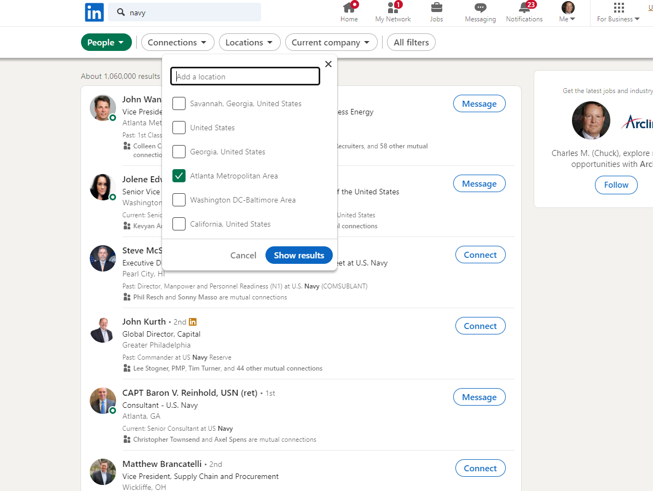
How to use LinkedIn to Identify Prospective Council Members
Enter desired
location
Selected location will then appear below Ina checked box
Click on “Show Results”
Notes:
Encourage your Representative to join the Congressional Shipbuilding Caucus, if they haven’t already. The Navy League sponsors a quarterly breakfast series with them to explore topics of interest to the shipbuilding community. It’s bipartisan, co-chaired by Rep. Rob Wittman (R-VA) and Rep. Joe Courtney (D-CT). We can also help them in selecting nominees for the service academies. And the Center for Maritime Strategy, housed within the Navy League, is a thought leader on all matters in the maritime realm. The Center for Maritime Strategy (CMS) is a non-profit, non-partisan think tank and research institution dedicated to studying maritime issues and their context within wider American national security policy. Through its research and analysis, external outreach, publications, and high-level events, CMS engages key stakeholders across government, academia, and industry.

Slide 9
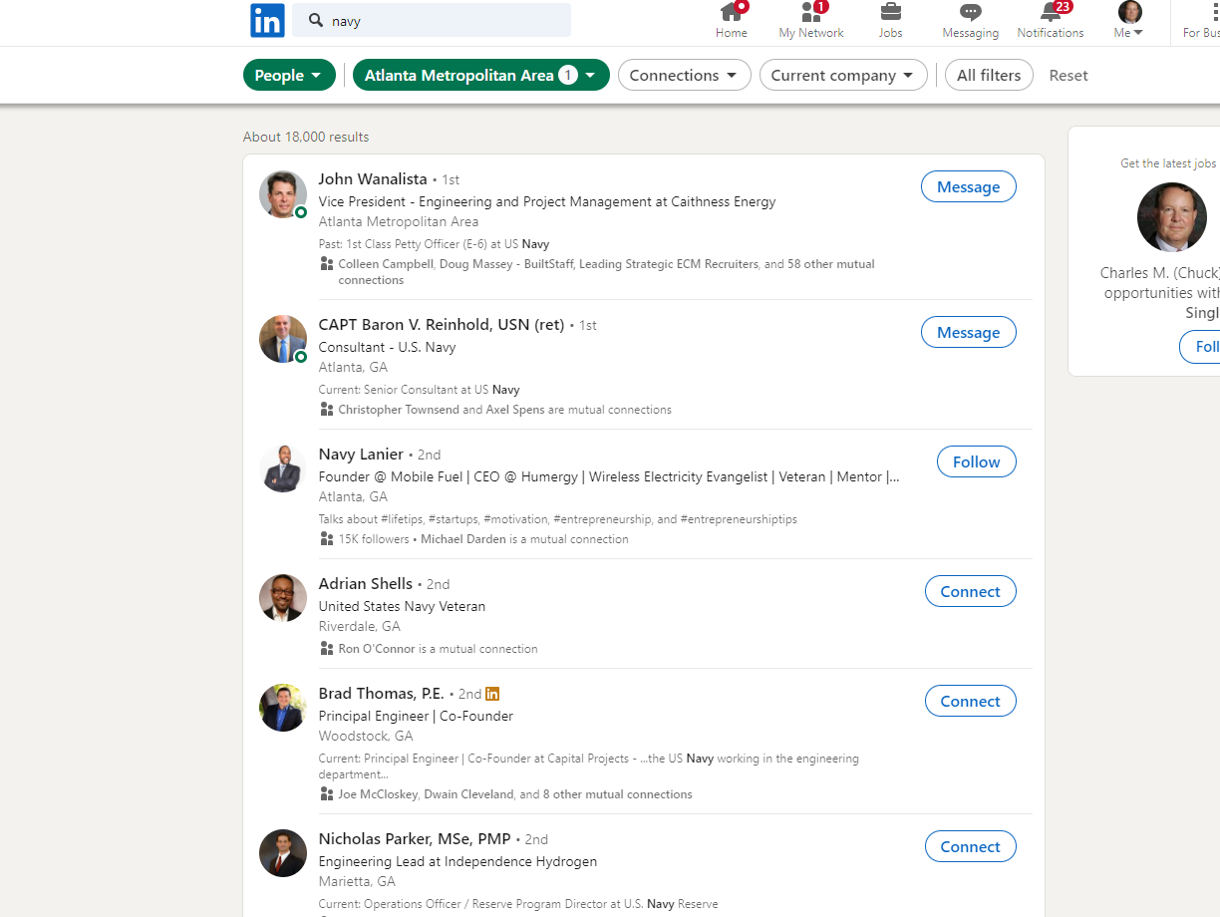
Click on name to see full profile
Note each person
here has a Navy
connection
Notes:
Encourage your Representative to join the Congressional Shipbuilding Caucus, if they haven’t already. The Navy League sponsors a quarterly breakfast series with them to explore topics of interest to the shipbuilding community. It’s bipartisan, co-chaired by Rep. Rob Wittman (R-VA) and Rep. Joe Courtney (D-CT). We can also help them in selecting nominees for the service academies. And the Center for Maritime Strategy, housed within the Navy League, is a thought leader on all matters in the maritime realm. The Center for Maritime Strategy (CMS) is a non-profit, non-partisan think tank and research institution dedicated to studying maritime issues and their context within wider American national security policy. Through its research and analysis, external outreach, publications, and high-level events, CMS engages key stakeholders across government, academia, and industry.

Slide 10
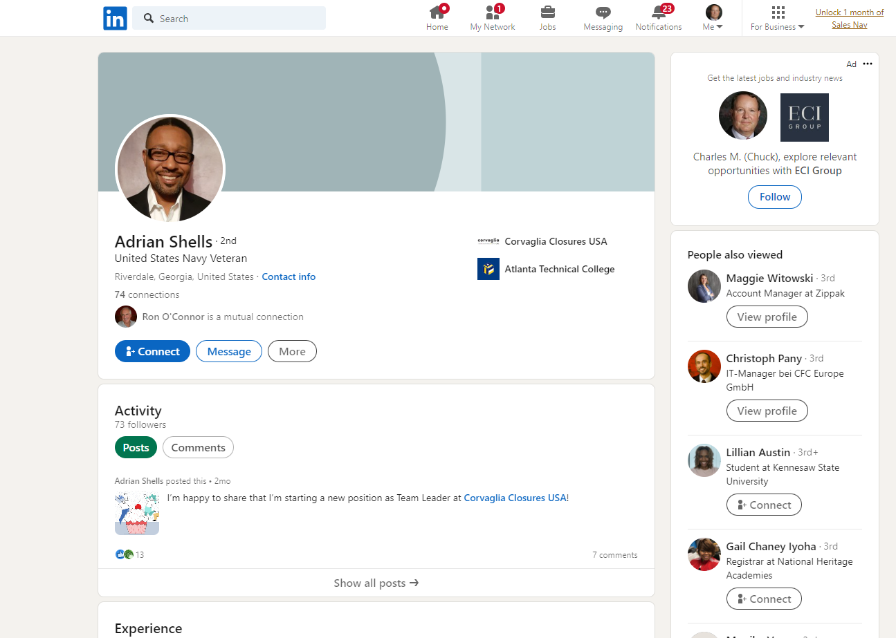
Click on “Connect” to send invite to connect on LinkedIn
Notes:
Encourage your Representative to join the Congressional Shipbuilding Caucus, if they haven’t already. The Navy League sponsors a quarterly breakfast series with them to explore topics of interest to the shipbuilding community. It’s bipartisan, co-chaired by Rep. Rob Wittman (R-VA) and Rep. Joe Courtney (D-CT). We can also help them in selecting nominees for the service academies. And the Center for Maritime Strategy, housed within the Navy League, is a thought leader on all matters in the maritime realm. The Center for Maritime Strategy (CMS) is a non-profit, non-partisan think tank and research institution dedicated to studying maritime issues and their context within wider American national security policy. Through its research and analysis, external outreach, publications, and high-level events, CMS engages key stakeholders across government, academia, and industry.

Slide 11
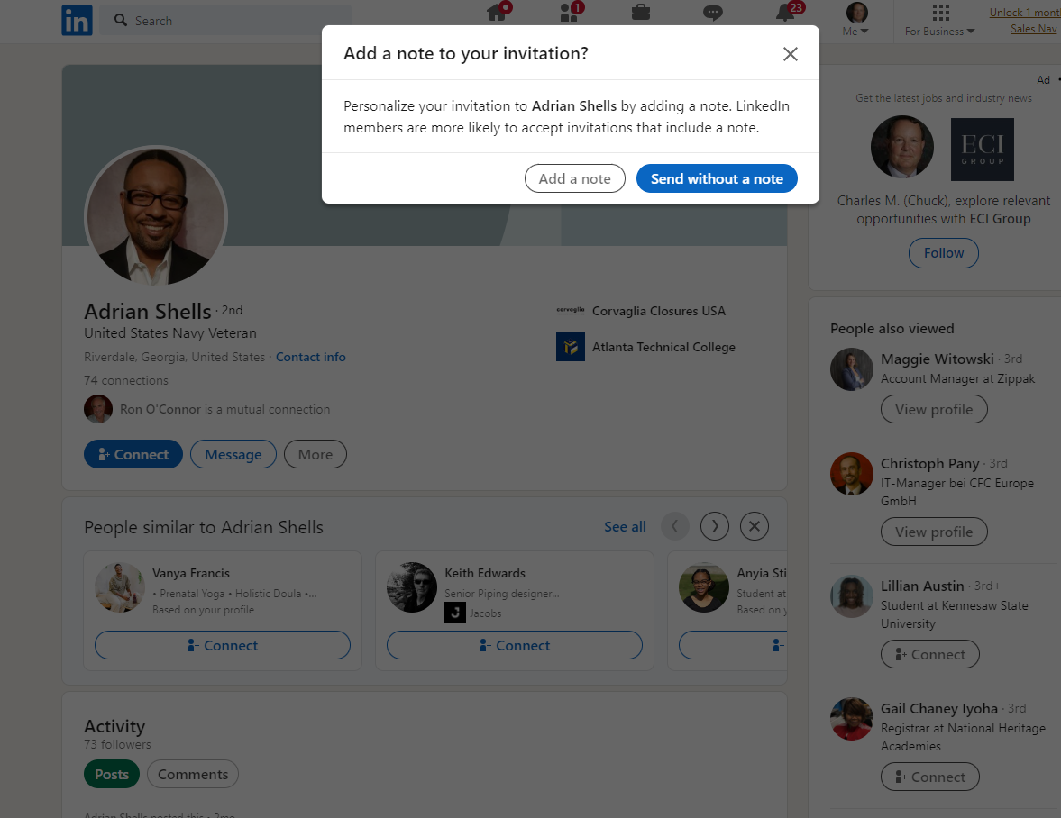
Click on “Add a note”
Notes:
Encourage your Representative to join the Congressional Shipbuilding Caucus, if they haven’t already. The Navy League sponsors a quarterly breakfast series with them to explore topics of interest to the shipbuilding community. It’s bipartisan, co-chaired by Rep. Rob Wittman (R-VA) and Rep. Joe Courtney (D-CT). We can also help them in selecting nominees for the service academies. And the Center for Maritime Strategy, housed within the Navy League, is a thought leader on all matters in the maritime realm. The Center for Maritime Strategy (CMS) is a non-profit, non-partisan think tank and research institution dedicated to studying maritime issues and their context within wider American national security policy. Through its research and analysis, external outreach, publications, and high-level events, CMS engages key stakeholders across government, academia, and industry.

Slide 12
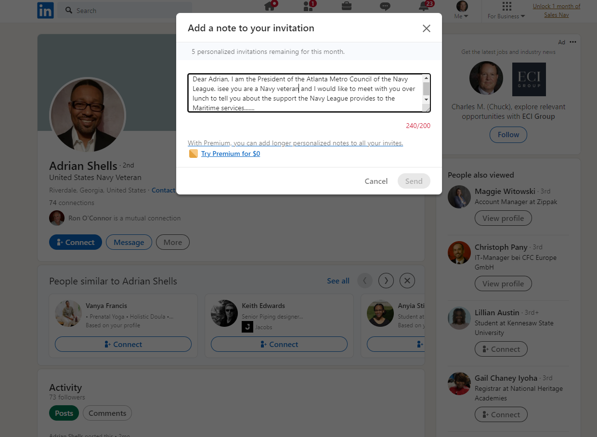
Enter note to inspire
them to connect. Once connected you can
send unlimited
messages
Note 200 character limit on
initial invite
Notes:
Encourage your Representative to join the Congressional Shipbuilding Caucus, if they haven’t already. The Navy League sponsors a quarterly breakfast series with them to explore topics of interest to the shipbuilding community. It’s bipartisan, co-chaired by Rep. Rob Wittman (R-VA) and Rep. Joe Courtney (D-CT). We can also help them in selecting nominees for the service academies. And the Center for Maritime Strategy, housed within the Navy League, is a thought leader on all matters in the maritime realm. The Center for Maritime Strategy (CMS) is a non-profit, non-partisan think tank and research institution dedicated to studying maritime issues and their context within wider American national security policy. Through its research and analysis, external outreach, publications, and high-level events, CMS engages key stakeholders across government, academia, and industry.

Slide 13
How to use LinkedIn to Identify Prospective Council Members
LinkedIn use final notes:
Number of personalized invites may be limited
You may have to get a Premium account to send more personalized invites
Atlanta Council offers free lunch to entice potential Board members to meet and then join
Youth Programs, ACDU Unit Support, and Legislative Affairs are the key sell points
Notes:
Encourage your Representative to join the Congressional Shipbuilding Caucus, if they haven’t already. The Navy League sponsors a quarterly breakfast series with them to explore topics of interest to the shipbuilding community. It’s bipartisan, co-chaired by Rep. Rob Wittman (R-VA) and Rep. Joe Courtney (D-CT). We can also help them in selecting nominees for the service academies. And the Center for Maritime Strategy, housed within the Navy League, is a thought leader on all matters in the maritime realm. The Center for Maritime Strategy (CMS) is a non-profit, non-partisan think tank and research institution dedicated to studying maritime issues and their context within wider American national security policy. Through its research and analysis, external outreach, publications, and high-level events, CMS engages key stakeholders across government, academia, and industry.

Slide 14
Recruitment Best Practices
Membership Recruitment Opportunities
NROTC Scholarship Recipients- List is at NTAG
USNA Appointees
USCG Academy Appointees
Blue & Gold Association (USNA Parents)
USNAAA
*NTAG- Active Duty
*NROTC- Active Duty
*NOSC- Active Duty
*NLUS working to get CNO to encourage joining or at least clarify
that it is OK
Notes:
Encourage your Representative to join the Congressional Shipbuilding Caucus, if they haven’t already. The Navy League sponsors a quarterly breakfast series with them to explore topics of interest to the shipbuilding community. It’s bipartisan, co-chaired by Rep. Rob Wittman (R-VA) and Rep. Joe Courtney (D-CT). We can also help them in selecting nominees for the service academies. And the Center for Maritime Strategy, housed within the Navy League, is a thought leader on all matters in the maritime realm. The Center for Maritime Strategy (CMS) is a non-profit, non-partisan think tank and research institution dedicated to studying maritime issues and their context within wider American national security policy. Through its research and analysis, external outreach, publications, and high-level events, CMS engages key stakeholders across government, academia, and industry.

Slide 15
Recruitment Best Practices
Membership Recruitment Opportunities
Spouse Appreciation Program – leads to new members
Quarterly Large events with Guests
Pickleball Tournament
Golf Tournament
5K Race
Invite all Sea Cadets. NJROTC SNIs, and Cadets, plus Parents, to NAVY Ball
Bus Trips to Kings Bay for NJROTC/MCJROTC/Sea Cadets & Parents (and general public)
Ask Fortune 500 Companies in local area to be Sponsors. Use Impact Sheet to sell it. Most have Foundations- that should be our target
Notes:
Encourage your Representative to join the Congressional Shipbuilding Caucus, if they haven’t already. The Navy League sponsors a quarterly breakfast series with them to explore topics of interest to the shipbuilding community. It’s bipartisan, co-chaired by Rep. Rob Wittman (R-VA) and Rep. Joe Courtney (D-CT). We can also help them in selecting nominees for the service academies. And the Center for Maritime Strategy, housed within the Navy League, is a thought leader on all matters in the maritime realm. The Center for Maritime Strategy (CMS) is a non-profit, non-partisan think tank and research institution dedicated to studying maritime issues and their context within wider American national security policy. Through its research and analysis, external outreach, publications, and high-level events, CMS engages key stakeholders across government, academia, and industry.

Slide 16
Recruitment Best Practices
Membership Recruitment Opportunities
Attend Sea Cadet Parent Meetings
Hold Sea Cadet Event at Lake Allatoona Rec Area
Hold NJROTC Cadet Event at Lake Allatoona Rec Area
Leverage Sea Cadet Foundation Scholarship Program
Black Tie Mess Dress Gala (Navy Ball could be one)
Create Networking Opportunities:
Identify predominant local industries
Recruit from those industries
Leverage Air shows
Have local National Security Briefings
Notes:
Encourage your Representative to join the Congressional Shipbuilding Caucus, if they haven’t already. The Navy League sponsors a quarterly breakfast series with them to explore topics of interest to the shipbuilding community. It’s bipartisan, co-chaired by Rep. Rob Wittman (R-VA) and Rep. Joe Courtney (D-CT). We can also help them in selecting nominees for the service academies. And the Center for Maritime Strategy, housed within the Navy League, is a thought leader on all matters in the maritime realm. The Center for Maritime Strategy (CMS) is a non-profit, non-partisan think tank and research institution dedicated to studying maritime issues and their context within wider American national security policy. Through its research and analysis, external outreach, publications, and high-level events, CMS engages key stakeholders across government, academia, and industry.

Slide 17
Sponsor Recruitment Best Practices
Sponsor Recruitment Opportunities
Ask Fortune 500 Companies in local area to be Sponsors. Use Impact Sheet to sell it. Most have Foundations- that should be our target
Emphasize to Fortune 500 Companies that 90% of their goods and raw materials travel via sea lanes
Leverage Youth Awards Banquet to gain Corporate Sponsors (as we used to with Lockheed)
Recruit Sponsors to support Council
Display banners at all events
Logos on website, LinkedIn, Facebook
Logos in all event programs
Memberships included with Sponsorship
Notes:
Encourage your Representative to join the Congressional Shipbuilding Caucus, if they haven’t already. The Navy League sponsors a quarterly breakfast series with them to explore topics of interest to the shipbuilding community. It’s bipartisan, co-chaired by Rep. Rob Wittman (R-VA) and Rep. Joe Courtney (D-CT). We can also help them in selecting nominees for the service academies. And the Center for Maritime Strategy, housed within the Navy League, is a thought leader on all matters in the maritime realm. The Center for Maritime Strategy (CMS) is a non-profit, non-partisan think tank and research institution dedicated to studying maritime issues and their context within wider American national security policy. Through its research and analysis, external outreach, publications, and high-level events, CMS engages key stakeholders across government, academia, and industry.

Slide 18
Community Outreach
Kevin Button
Region President, Pacific Southwest

Slide 19
Community Outreach Kevin Button
Join your local Chamber of Commerce.
Attend their events
Volunteer to assist in their projects
Speak at their breakfasts and lunches
Speak to the local community service clubs
Rotary
Kiwanis
Lions
American Legion
Veterans of Foreign wars
Coast Guard Auxiliary
Wear your Navy League shirt and hat to all community events
Have your elevator speech ready to go.
Notes:
Encourage your Representative to join the Congressional Shipbuilding Caucus, if they haven’t already. The Navy League sponsors a quarterly breakfast series with them to explore topics of interest to the shipbuilding community. It’s bipartisan, co-chaired by Rep. Rob Wittman (R-VA) and Rep. Joe Courtney (D-CT). We can also help them in selecting nominees for the service academies. And the Center for Maritime Strategy, housed within the Navy League, is a thought leader on all matters in the maritime realm. The Center for Maritime Strategy (CMS) is a non-profit, non-partisan think tank and research institution dedicated to studying maritime issues and their context within wider American national security policy. Through its research and analysis, external outreach, publications, and high-level events, CMS engages key stakeholders across government, academia, and industry.

Slide 20
Recruitment Through Events
Berkley Terry
Secretary, Central Florida Council

Slide 21
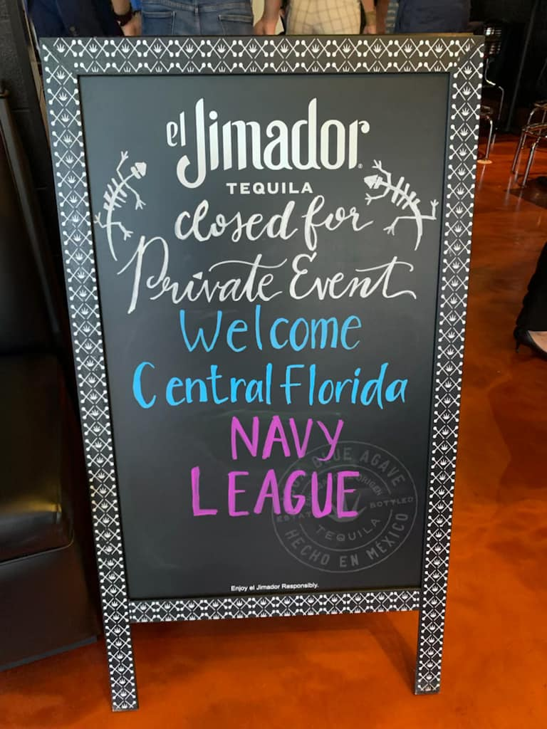
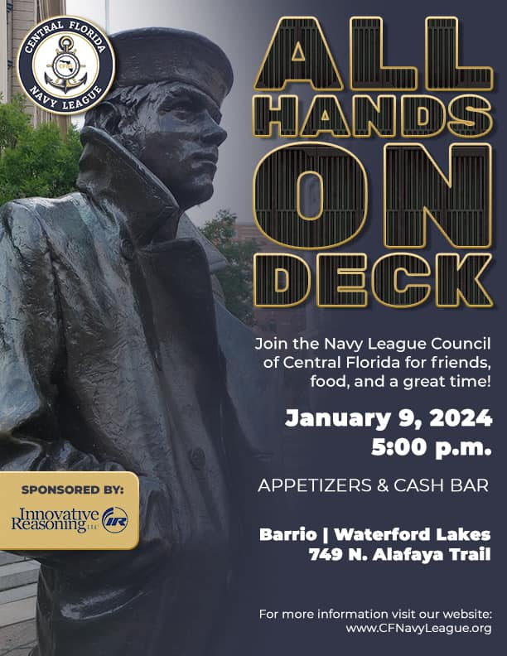
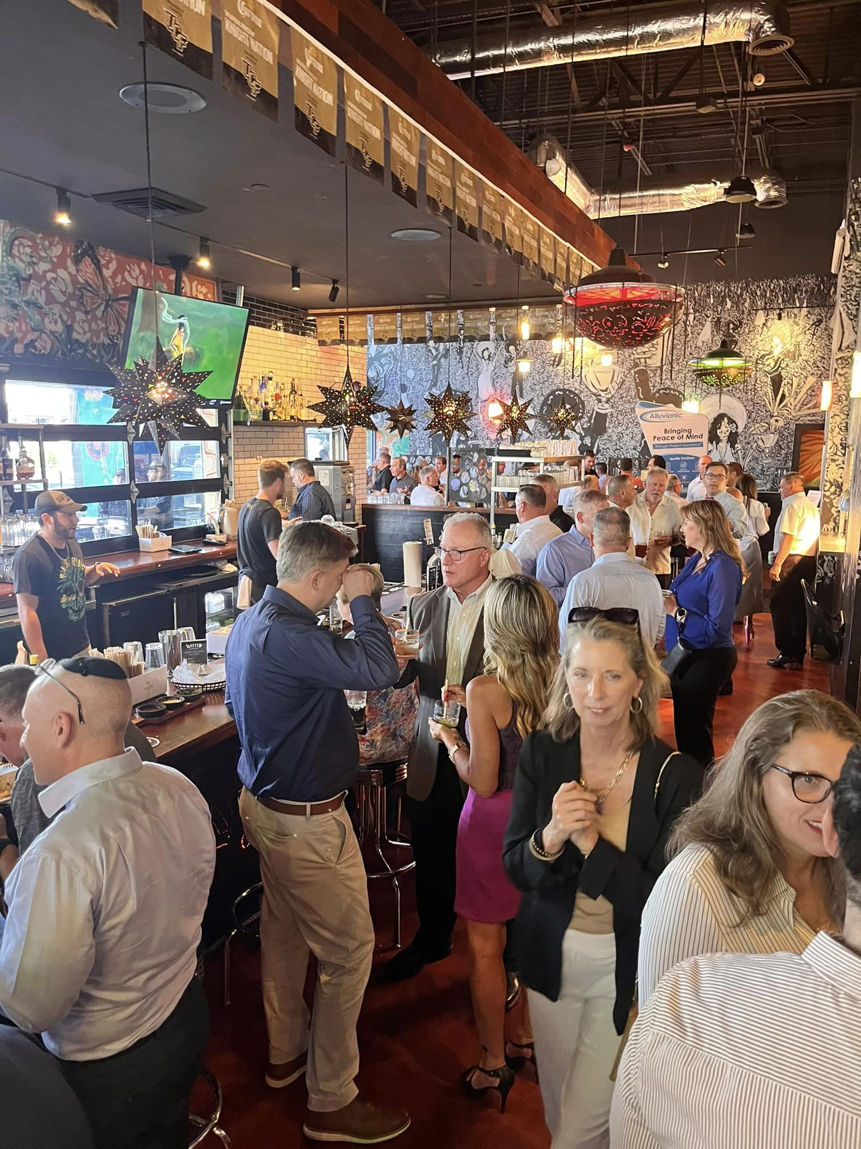
Community Engagement
Leveraging fun events to drive engagement
Socials at a local bar/restaurant
Identify local events for marketing
Pickleball, Cyber/STEM Camp
Local school involvement
Notes:
Bi monthly socials at a local bar, gets a fun social environment to recruit new members, keeps active members engaged,
Member appreciation event had to be a member to attend, axe throwing, karaoke, food covered by sponsor

Slide 22
Pickle For Patriots
Inaugural event held August 2023
100+ attendees, 50+ first exposure to Navy League
11 new sponsors
$6,000 in net profits, in support of our scholarships and beneficiaries
Notes:
Taking a fun hobby and turning it into a fundraiser

Slide 23
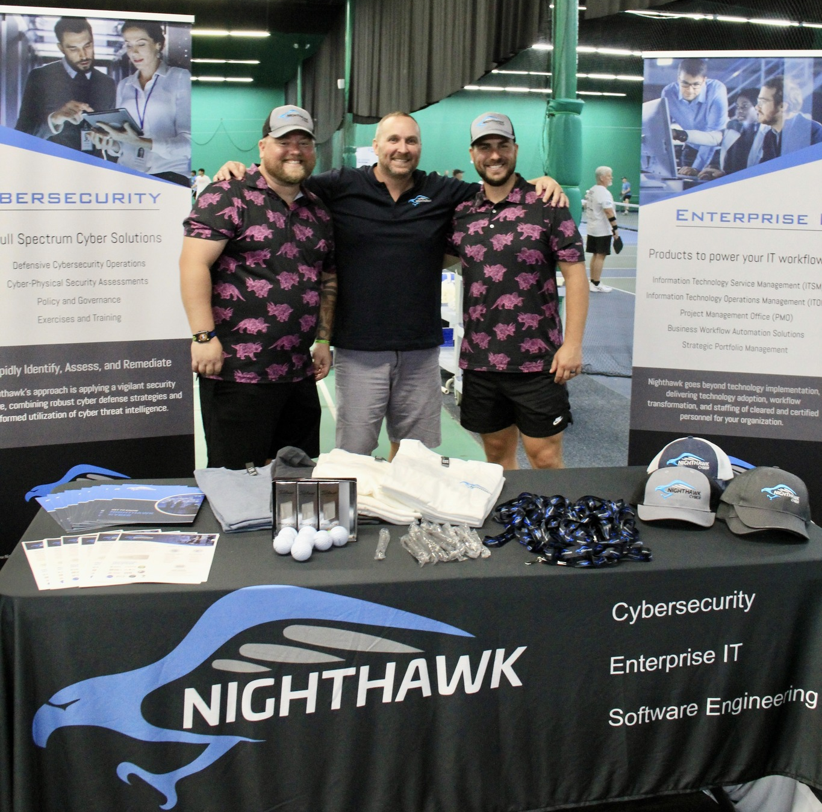
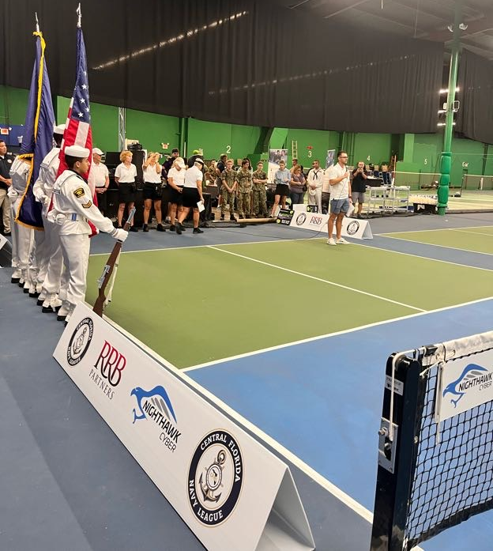
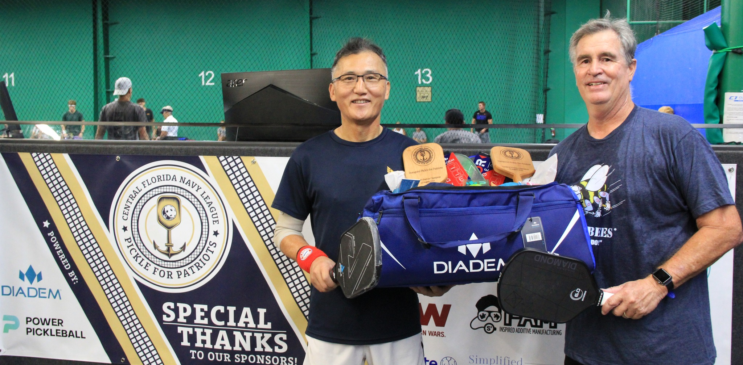
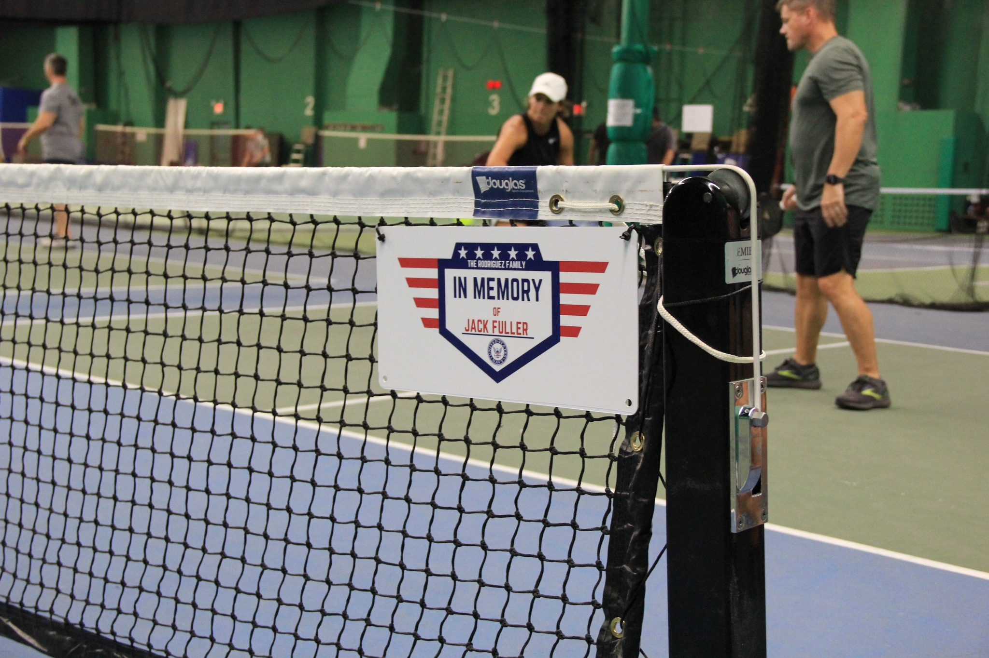
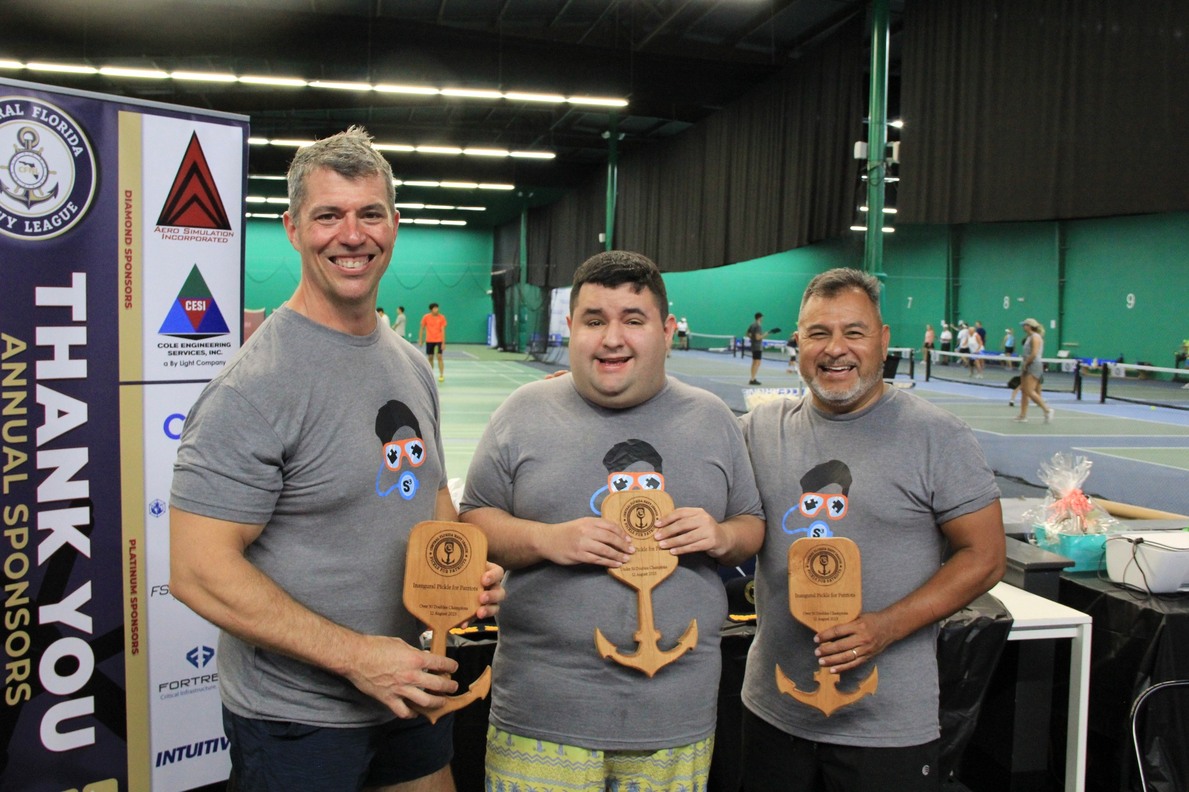
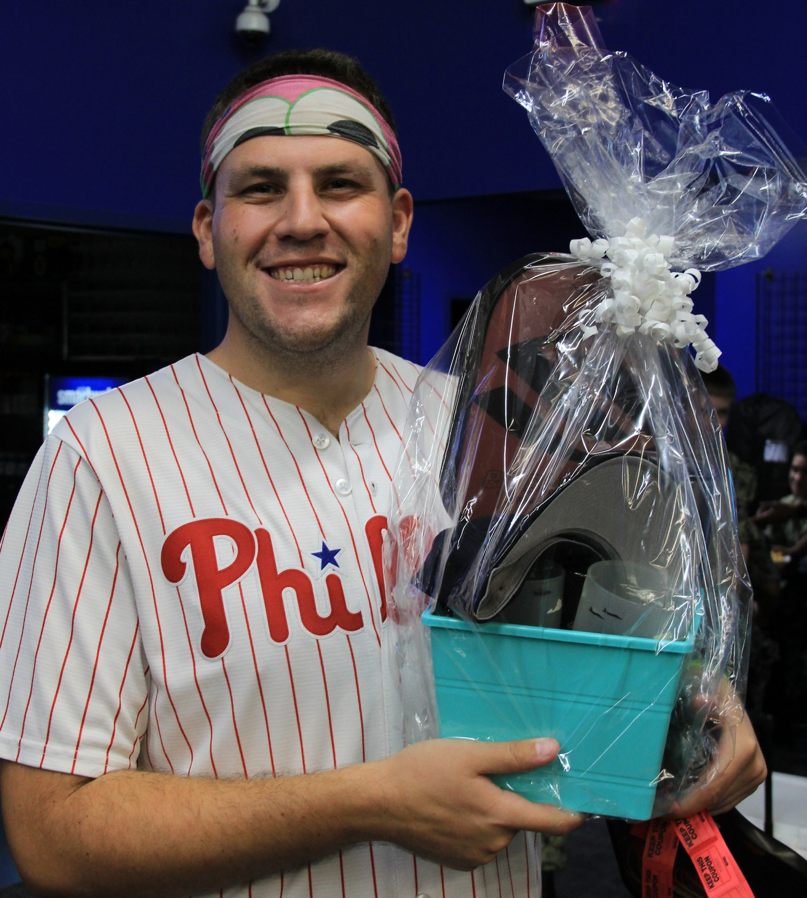

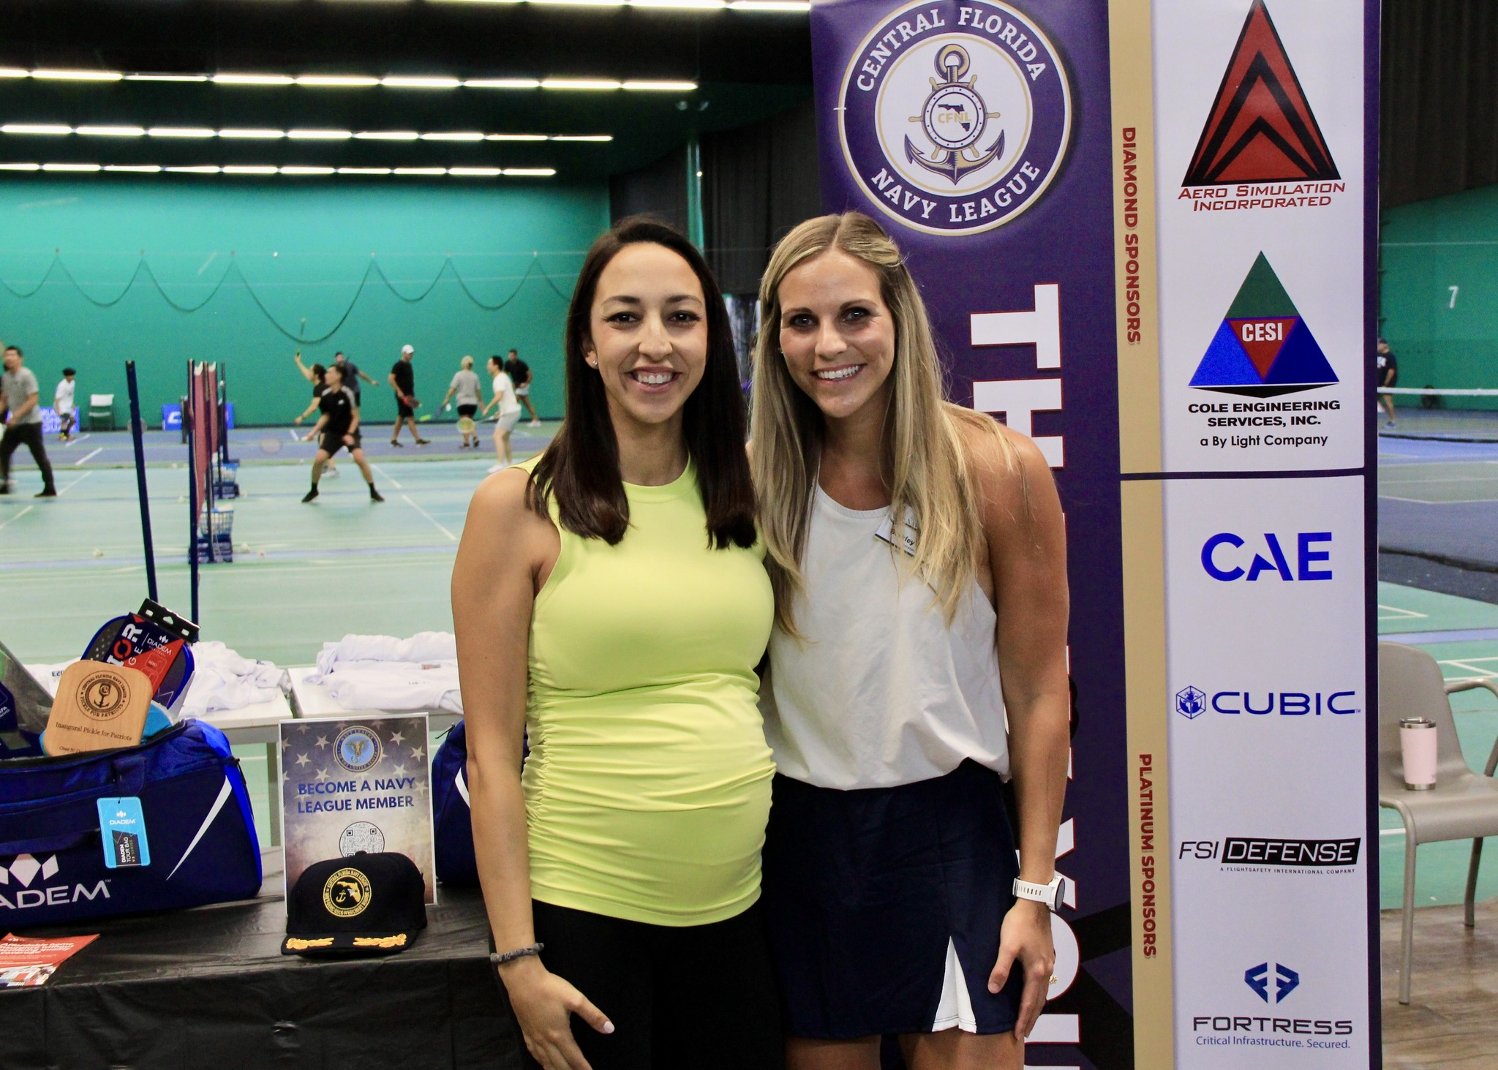
Pickle For Patriots
Notes:
Note the sponsor table, stretch zone came out, free stretch cards
Sea cadet support
All donated product for the awards
Signage donated

Slide 24
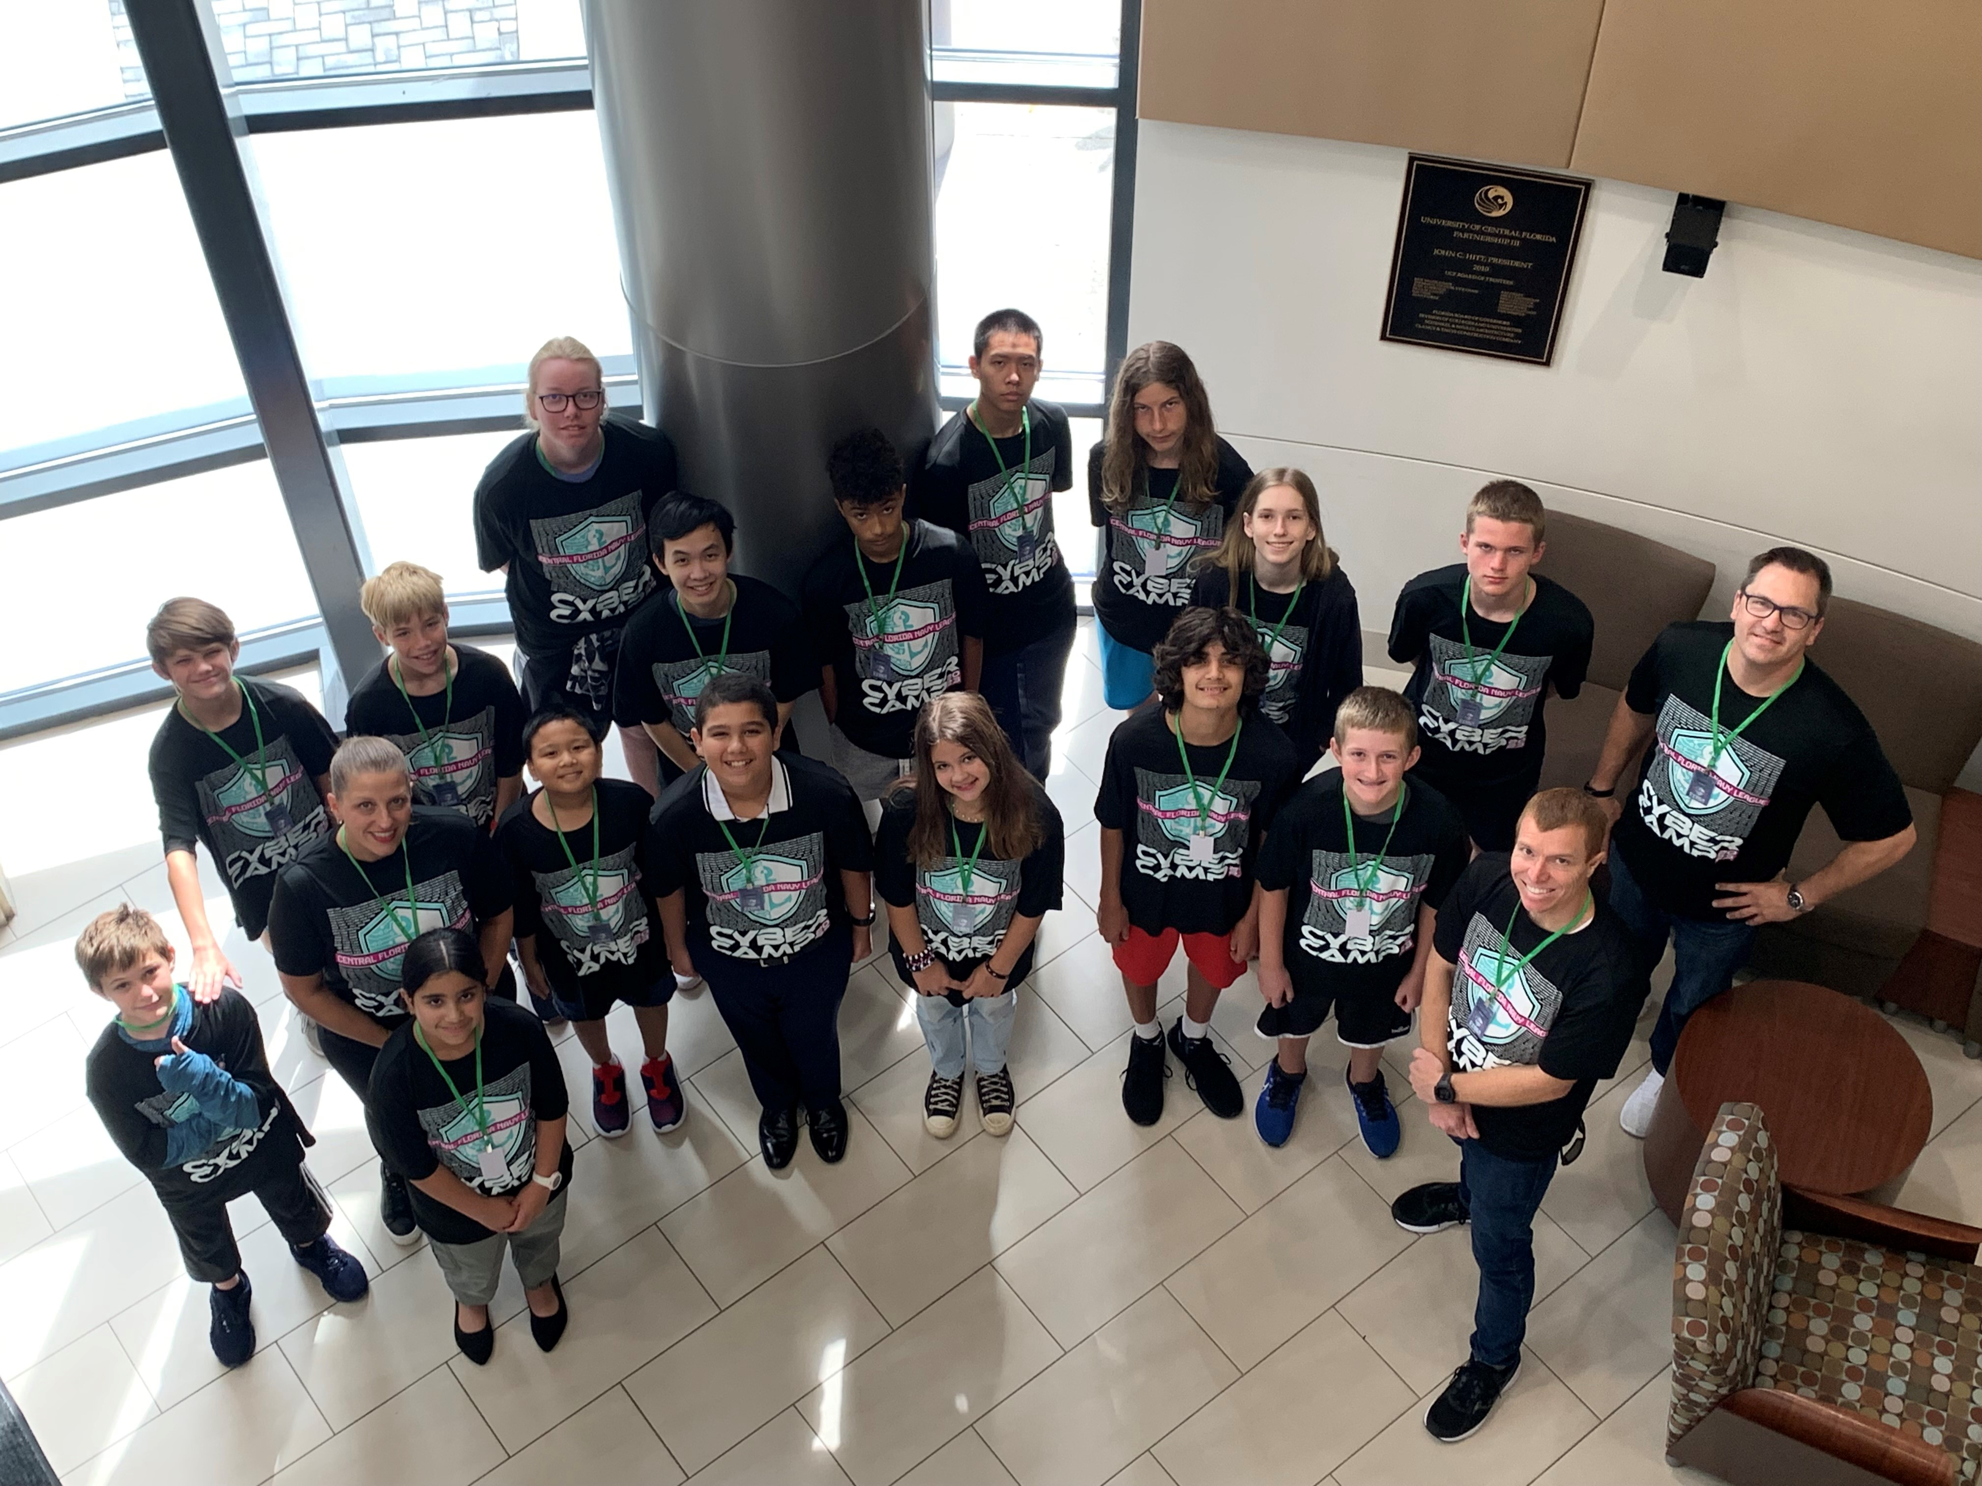
Cyber Camp
Hosted a cyber camp the week of 31 Jul – 4 Aug 2023
Organized and run by STEM Director
Head instructor was Dr. Jonathan Harris, NAWCTSD
Location was NCS Starbase in the Partnership III Building
18 attendees
Used the Air Force Association CyberPatriot curriculum
Local companies with cyber expertise presented
Notes:
Sponsorship opps.

Slide 25
The Importance of Personal Connections
Jane Ferreira
Executive Director, Honolulu Council

Slide 26
Best Practices for Membership
Find value and a win-win for a prospective member
Convert “I heard from a friend that you guys do cool stuff”
to having them be your newest council member
Finding a win – win proposition
PERSONAL CONNECTION – FIND A MUTUAL THREAD

Slide 27
Share the Mission
ADVOCATE – EDUCATE – SUPPORT
We share why elected officials they should advocate for stronger seas
Why that is important as a Maritime Nation
Meet ships, subs, cutters returning from deployment
Provide Youth Leadership opportunities through Sea Cadets
Host Sailor of the Quarter/Year events
Provide member discounts to restaurants
Host families of deployed service members
Recognition events for sailors and spouses
Support and celebrate those who serve, and their families
Notes:
Encourage your Representative to join the Congressional Shipbuilding Caucus, if they haven’t already. The Navy League sponsors a quarterly breakfast series with them to explore topics of interest to the shipbuilding community. It’s bipartisan, co-chaired by Rep. Rob Wittman (R-VA) and Rep. Joe Courtney (D-CT). We can also help them in selecting nominees for the service academies. And the Center for Maritime Strategy, housed within the Navy League, is a thought leader on all matters in the maritime realm. The Center for Maritime Strategy (CMS) is a non-profit, non-partisan think tank and research institution dedicated to studying maritime issues and their context within wider American national security policy. Through its research and analysis, external outreach, publications, and high-level events, CMS engages key stakeholders across government, academia, and industry.

Slide 28
The Close
May I email you some information and a membership form?
We are always looking for people who support what is important to our community and our country
You didn’t need to serve – every day patriotism is great!
Everything the Navy League does is made possible by our members
Be passionate, be excited, be informed – it’s contagious
Notes:
Encourage your Representative to join the Congressional Shipbuilding Caucus, if they haven’t already. The Navy League sponsors a quarterly breakfast series with them to explore topics of interest to the shipbuilding community. It’s bipartisan, co-chaired by Rep. Rob Wittman (R-VA) and Rep. Joe Courtney (D-CT). We can also help them in selecting nominees for the service academies. And the Center for Maritime Strategy, housed within the Navy League, is a thought leader on all matters in the maritime realm. The Center for Maritime Strategy (CMS) is a non-profit, non-partisan think tank and research institution dedicated to studying maritime issues and their context within wider American national security policy. Through its research and analysis, external outreach, publications, and high-level events, CMS engages key stakeholders across government, academia, and industry.

Slide 29
Upcoming Webinars
March 13th Legislative Affairs
April NL President and CEO (date to be announced)
May 8th Topic to be announced
June 6-9 National Convention in San Diego, CA

Slide 30
Thank You!

