Slide 1
Navy League Membership Drive Best Practices
October 2024
Evan Clarke, Marketing Director

Slide 2
Best Practices for Marketing Events
As you prepare to promote your local membership drive events, we at Navy League Headquarters want to provide you with a comprehensive guide to ensure your efforts are as effective and engaging as possible. This guide outlines best practices for creating and promoting your events across various platforms, including social media, email, and more. Let's work together to grow our Navy League community!

Slide 3
Value Proposition
Keep in Mind:
What unique value and benefits will members receive by joining your council? Leverage your location, community ties, networking opportunities…
Keep in mind - What makes your council unique?
Direct impact
Advocacy
Networking opportunities
Events
Educational resources
Awards and Honors
Sense of Community

Slide 4
Our Objective
Remember our objective:
The main objective of a membership drive is to find potential members and encourage them to join, thus building a strong community of people who want to participate in the organization’s programs, events and volunteer efforts. Membership drives help organizations reach their goals, expand their impact, and ensure their future growth

Slide 5
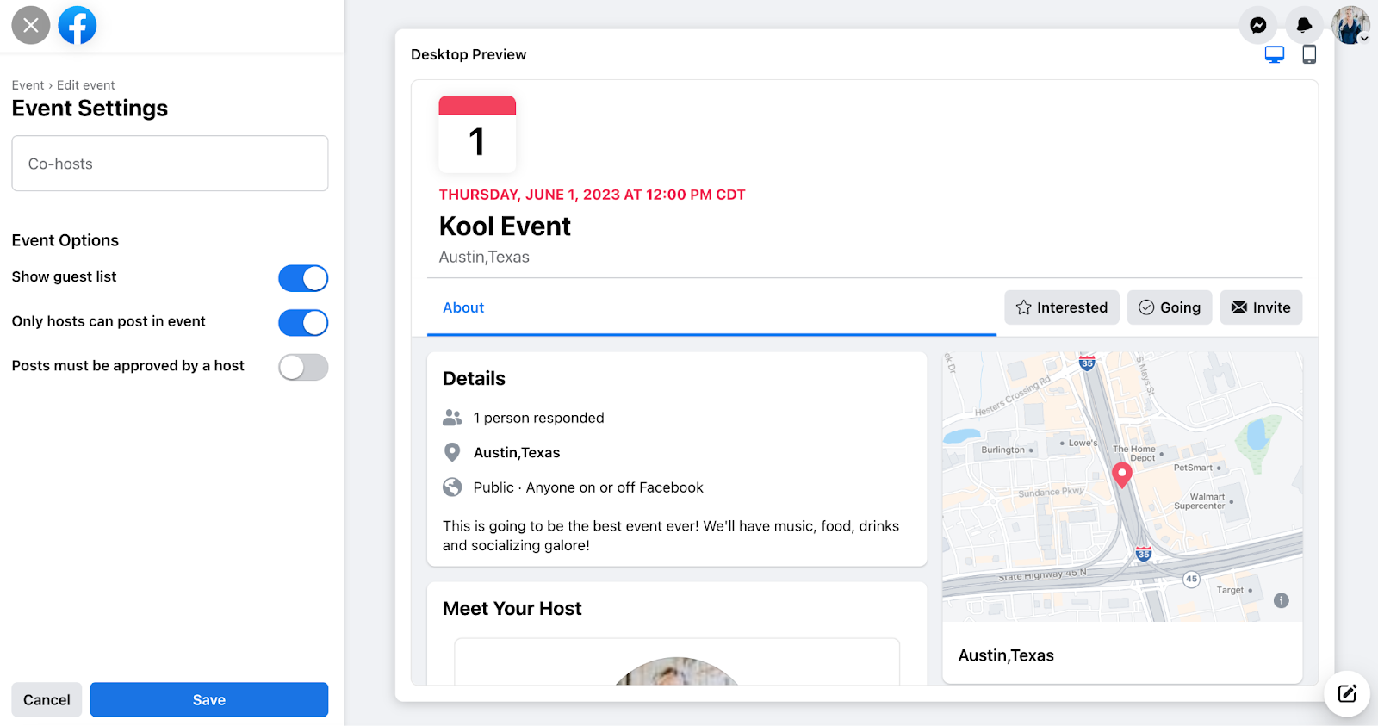
Creating and Promoting a Facebook Event
Why Facebook Events? Facebook Events are an excellent way to increase visibility and engagement. They allow you to reach your followers, their networks, and a broader audience in your local area.
Notes:
Objectives are in line with Project Phoenix
Objectives -
Increase membership through targeted event marketing and other digital marketing strategies ill touch on later.
Support our councils with professional marketing resources and consultations
Raise Awareness of the Navy League
Engage current members who maybe aren't attending events... members who haven't come out yet.
Create a unified campaign that showcases the value of joining the navy league

Slide 6
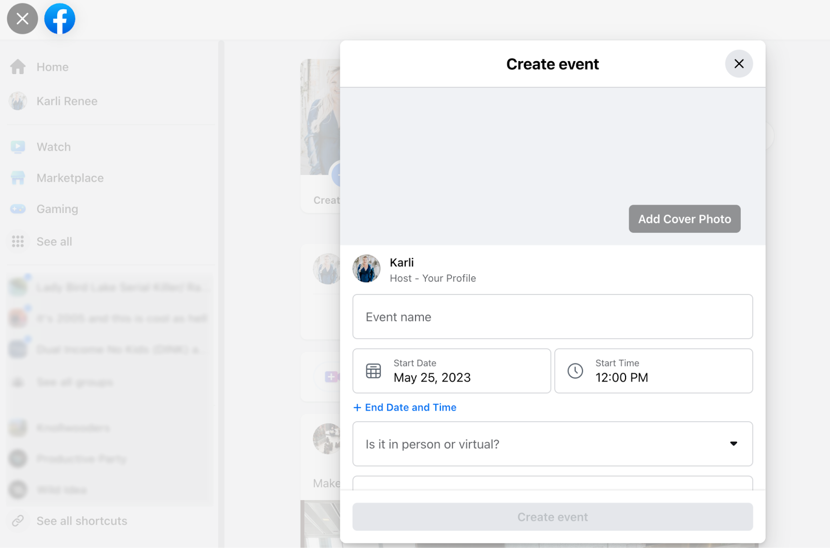
Facebook Events: Step by Step Instructions
Access Council’s Facebook Page
- Navigate to 'Events'
- Create New Event
Add Event Details (Name, Date, Location, Description, Cover Photo)
- Invite & Promote
Notes:
Objectives are in line with Project Phoenix
Objectives -
Increase membership through targeted event marketing and other digital marketing strategies ill touch on later.
Support our councils with professional marketing resources and consultations
Raise Awareness of the Navy League
Engage current members who maybe aren't attending events... members who haven't come out yet.
Create a unified campaign that showcases the value of joining the navy league

Slide 7
Sharing Events on Social Media
Platform-Specific Tips:
Facebook: Regular posts, stories, and group sharing
Instagram: Feed posts, stories, reels
LinkedIn: Posts, Group Sharing
Twitter: Tweets, engagement with relevant accounts
Notes:
Objectives are in line with Project Phoenix
Objectives -
Increase membership through targeted event marketing and other digital marketing strategies ill touch on later.
Support our councils with professional marketing resources and consultations
Raise Awareness of the Navy League
Engage current members who maybe aren't attending events... members who haven't come out yet.
Create a unified campaign that showcases the value of joining the navy league

Slide 8
Email Campaign Best Practices
Email Campaign Tips:
- Segment Your Audience
- Use Compelling Subject Lines
- Personalization & Clear Call-To-Action’s
- Mobile Optimization
- Follow-Up Emails
Notes:
Objectives are in line with Project Phoenix
Objectives -
Increase membership through targeted event marketing and other digital marketing strategies ill touch on later.
Support our councils with professional marketing resources and consultations
Raise Awareness of the Navy League
Engage current members who maybe aren't attending events... members who haven't come out yet.
Create a unified campaign that showcases the value of joining the navy league

Slide 9
Think Membership, but Act Like PR
Communications is fundamentally the same as recruitment.
Instead of spreading your message to one person, speak to a wider audience.
Notes:
Objectives are in line with Project Phoenix
Objectives -
Increase membership through targeted event marketing and other digital marketing strategies ill touch on later.
Support our councils with professional marketing resources and consultations
Raise Awareness of the Navy League
Engage current members who maybe aren't attending events... members who haven't come out yet.
Create a unified campaign that showcases the value of joining the navy league

Slide 10
Offline Promotion Strategies
Best Practices:
- Distribute Flyers & Posters
- Encourage Word of Mouth
- Partner with Local Businesses
- Public Speaking Opportunities
Notes:
Objectives are in line with Project Phoenix
Objectives -
Increase membership through targeted event marketing and other digital marketing strategies ill touch on later.
Support our councils with professional marketing resources and consultations
Raise Awareness of the Navy League
Engage current members who maybe aren't attending events... members who haven't come out yet.
Create a unified campaign that showcases the value of joining the navy league

Slide 11
Media Outreach
Keep a list of local press’ emails
You can find them in the newspaper, on their website
Reporters that cover defense, local events, compile a calendar
When you are hosting an event, send them a press release or media alert in advance
Email is usually best
Notes:
Objectives are in line with Project Phoenix
Objectives -
Increase membership through targeted event marketing and other digital marketing strategies ill touch on later.
Support our councils with professional marketing resources and consultations
Raise Awareness of the Navy League
Engage current members who maybe aren't attending events... members who haven't come out yet.
Create a unified campaign that showcases the value of joining the navy league

Slide 12
Post-Event Follow-Up
Best Practices:
- Send Thank You Emails
- Share Event Recap
- Conduct Post-Event Surveys
- Reinforce Membership Call-to-Action
Notes:
Objectives are in line with Project Phoenix
Objectives -
Increase membership through targeted event marketing and other digital marketing strategies ill touch on later.
Support our councils with professional marketing resources and consultations
Raise Awareness of the Navy League
Engage current members who maybe aren't attending events... members who haven't come out yet.
Create a unified campaign that showcases the value of joining the navy league

Slide 13
Helpful Links
How to Create a Facebook Event or 5 examples of Facebook Events
Membership Drive Ideas for Events
14 Engaging Membership Drive & Event Ideas
Ask your local Navy, USCG, Marine’s how your council can help
Download

Slide 14
Remember to Submit Your Event to HQ!
Councils will submit their event through a submission form or email eclarke@navyleague.org
Include event details:
Event type
Date
Location
Time
Sponsors
Target audience
Point of contact for event
Relevant links

