Slide 1
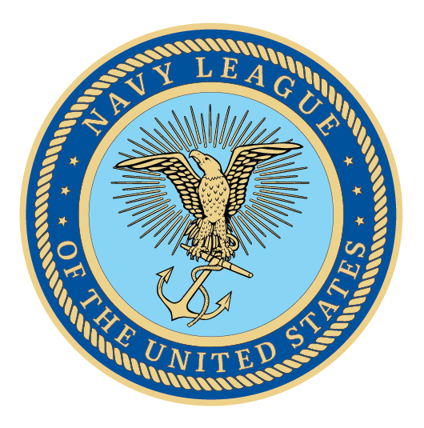
Notes:
We are here because America is at a dangerous inflection point in regards to our national and economic security. As we focus on great power competitors like China and Russia, it is impossible to overlook the fact that the sea services will be the tip of the spear in projecting U.S. power and deterring conflict with an aggressive forward posture. Today, we will cover the most important needs of the sea services and explain how they secure America’s interests.

Slide 2
How to use LinkedIN to Identify Prospective Council Members
LinkedIN is free to use
Step 1: Create a LinkedIn Profile if you do not have one already
Step 2: Start search (see next slide) Use keyword depending on what you are seeking e.g.:
“Navy” for retired or Active Duty Navy, Veterans, or civilians who work with or for the Navy.
“Coast Guard” for the same as above but Coast Guard
“Marines” for the same as above but Marine
“Merchant Marine” to find those related to the Merchant Marine
Notes:
Encourage your Representative to join the Congressional Shipbuilding Caucus, if they haven’t already. The Navy League sponsors a quarterly breakfast series with them to explore topics of interest to the shipbuilding community. It’s bipartisan, co-chaired by Rep. Rob Wittman (R-VA) and Rep. Joe Courtney (D-CT). We can also help them in selecting nominees for the service academies. And the Center for Maritime Strategy, housed within the Navy League, is a thought leader on all matters in the maritime realm. The Center for Maritime Strategy (CMS) is a non-profit, non-partisan think tank and research institution dedicated to studying maritime issues and their context within wider American national security policy. Through its research and analysis, external outreach, publications, and high-level events, CMS engages key stakeholders across government, academia, and industry.

Slide 3
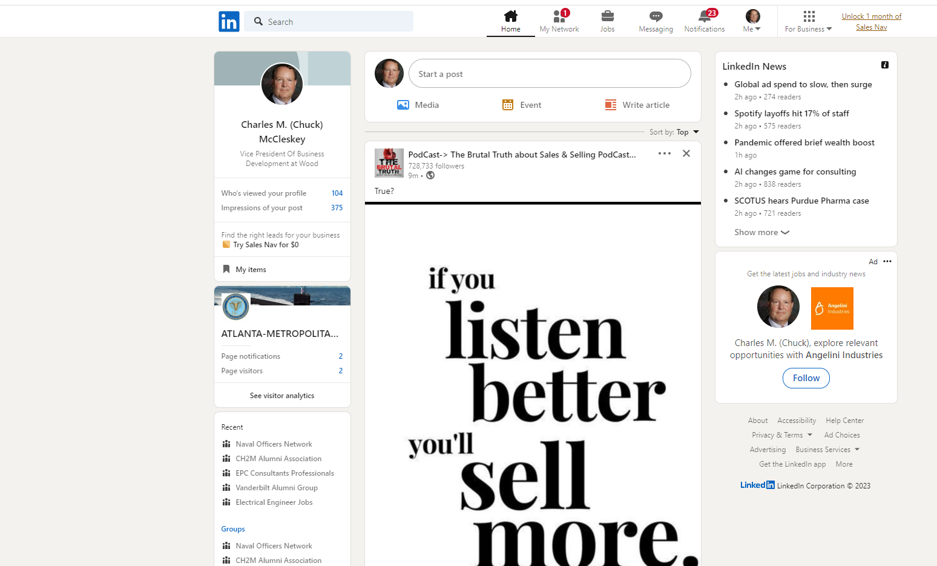
How to use LinkedIN to Identify Prospective Council Members
Enter “Navy” or other search term here
Notes:
Encourage your Representative to join the Congressional Shipbuilding Caucus, if they haven’t already. The Navy League sponsors a quarterly breakfast series with them to explore topics of interest to the shipbuilding community. It’s bipartisan, co-chaired by Rep. Rob Wittman (R-VA) and Rep. Joe Courtney (D-CT). We can also help them in selecting nominees for the service academies. And the Center for Maritime Strategy, housed within the Navy League, is a thought leader on all matters in the maritime realm. The Center for Maritime Strategy (CMS) is a non-profit, non-partisan think tank and research institution dedicated to studying maritime issues and their context within wider American national security policy. Through its research and analysis, external outreach, publications, and high-level events, CMS engages key stakeholders across government, academia, and industry.

Slide 4
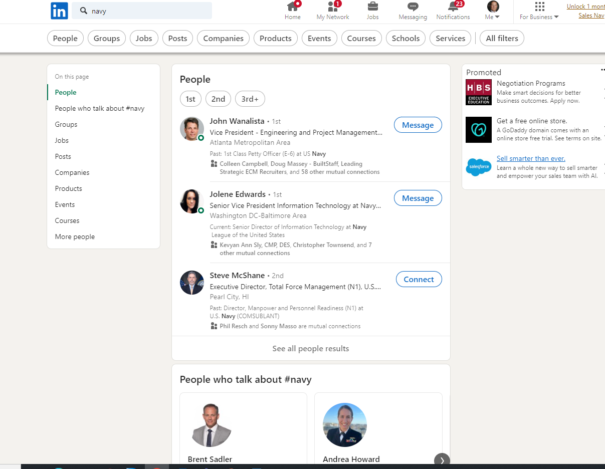
How to use LinkedIN to Identify Prospective Council Members
Select “People” for People search
Notes:
Encourage your Representative to join the Congressional Shipbuilding Caucus, if they haven’t already. The Navy League sponsors a quarterly breakfast series with them to explore topics of interest to the shipbuilding community. It’s bipartisan, co-chaired by Rep. Rob Wittman (R-VA) and Rep. Joe Courtney (D-CT). We can also help them in selecting nominees for the service academies. And the Center for Maritime Strategy, housed within the Navy League, is a thought leader on all matters in the maritime realm. The Center for Maritime Strategy (CMS) is a non-profit, non-partisan think tank and research institution dedicated to studying maritime issues and their context within wider American national security policy. Through its research and analysis, external outreach, publications, and high-level events, CMS engages key stakeholders across government, academia, and industry.

Slide 5
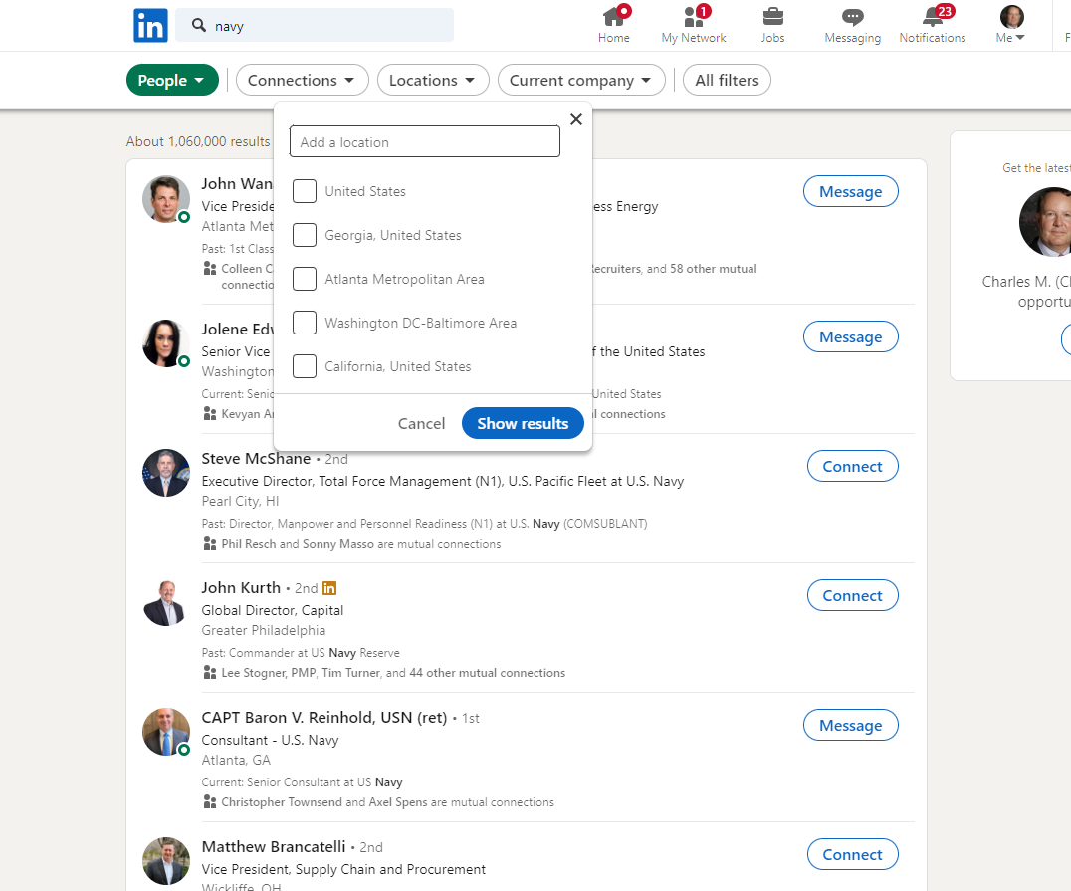
How to use LinkedIN to Identify Prospective Council Members
Click on Locations
Notes:
Encourage your Representative to join the Congressional Shipbuilding Caucus, if they haven’t already. The Navy League sponsors a quarterly breakfast series with them to explore topics of interest to the shipbuilding community. It’s bipartisan, co-chaired by Rep. Rob Wittman (R-VA) and Rep. Joe Courtney (D-CT). We can also help them in selecting nominees for the service academies. And the Center for Maritime Strategy, housed within the Navy League, is a thought leader on all matters in the maritime realm. The Center for Maritime Strategy (CMS) is a non-profit, non-partisan think tank and research institution dedicated to studying maritime issues and their context within wider American national security policy. Through its research and analysis, external outreach, publications, and high-level events, CMS engages key stakeholders across government, academia, and industry.

Slide 6
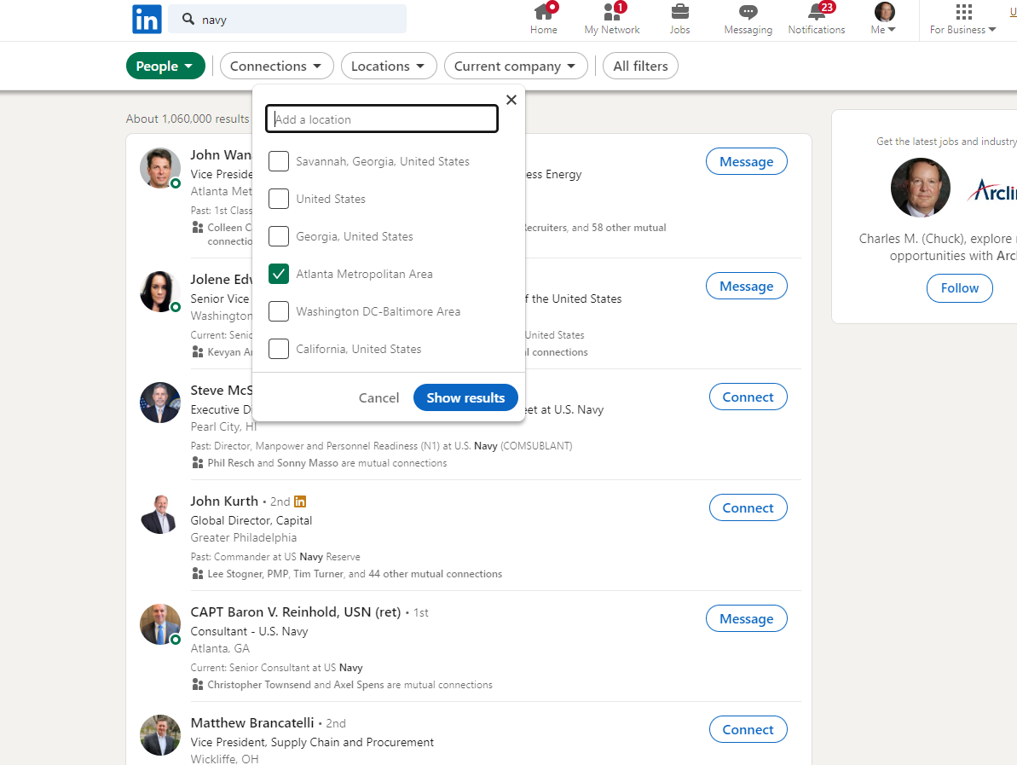
How to use LinkedIN to Identify Prospective Council Members
Enter desired
location
Selected location willthen appear below ina checked box
Click on “Show Results”
Notes:
Encourage your Representative to join the Congressional Shipbuilding Caucus, if they haven’t already. The Navy League sponsors a quarterly breakfast series with them to explore topics of interest to the shipbuilding community. It’s bipartisan, co-chaired by Rep. Rob Wittman (R-VA) and Rep. Joe Courtney (D-CT). We can also help them in selecting nominees for the service academies. And the Center for Maritime Strategy, housed within the Navy League, is a thought leader on all matters in the maritime realm. The Center for Maritime Strategy (CMS) is a non-profit, non-partisan think tank and research institution dedicated to studying maritime issues and their context within wider American national security policy. Through its research and analysis, external outreach, publications, and high-level events, CMS engages key stakeholders across government, academia, and industry.

Slide 7
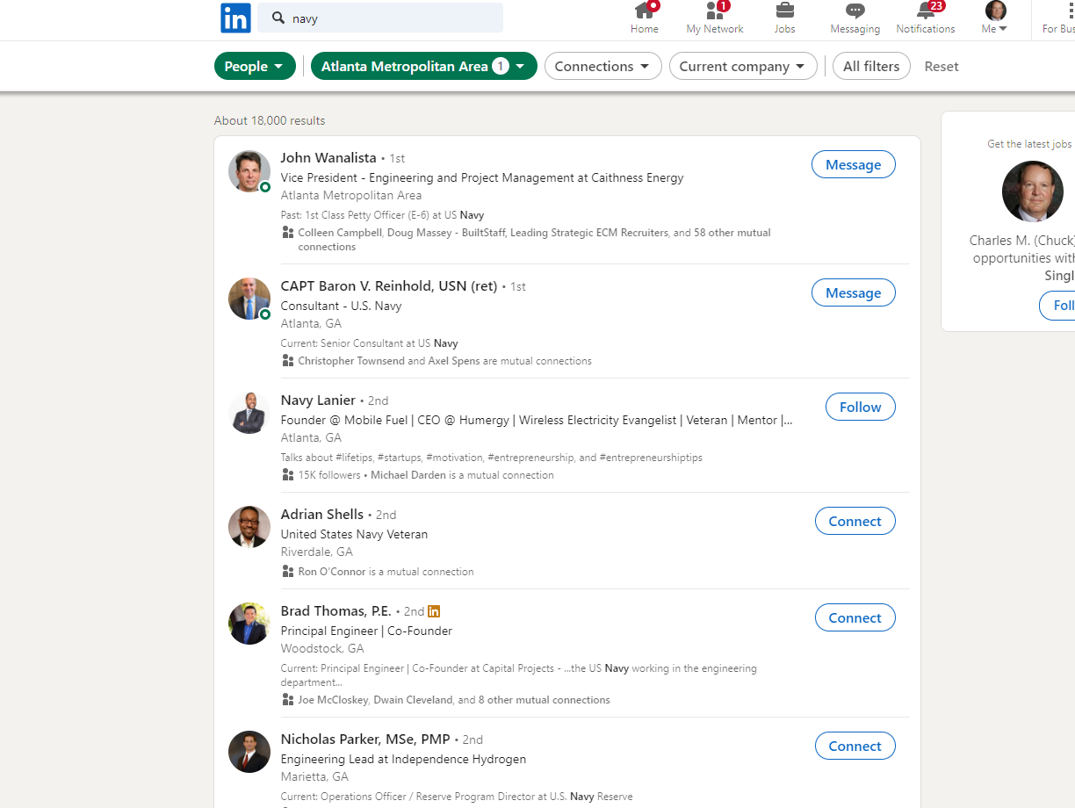
Click on name to see full profile
Note each person
here has a Navy
connection
Notes:
Encourage your Representative to join the Congressional Shipbuilding Caucus, if they haven’t already. The Navy League sponsors a quarterly breakfast series with them to explore topics of interest to the shipbuilding community. It’s bipartisan, co-chaired by Rep. Rob Wittman (R-VA) and Rep. Joe Courtney (D-CT). We can also help them in selecting nominees for the service academies. And the Center for Maritime Strategy, housed within the Navy League, is a thought leader on all matters in the maritime realm. The Center for Maritime Strategy (CMS) is a non-profit, non-partisan think tank and research institution dedicated to studying maritime issues and their context within wider American national security policy. Through its research and analysis, external outreach, publications, and high-level events, CMS engages key stakeholders across government, academia, and industry.

Slide 8
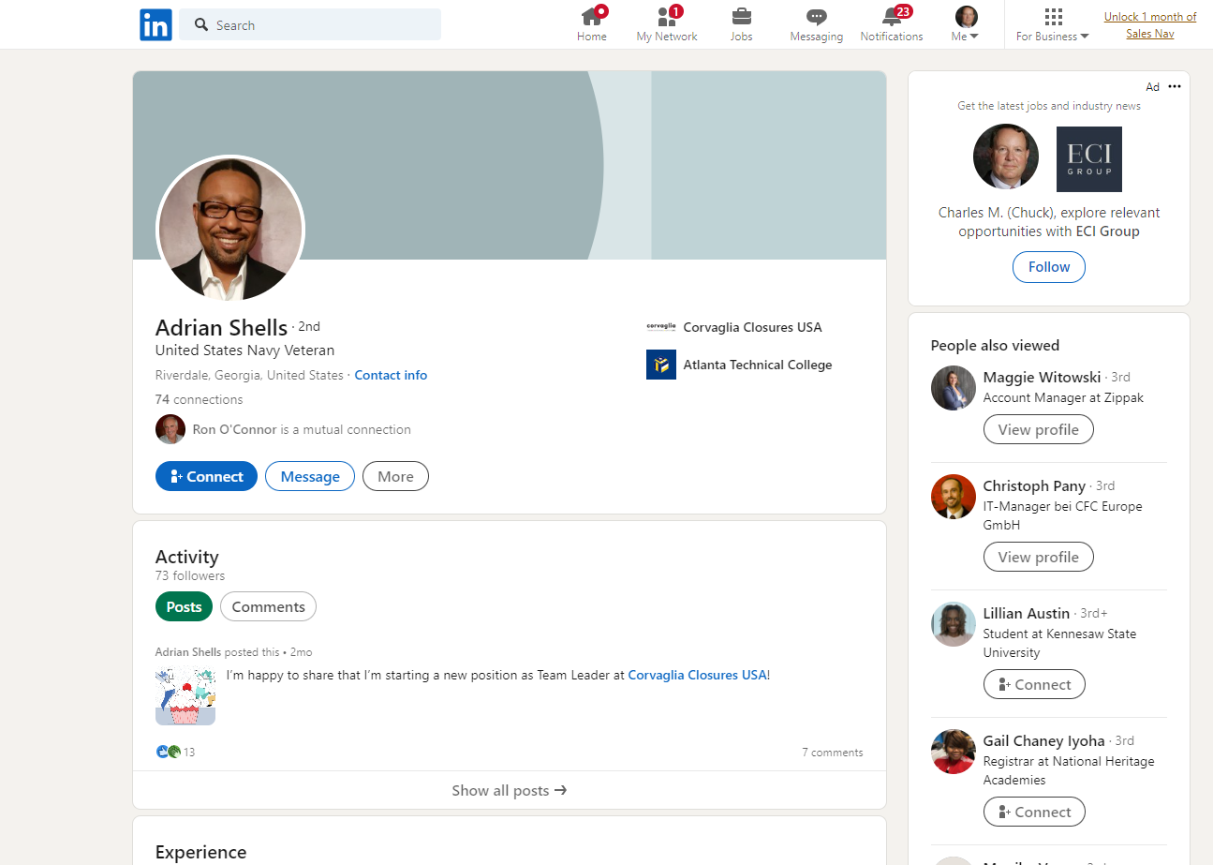
Click on “Connect” to send invite to connect on LinkedIN
Notes:
Encourage your Representative to join the Congressional Shipbuilding Caucus, if they haven’t already. The Navy League sponsors a quarterly breakfast series with them to explore topics of interest to the shipbuilding community. It’s bipartisan, co-chaired by Rep. Rob Wittman (R-VA) and Rep. Joe Courtney (D-CT). We can also help them in selecting nominees for the service academies. And the Center for Maritime Strategy, housed within the Navy League, is a thought leader on all matters in the maritime realm. The Center for Maritime Strategy (CMS) is a non-profit, non-partisan think tank and research institution dedicated to studying maritime issues and their context within wider American national security policy. Through its research and analysis, external outreach, publications, and high-level events, CMS engages key stakeholders across government, academia, and industry.

Slide 9
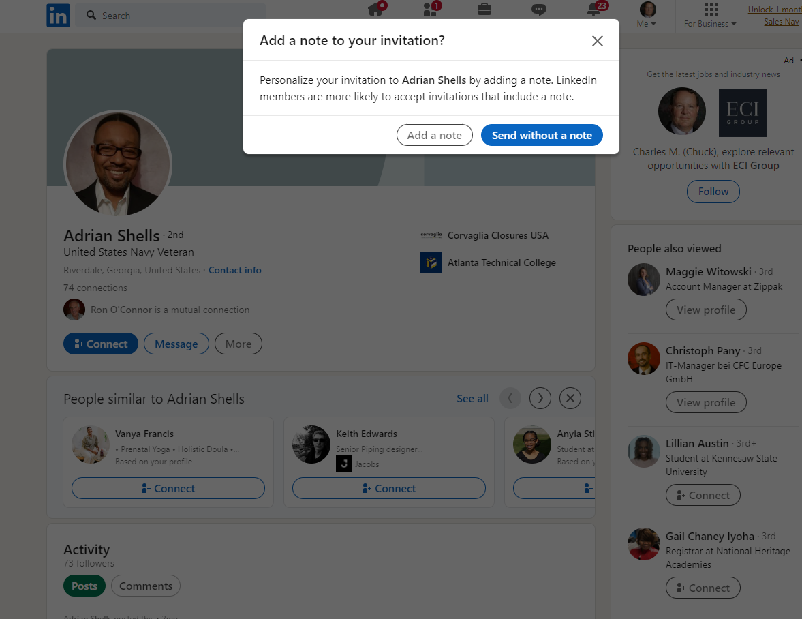
Click on “Add a note”
Notes:
Encourage your Representative to join the Congressional Shipbuilding Caucus, if they haven’t already. The Navy League sponsors a quarterly breakfast series with them to explore topics of interest to the shipbuilding community. It’s bipartisan, co-chaired by Rep. Rob Wittman (R-VA) and Rep. Joe Courtney (D-CT). We can also help them in selecting nominees for the service academies. And the Center for Maritime Strategy, housed within the Navy League, is a thought leader on all matters in the maritime realm. The Center for Maritime Strategy (CMS) is a non-profit, non-partisan think tank and research institution dedicated to studying maritime issues and their context within wider American national security policy. Through its research and analysis, external outreach, publications, and high-level events, CMS engages key stakeholders across government, academia, and industry.

Slide 10
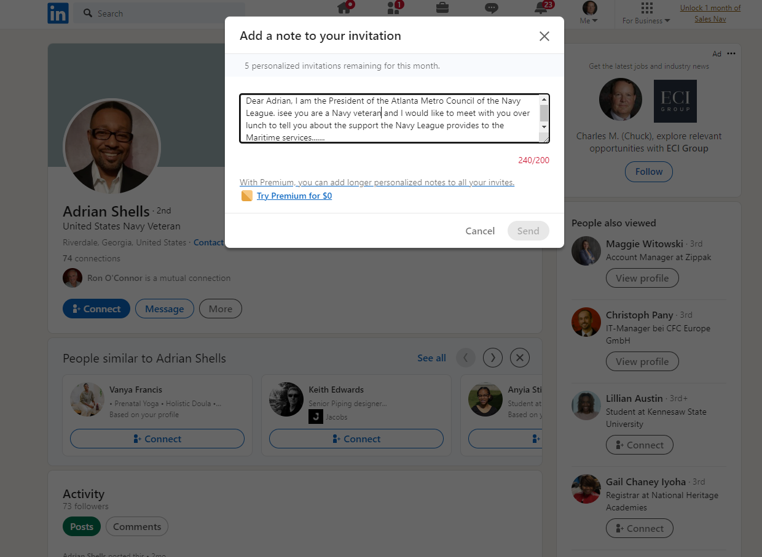
Enter note to inspire
them to connect. Once connected you can
send unlimited
messages
Note 200 character limit on
initial invite
Notes:
Encourage your Representative to join the Congressional Shipbuilding Caucus, if they haven’t already. The Navy League sponsors a quarterly breakfast series with them to explore topics of interest to the shipbuilding community. It’s bipartisan, co-chaired by Rep. Rob Wittman (R-VA) and Rep. Joe Courtney (D-CT). We can also help them in selecting nominees for the service academies. And the Center for Maritime Strategy, housed within the Navy League, is a thought leader on all matters in the maritime realm. The Center for Maritime Strategy (CMS) is a non-profit, non-partisan think tank and research institution dedicated to studying maritime issues and their context within wider American national security policy. Through its research and analysis, external outreach, publications, and high-level events, CMS engages key stakeholders across government, academia, and industry.

Slide 11
How to use LinkedIN to Identify Prospective Council Members
LinkedIN use final notes:
Number of personalized invites may be limited
You may have to get a Premium account to send more personalized invites
Atlanta Council offers free lunch to entice potential Board members to meet and then join
Youth Programs, ACDU Unit Support, and Legislative Affairs are the key sell points
Notes:
Encourage your Representative to join the Congressional Shipbuilding Caucus, if they haven’t already. The Navy League sponsors a quarterly breakfast series with them to explore topics of interest to the shipbuilding community. It’s bipartisan, co-chaired by Rep. Rob Wittman (R-VA) and Rep. Joe Courtney (D-CT). We can also help them in selecting nominees for the service academies. And the Center for Maritime Strategy, housed within the Navy League, is a thought leader on all matters in the maritime realm. The Center for Maritime Strategy (CMS) is a non-profit, non-partisan think tank and research institution dedicated to studying maritime issues and their context within wider American national security policy. Through its research and analysis, external outreach, publications, and high-level events, CMS engages key stakeholders across government, academia, and industry.

Slide 12
Thank You!

