Slide 1
Welcome!
We kindly request that you mute your laptops and phones.
If you have questions, we will take a moment at the end for discussion. You can also put them in the chat box.
This session will be recorded and available on the member dashboard.

Slide 2
Social Media for Councils Examples, Resouces & Content Ideas for Council

Slide 3
How should a council delegate social media?
Establish at least one people in your council who is responsible for social media
If you feel like running your councils Facebook or LinkedIn page is not for you, seek assistance from these places:
Interns (Handshake.com, LinkedIn, Indeed, University Career Pages)
Younger Members

Slide 4
Council Resouces
Introducing our Council Social Media Toolkit
Includes:
Simple Post Ideas
Guidelines
Content Calendar
Headquarters Graphics
Canva Tutorial
Using A.I.

Slide 5
What should we post?
What kind of content should councils share?
📌 Think: Local, Personal, Patriotic, Mission-Driven
Golden Rule:
If your council is doing something that supports the sea services or your members—take a photo and post it with a short caption. That’s it! You don't have to be a marketing pro!
Encourage members to post about your council or an event your council is hosting

Slide 6
What should we post?
📢 You don’t always need to create content—resharing is powerful too!
Follow relevant and similar pages your council is connected to:
Your adopted ship or unit
Your local Sea Cadet Unit
Navy, Marine Corps, Coast Guard Pages
Local Naval Station or Command pages
Local community organizations
Navy League HQ!

Slide 7
How Often Should We Post?
Start with 1–2 posts per week
Prioritize consistency over perfection

Slide 8
Content Ideas
Awards Posts - Theodore Roosevelt Youth Awards. Sailor of the Quarter/Year Posts. Certificate of Appreciations.
Welcome New Members Post: Once a month, or once a quarter, welcome all your new members with a post on Facebook or LinkedIn. This simple gesture helps build a sense of community, shows appreciation, and lets your followers know your council is growing. Tag new members (if possible), invite them to introduce themselves in the comments, and remind others how they can get involved or join.

Slide 9
Content Ideas
Holidays & National Day Posts
Ship Adoption Highlight Post: Let your followers know which ships or units your council has adopted and supports! If you don't have a photo from a commissioning or adoption ceremony, google the name of the ship and use a high-quality image from the internet. In the post, explain the ways in which your council supports them and how it ties into the Navy League mission and your local community.
"Our council is proud to support the crew of USS Minnesota (SSN 783). We recently delivered care packages and cards from local students. Thank you for your service! ⚓

Slide 10
Content Ideas
Event Invitations: Post about upcoming events with key details—what, when, where, and why someone should attend. Use eye-catching visuals or flyers, and encourage members to RSVP or share the post.
Event Recaps: After the event, share a recap with photos, highlights, and a quick thank-you to attendees, speakers, or sponsors. Tag people or partner organizations when possible.

Slide 11
Content Ideas
Patriotic (sea service related) Quotes over graphics (use Canva templates!)
Share articles from the Center for Maritime Strategy
Post a link to the scholarships available from your council or the Navy League Foundation

Slide 12
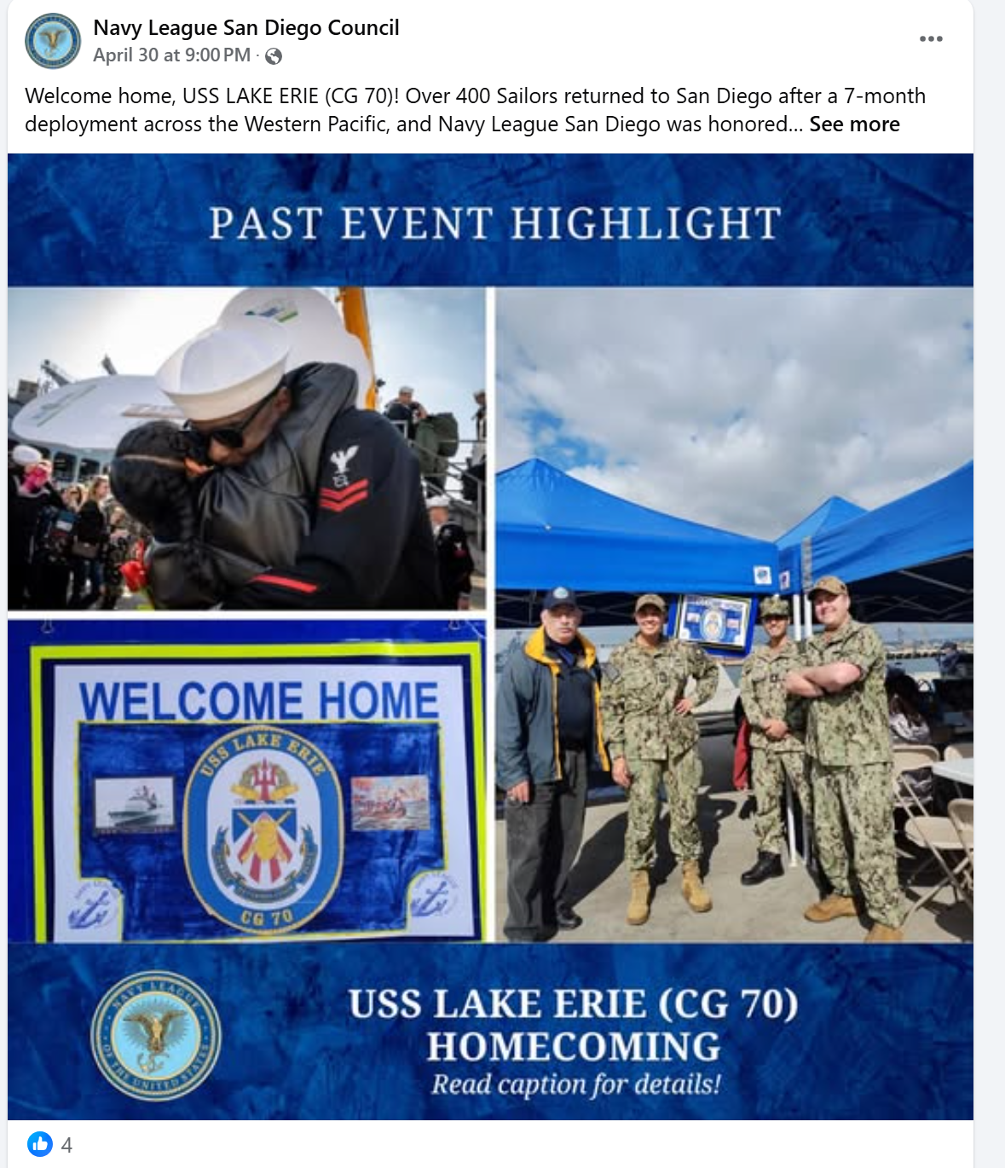
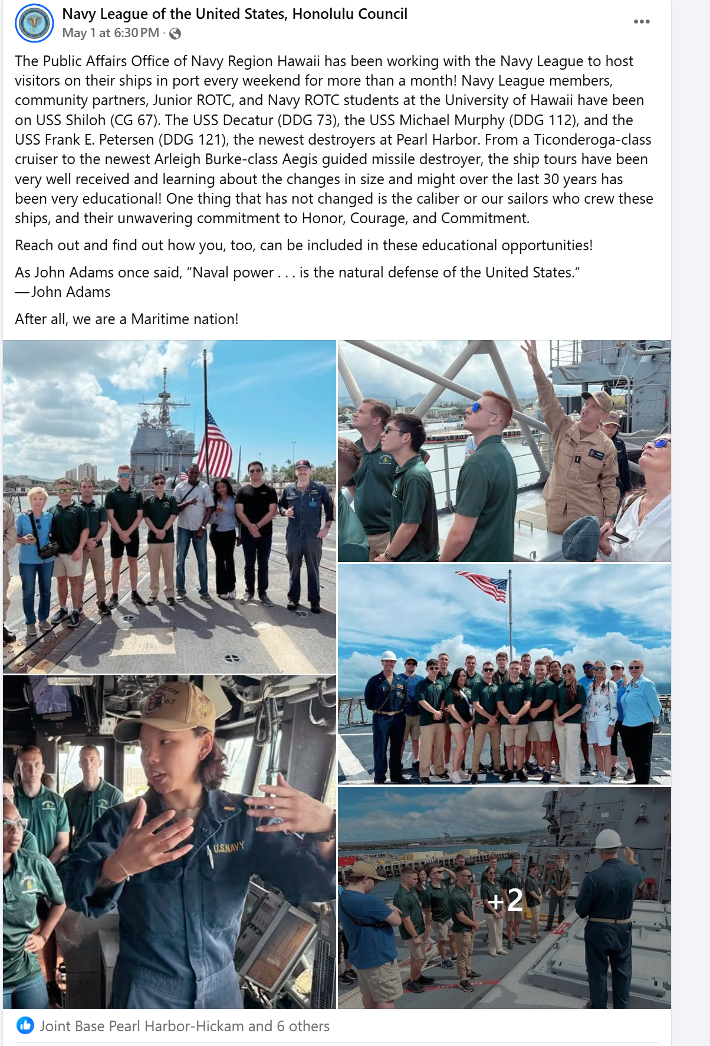
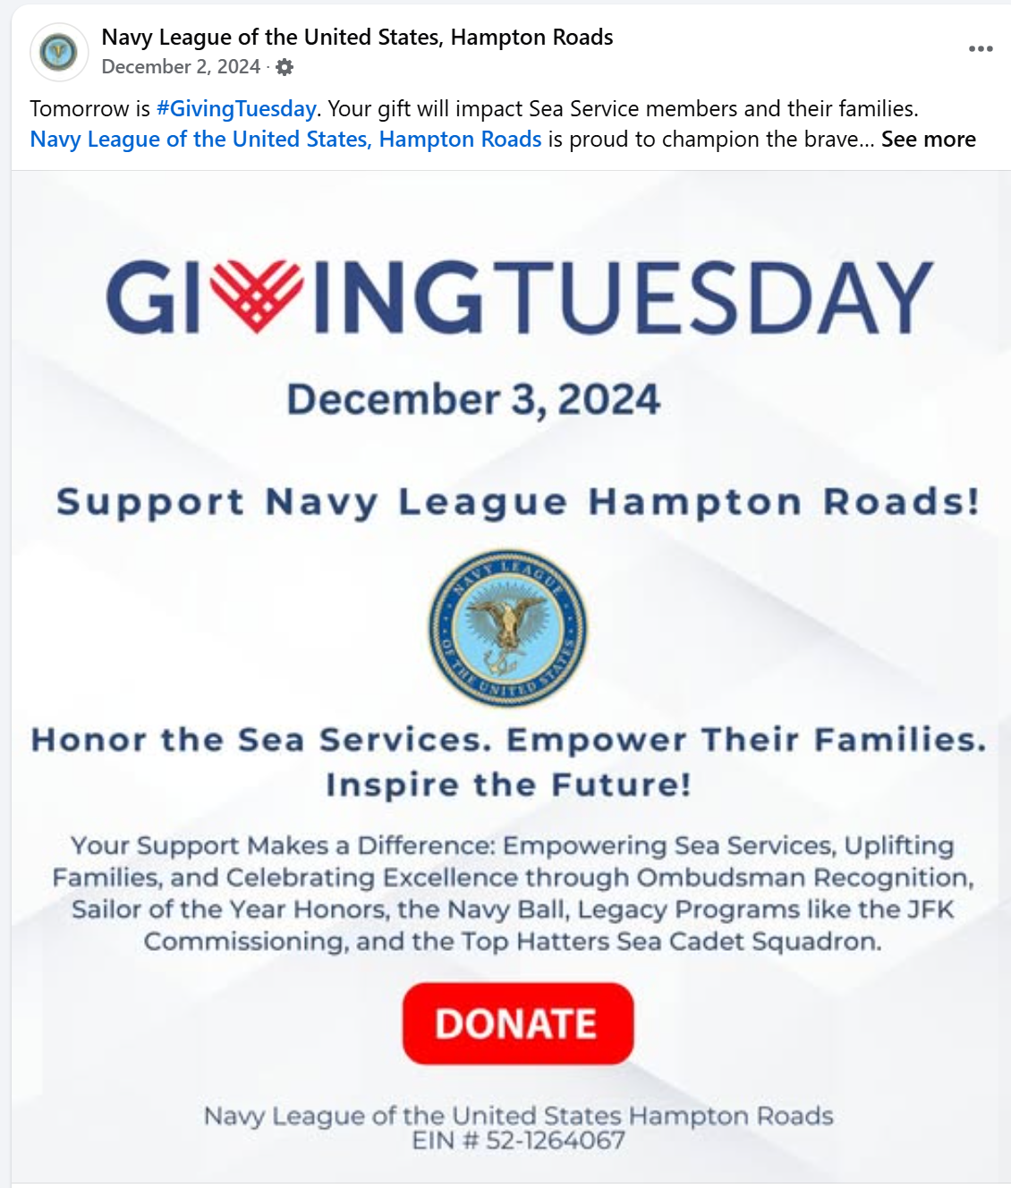
Examples from Councils
What a Great Post Looks Like

Slide 13
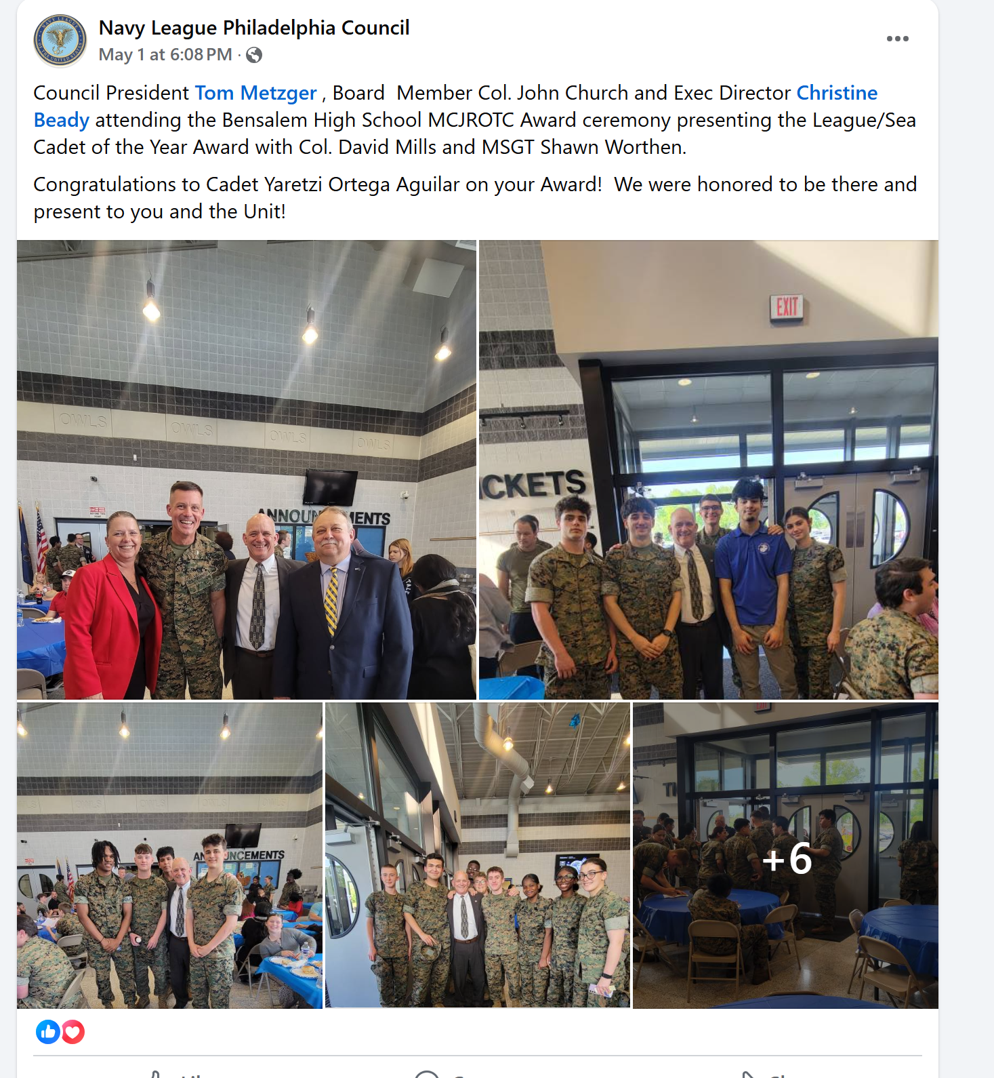
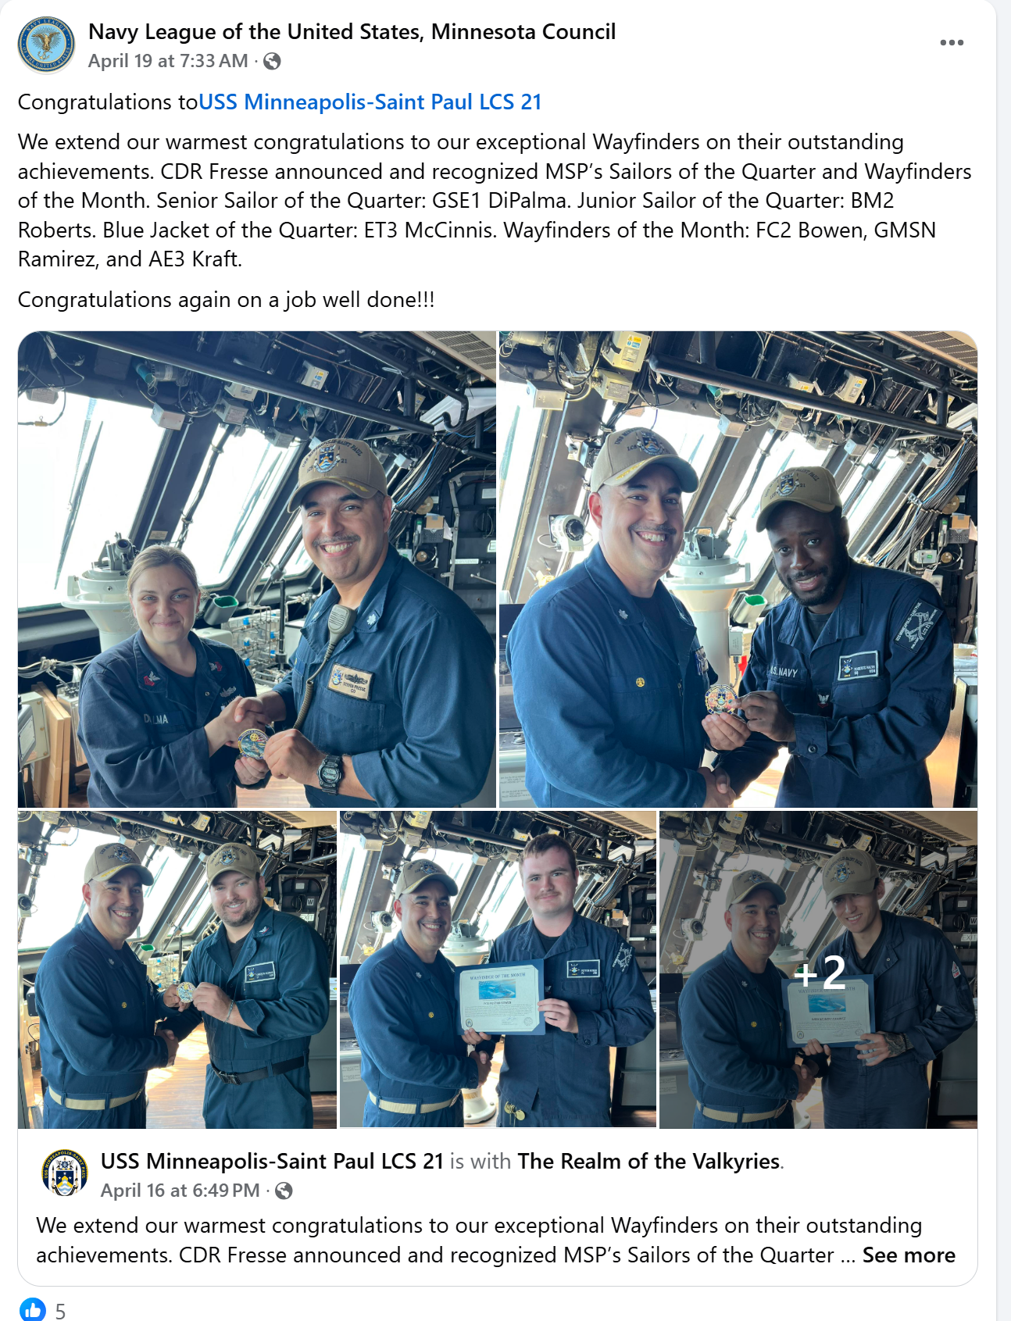
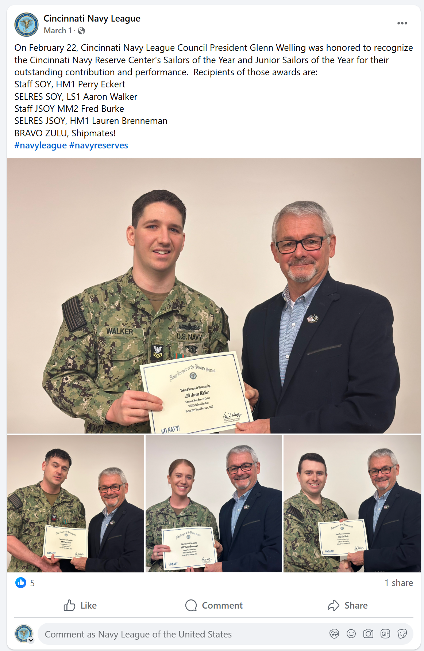
Examples from Councils
What a Great Post Looks Like

Slide 14
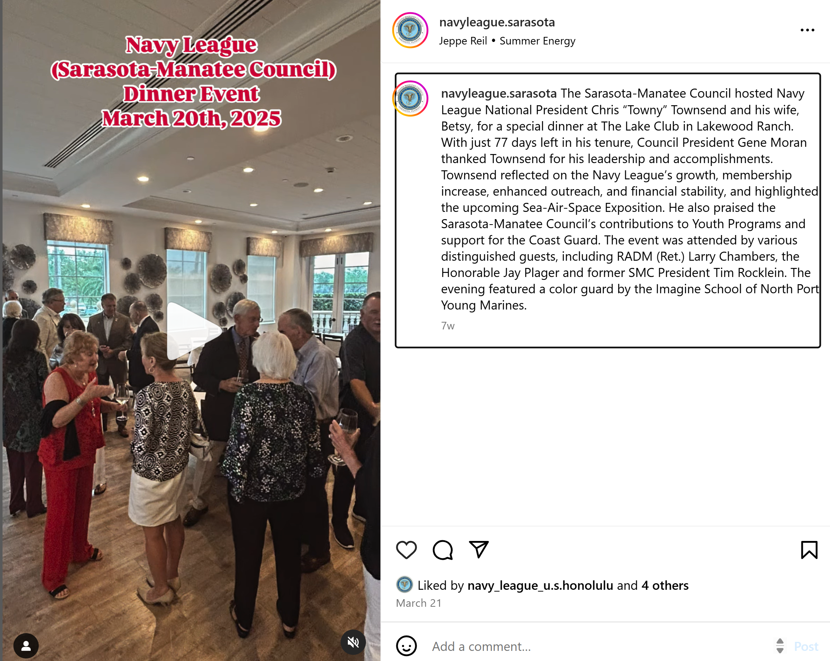
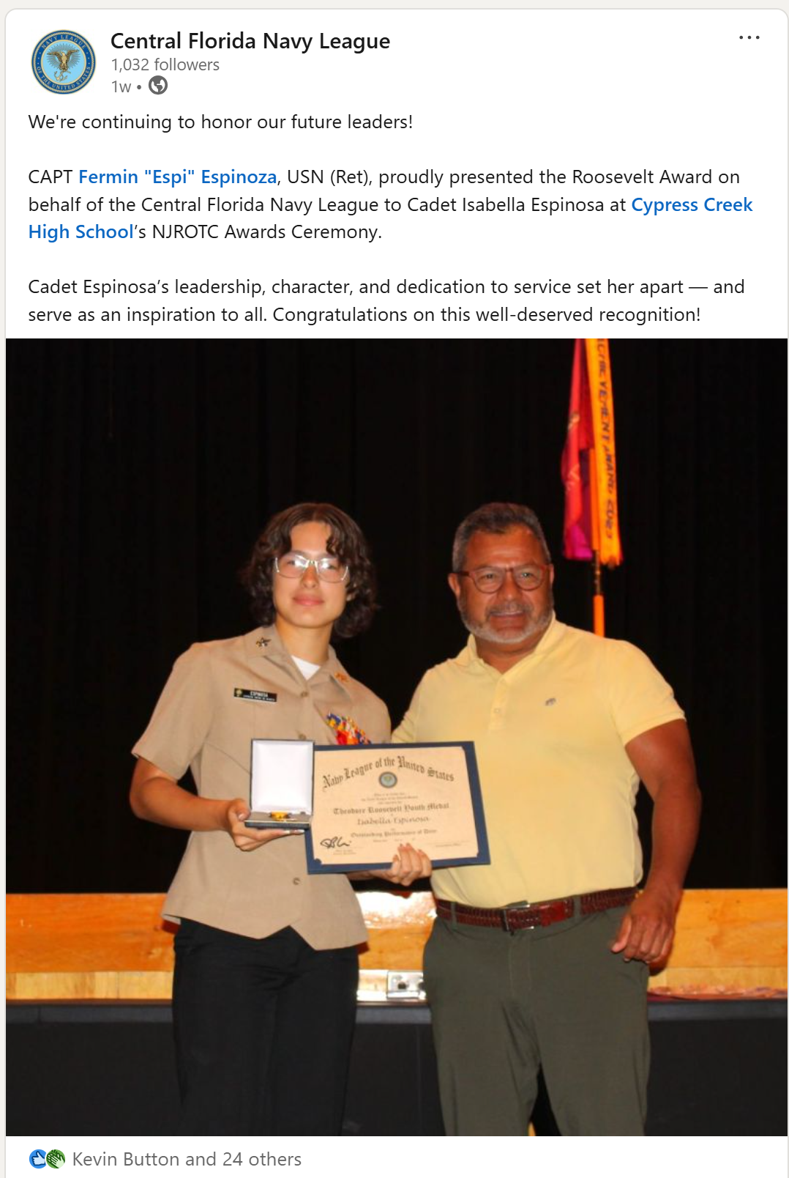
Examples from Councils

Slide 15
Top Platforms to Focus On
Facebook: Best for events, community connection, older audiences
Instagram: Great for visuals, stories, and younger veterans/supporters
LinkedIn: Your personal profile is one of the most powerful tools you have. If your council has a LinkedIn page, great, if not, use your own to connect with members and potential members. LinkedIn is full of potential members, sponsors, and civic leaders.

Slide 16
Upcoming Webinars
June 4-7th: National Convention in Jacksonville, FL

Slide 17
Thank You!
Evan Clarke
Senior Director of Marketing
Eclarke@navyleague.org

