Slide 1
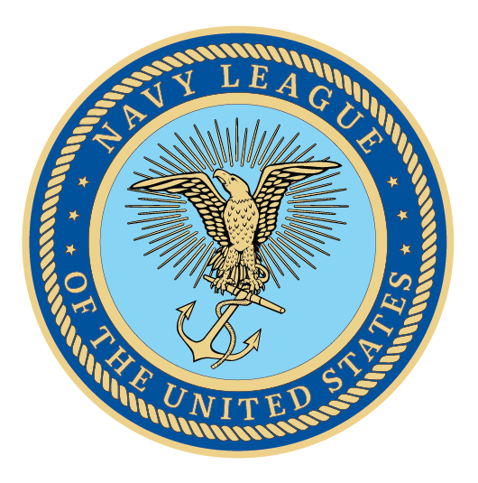
PRESENTER NAME
DATE

Slide 2
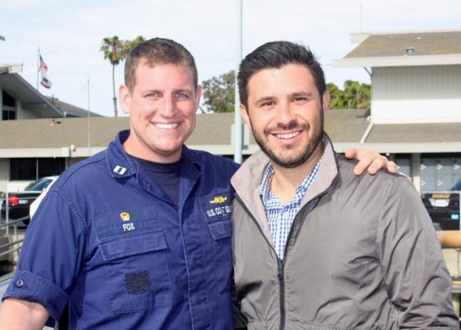
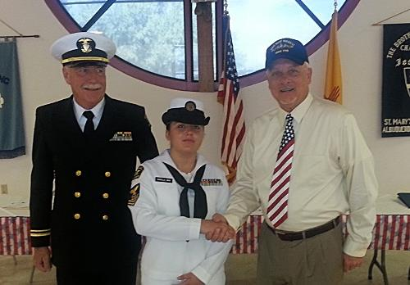
Navy League's Mission
The Navy League of the United States, founded in 1902 with the support of President Theodore Roosevelt, is a nonprofit civilian, educational and advocacy organization that supports America’s sea services: the Navy, Marine Corps, Coast Guard and U.S.-flag Merchant Marine.

Slide 3
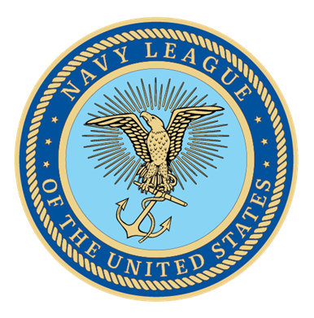
About the Navy League
Over 120 years of Service
30,000+ members
200 councils around the world
Since 1902, been the voice with Congress on maritime strength
Supports and advocates for members of the Navy, Marine Corps, Coast Guard, and U.S.-flag Merchant Marine

Slide 4

Why Become a Community Affiliate?
Amplify your impact for sea service members
Grow your reach
Connect with service-minded, patriotic customers
Support veterans and your local community
Expand your professional network

Slide 5

Exclusive Member Benefits
Includes memberships for four employees
Includes subscription to SeaPower Magazine, our official publication focused educating the public on maritime issues
Receive an engraved plaque with a sticker for each year of support
Access to local council events

Slide 6

How We Support Your Success
Boost your publicity through events and media
Connect you with leaders at NLUS events
Facilitate valuable networking
Publicly recognize your support and sponsorship

Slide 7

How Your Support Helps Us Grow
Unlock member discounts and benefits
Cross-promote to your customers
Provide vital financial support to councils
Strengthen local community connections

Slide 8

Together, We Make An Impact
We share interests and values
You provide value to your community
Your involvement deepens community impact
We grow together while supporting our Sea Services

Slide 9
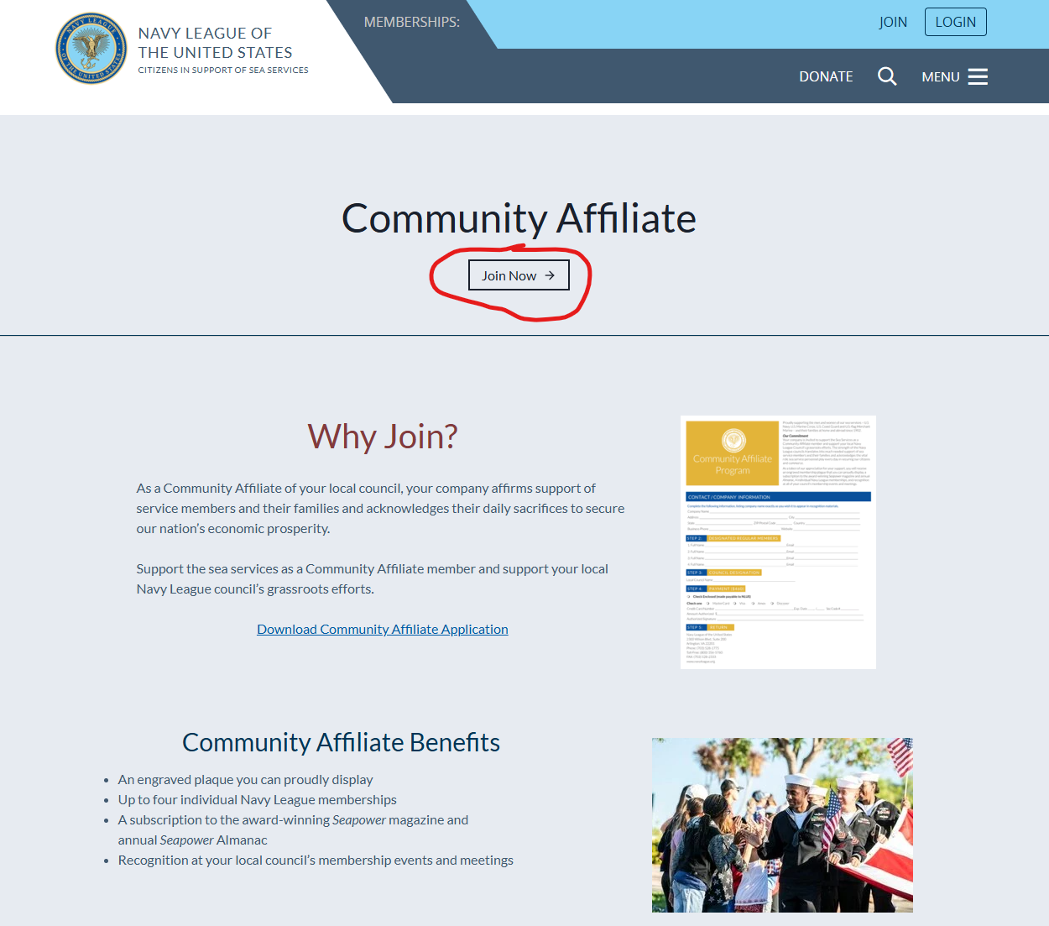
Joining Is Easy
Visit https://www.navyleague.org/join/#2
Create an account, and follow the prompts
If preferred, you can mail a check to headquarters with the CA application attached
For assistance or questions, contact us at 703.312.2880 or membership@navyleague.org.

Slide 10
Thank you!
YOUR NAME HERE

